Slide 1
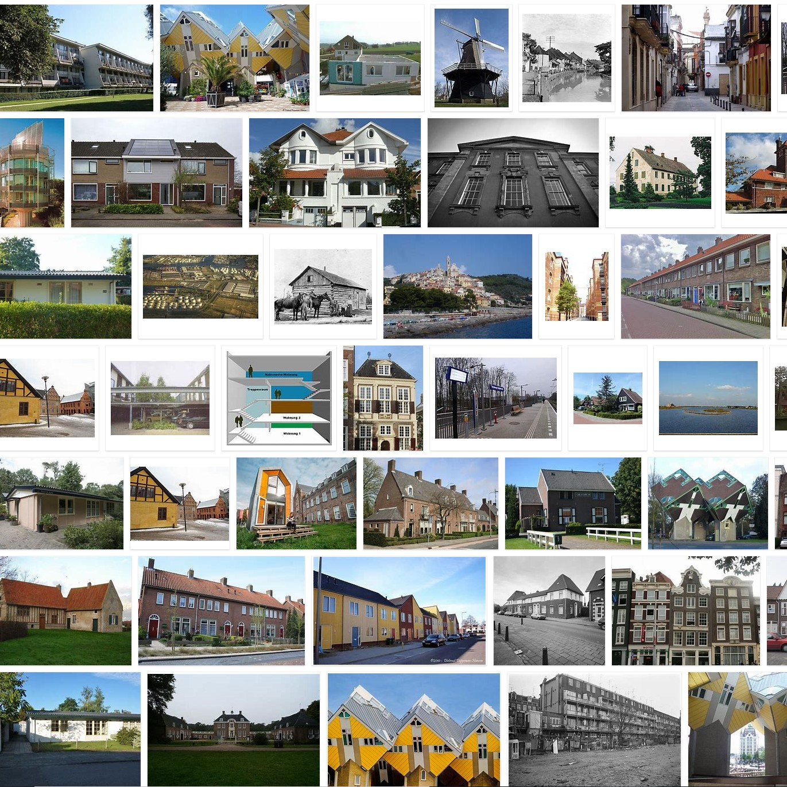
transmission infiltration ventilation
heating
solar irradiation
‘internal’ heat
Twomes
50 shades of green, from
4 white measurement devices, and
1 inverse grey-boxmodel?
Henri ter Hofte, h.ter.hofte@windesheim.nl
Associate Lector Energy Transition
heat loss
heat gain

Slide 2
Digital twins for the heating transition: 50 shades of green, from 4 white measurement devices, and 1 inverse grey-boxmodel?
Twomes Deliverable D8
Authors: Henri ter Hofte, Hossein Rahmani
Publication date: 24-05-2022
Parties involved: Research group Energy Transition (Windesheim)
Chair: Jeike Wallinga
This work is financially supported by BDR Thermea, Breman, Enpuls, TechForFuture, Witteveen + Bos and the municipality of Zwolle.
This is a publication by Saxion, University of Twente and Windesheim University of Applied Sciences
Licence: CC BY 4.0, Research group Energy Transition, Windesheim University of Applied Sciences
Notes:
The results of project Twomes are described in the following deliverables:
Deliverable D1a Project Plan contains the project plan that forms the basis for research activities.
Deliverable D1b Data management plan describes what data is collected in the project, how data should be handled during the project and after the project is finished.
Deliverable D1c: Uitkomsten bewonersonderzoek describes (in Dutch) the results of the research we conducted into questions residents have about the heat transition, via surveys and/or interviews. We used insights gained to focus further research in the project lays the foundation for advice modules.
Deliverable D2: Dataset 1 contains the monitoring data that we collected for exploratory analysis.
Deliverable D3: Analysis Methods and Tools, Version 1 contains a description of the analysis methods and tools used to analyze data from Deliverable D2. We also describe what we can learn from the available data and what additional measurements we deem necessary.
Deliverable D4: Testable Hypotheses describes the hypotheses we want to test with the research in Twomes.
Deliverable D5: Measurement methods and techniques describes the (additional) measurement methods and techniques that we have developed to collect data used to test hypotheses from D4.
Deliverable D6: Subject Information, Consent Forms includes all information and documents (in Dutch) we use to recruit and educate subjects, including a description of how we obtain consent to collect data.
Deliverable D7: Dataset 2 contains the data that we collected to do a detailed analysis including research into the hypotheses of D4.
Deliverable D8: Analysis Methods and Tools describes not only the analysis methods and tools we applied to the dataset from D7, but also the results and conclusions of this analysis.
Deliverable D9: Dissemination and design follow-up research includes all external presentations and publications for interested parties outside the project, including a plan for a follow-up study for the realization of advice modules.
Deliverable D10: Presentations, Report, Update Plan and Schedule includes all interim and progress presentations of the project, and updated plans.

Slide 3
In short
Twomes: Digital Twins for the Home Heating Transition
Crucial parameters for the heating transition of a specific home:
Building: specific heat loss: H [W/K], thermal inertia: τ [s], apparent window area: A [m²]
Installation: boiler efficiency η [%]
Comfort: weekly home/away/asleep thermostat setpoints: <T_{set};d;h> [Ks]
2-4 measurement devices (50-€100) per home to collect > 2 wk data
smart meter monitor, room monitor, boiler monitor, OpenTherm monitor, app;
available as open source software & open hardware designs on GitHub
security, privacy & technical variety: more challenging than expected, but doable
35 million datapoints from 23 homes in one heating season
Using the Twomes inverse grey-box model based on GEKKO Python:
Building parameters H [W/K], τ [s] seem learnable; working on A [m²]
More challenging than we expected!
No time left in project to analyze boiler efficiency η [%]

Slide 4








Who?
Twomes: Digital Twins for the Home Heating Transition
50 Tinten Groen Assendorp
58 respondents on survey
40 subjects invited to measure data at home
3 installation helpers + primary contact
8 project partners
Windesheim
36 students
30 HBO-ICT
6 Electrical Engineering
10 teachers
10 teacher-researchers
1 project leader
1 professor

Slide 5
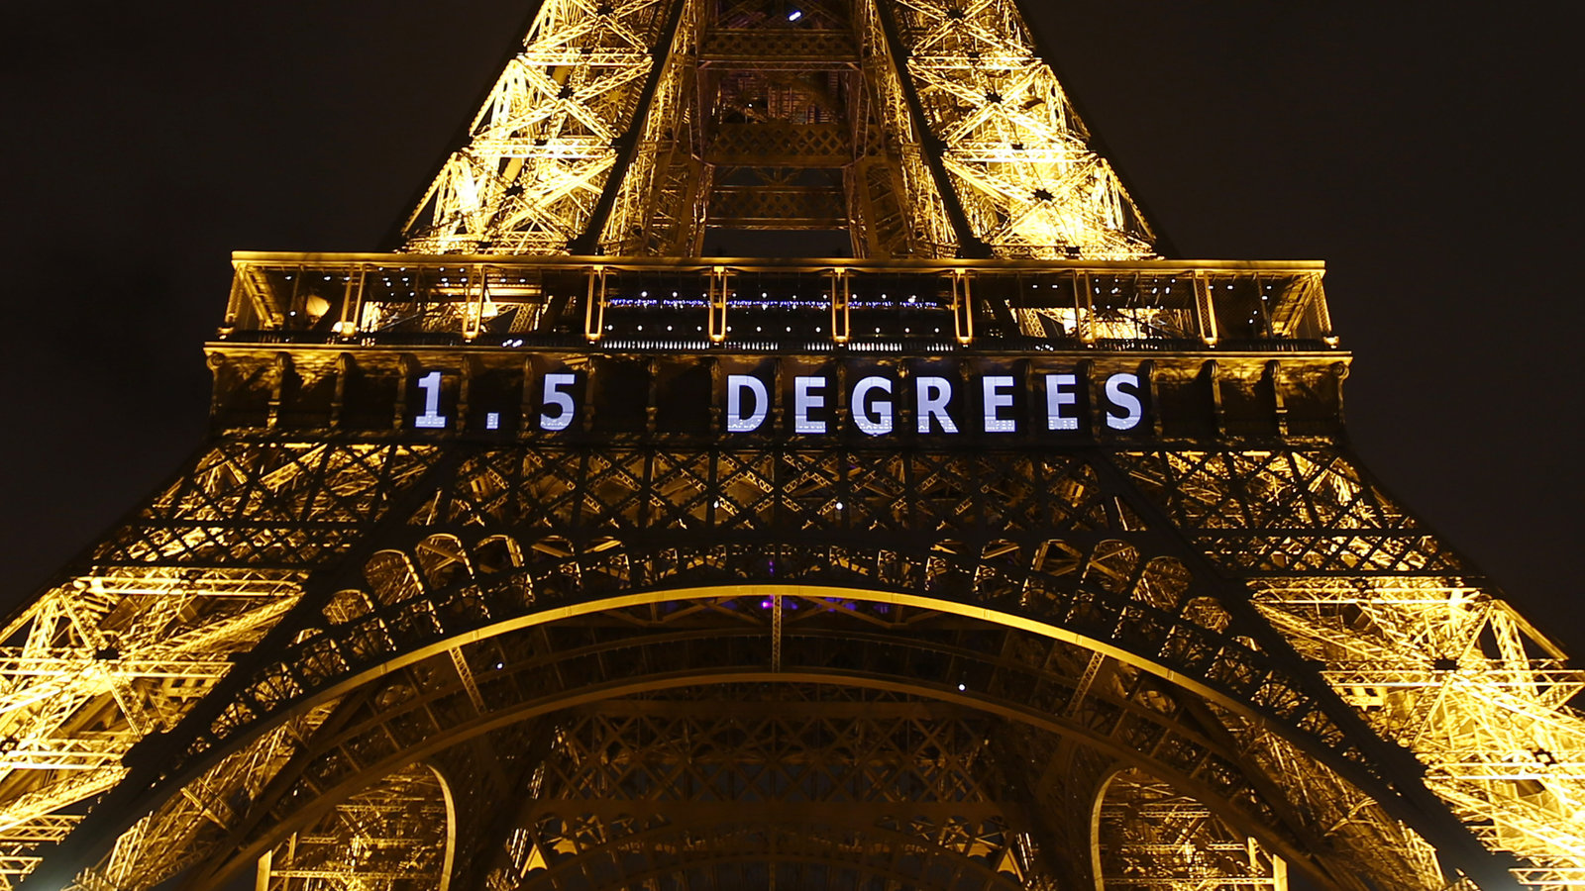
Francois Mori/AP
Why?
Notes:
https://www.npr.org/sections/thetwo-way/2015/12/12/459502597/2-degrees-100-billion-the-world-climate-agreement-by-the-numbers?t=1599027444292

Slide 6
hich home heating model parameters of specific homes can we learn automatically from energy monitoring data in order provide better advice to a specific household about their home heating transition?

Slide 7
Which kind of questions should Twomes help answer?
Goal
Questions about all homes in a country
Questions about specific homes and households
Questions that require close personal contact to answer
Questions about all homes in a city or neighbourhood
Questions that can be answered with help of monitoring data

Slide 8
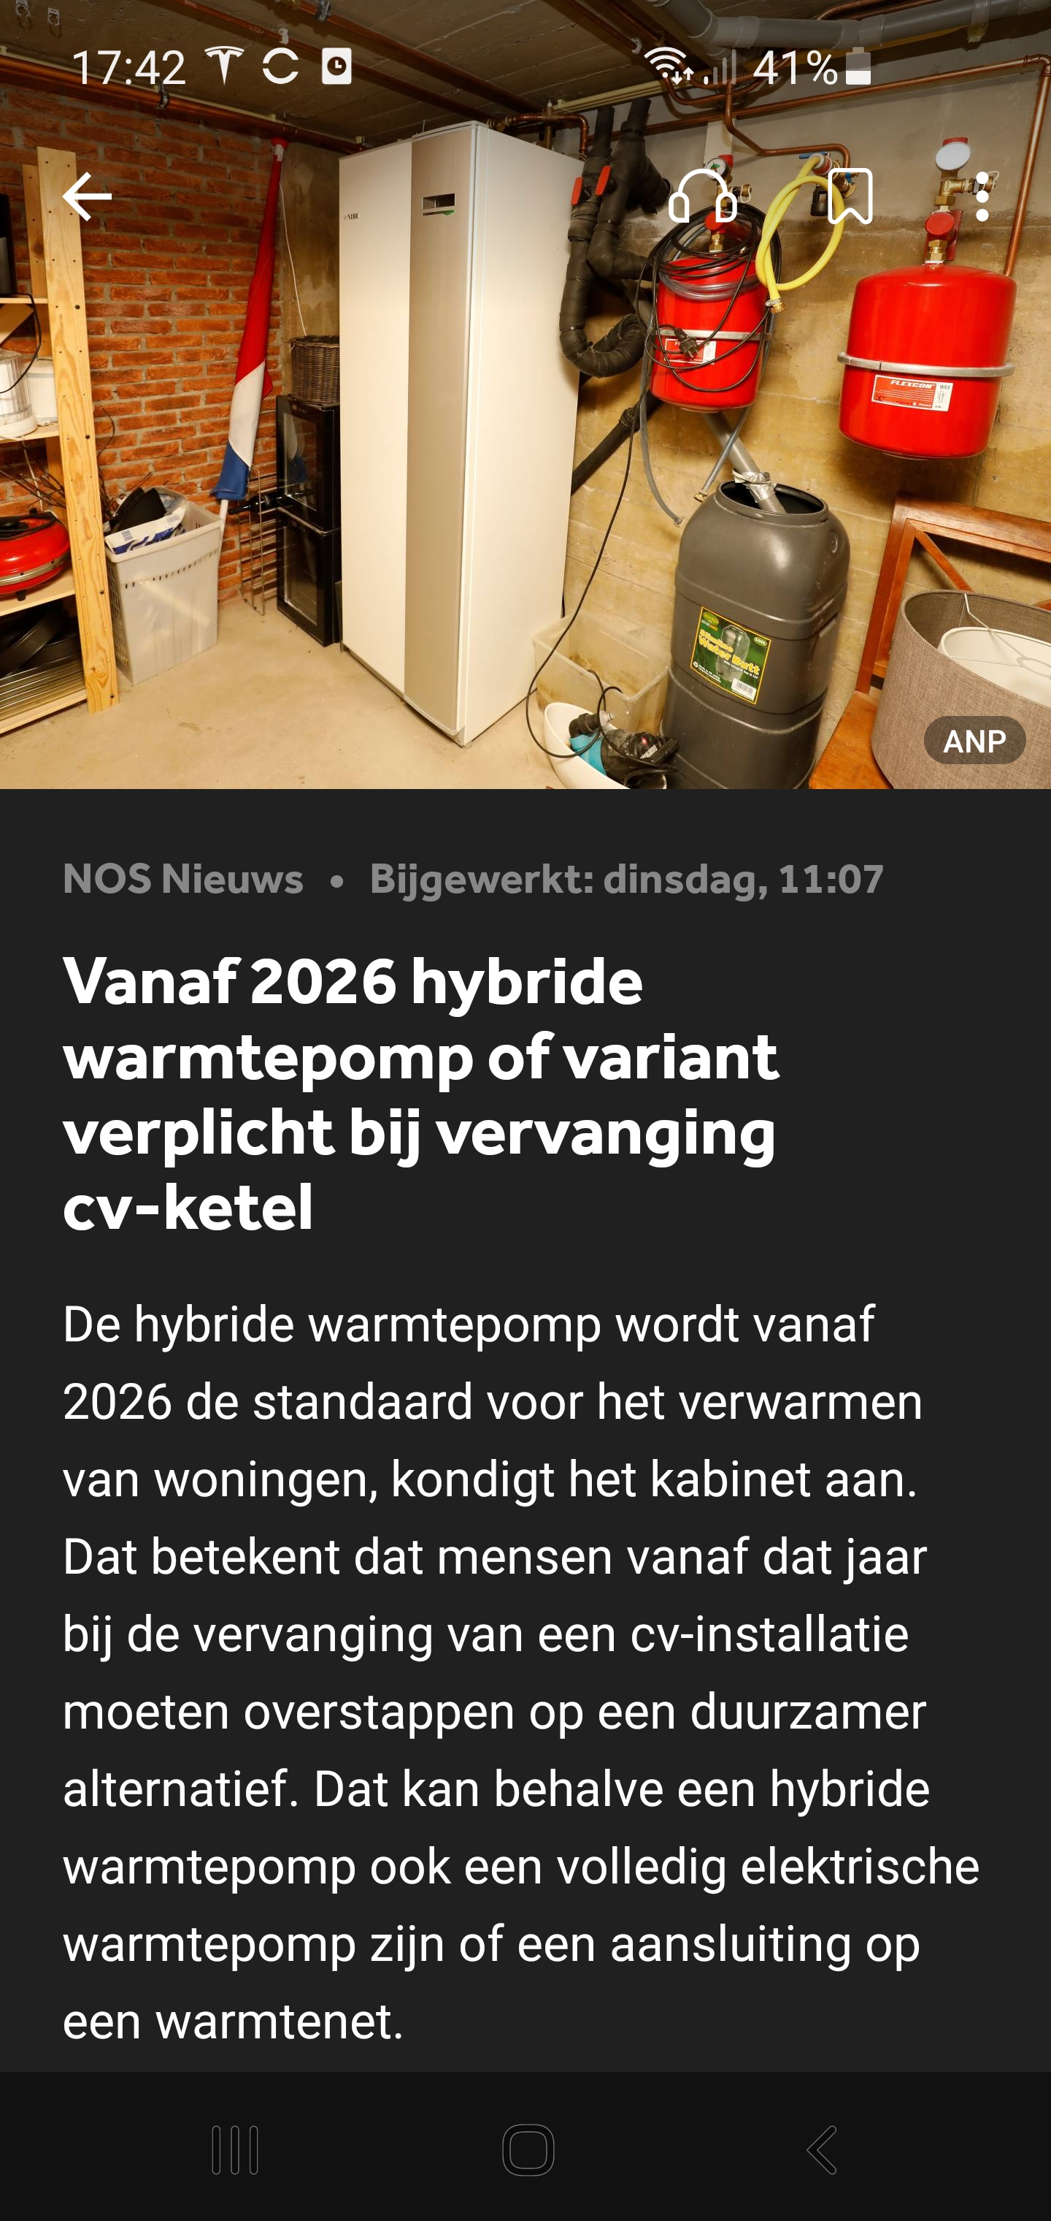
ill our home be comfortable enough if we switch to a (hybrid) heat pump?

Slide 9
Model parameters we want to learn
Twomes WP3: Data Analysis & Prediction
symbol | scope | parameter | unit
H | building | specific heat loss | W/K
τ | building | thermal inertia | s (or h)
C | building | thermal mass (C = H × τ) | J/K (or Wh/K)
A | building | apparent window area (imaginary horizontal window in roof) | m²
P_{max} | installation | maximum heating system power (boiler + distribution) | W
η_{s;CH} | installation | central heating system efficiency (superior value) | %
<T_{set;h;d}> | comfort needs | weekly thermostat setpoints (home/away/asleep) | K‧s

Slide 10



Model parameters for simulation
Twomes WP3: Data Analysis & Prediction
time series input data
time series output data
setpoint changes
weather
indoor temperature
energy use
building
installation
comfort needs

Slide 11

Model parameters for simulation
Twomes WP3: Data Analysis & Prediction
time series input data
time series output data
setpoint changes
weather
indoor temperature
energy use
building
installation
comf.needs
model parameters (time-independent)

Slide 12

Learn model parameters? Inverse grey-box modelling!
Twomes WP3: Data Analysis & Prediction
measured input data (time series data)
calculated output data (time series data)
calculated data (time series data)
calculated data (time series data)
calculated data (time series data)
calculated data (time series data)
calculated data (time series data)
calculated data (time series data)
calculated data (time series data)
calculated data (time series data)
calculated data (time series data)
calculated data (time series data)
calculated data (time series data)
calculated data (time series data)
setpoint changes
weather
indoor temperature
energy use
?
building
installation
comf.needs
indoor temperature
energy use
model parameters (time-independent)
measured comparison data (time series data)

Slide 13

Predict how changed parameters change outcome
Twomes WP3: Data Analysis & Prediction
time series data
calculated data
setpoint changes
weather
indoor temperature
energy use
building
installation
comf.needs
model parameters (time-independent)
Notes:
Thermostat setpoints can be e.g. replayed from a previous year, or derived from comfort needs. This depends on the type of prediction and comparison desired. Similarly, weather data can be e.g. replayed from a prvious year, or derived from a pre-determind average, also known as a ‘reference climate year’. Again, this depends on the type of prediction and comparison desired.

Slide 14
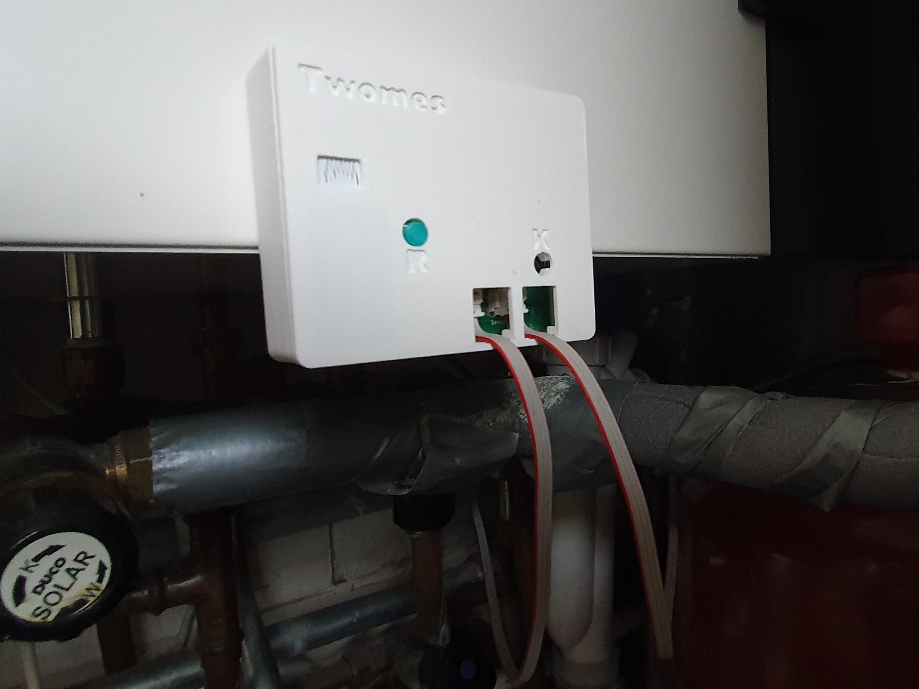

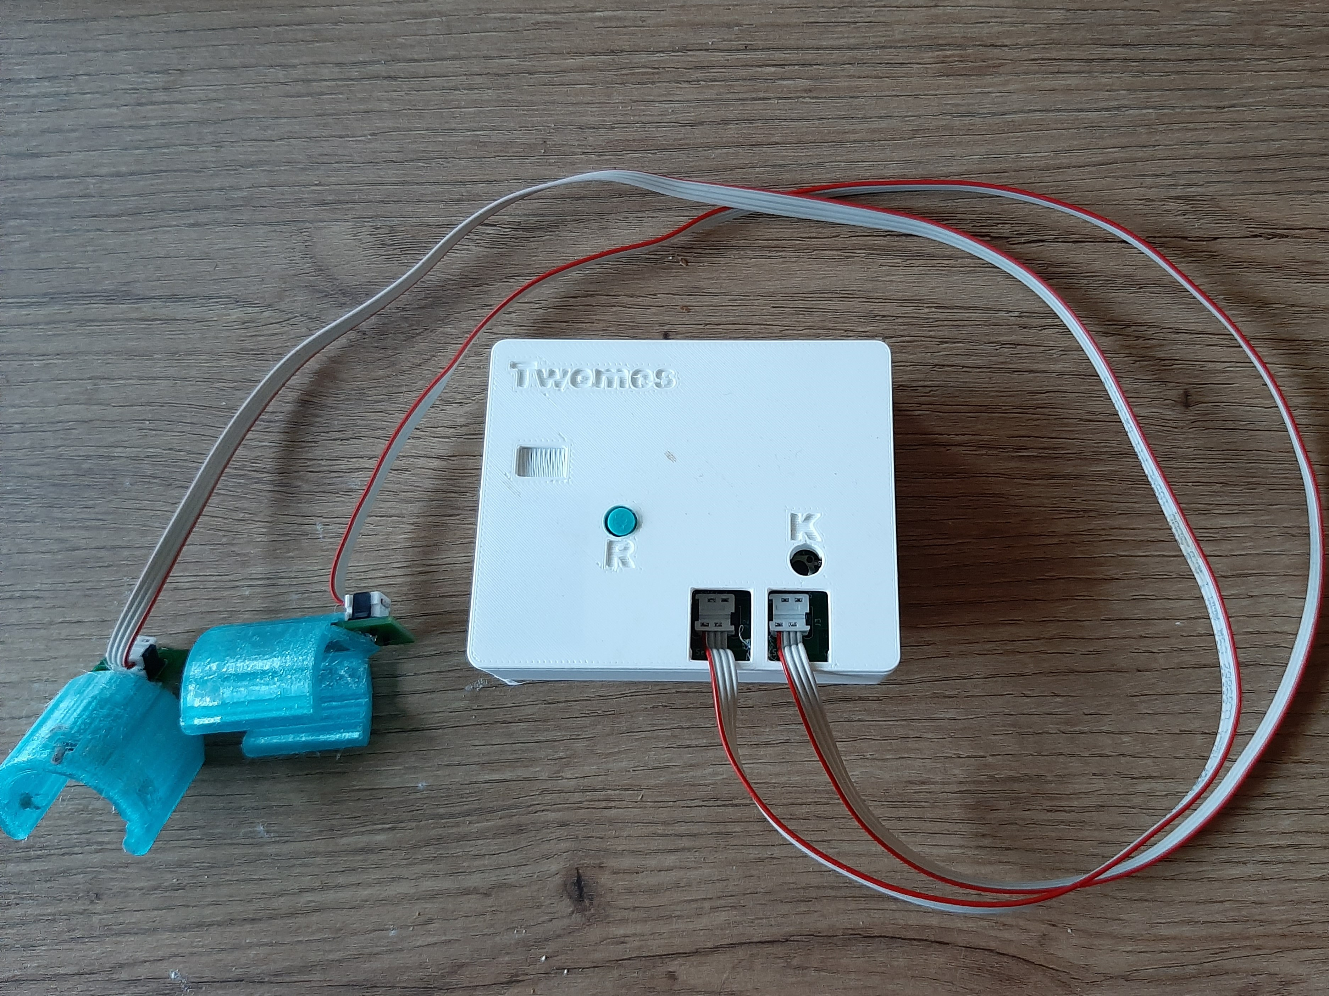
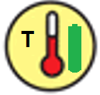

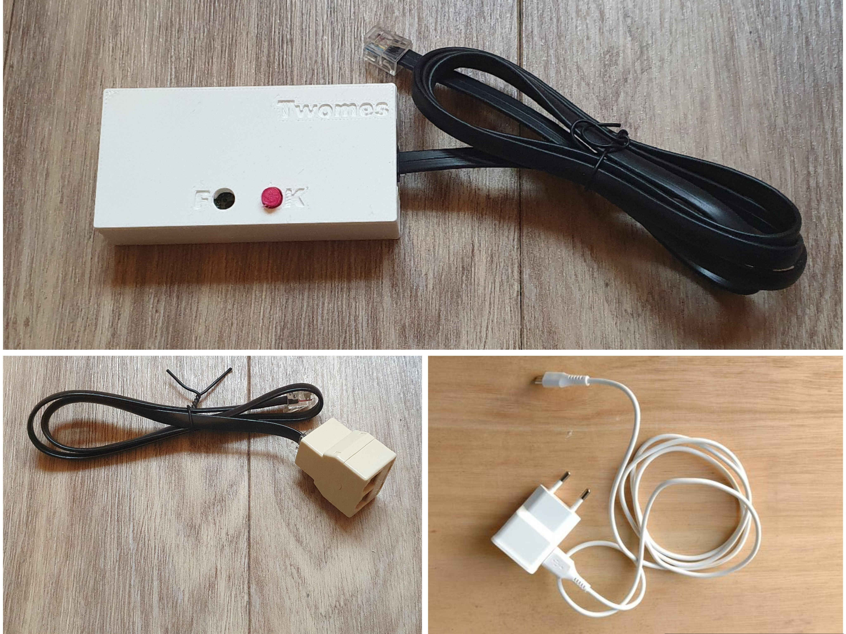
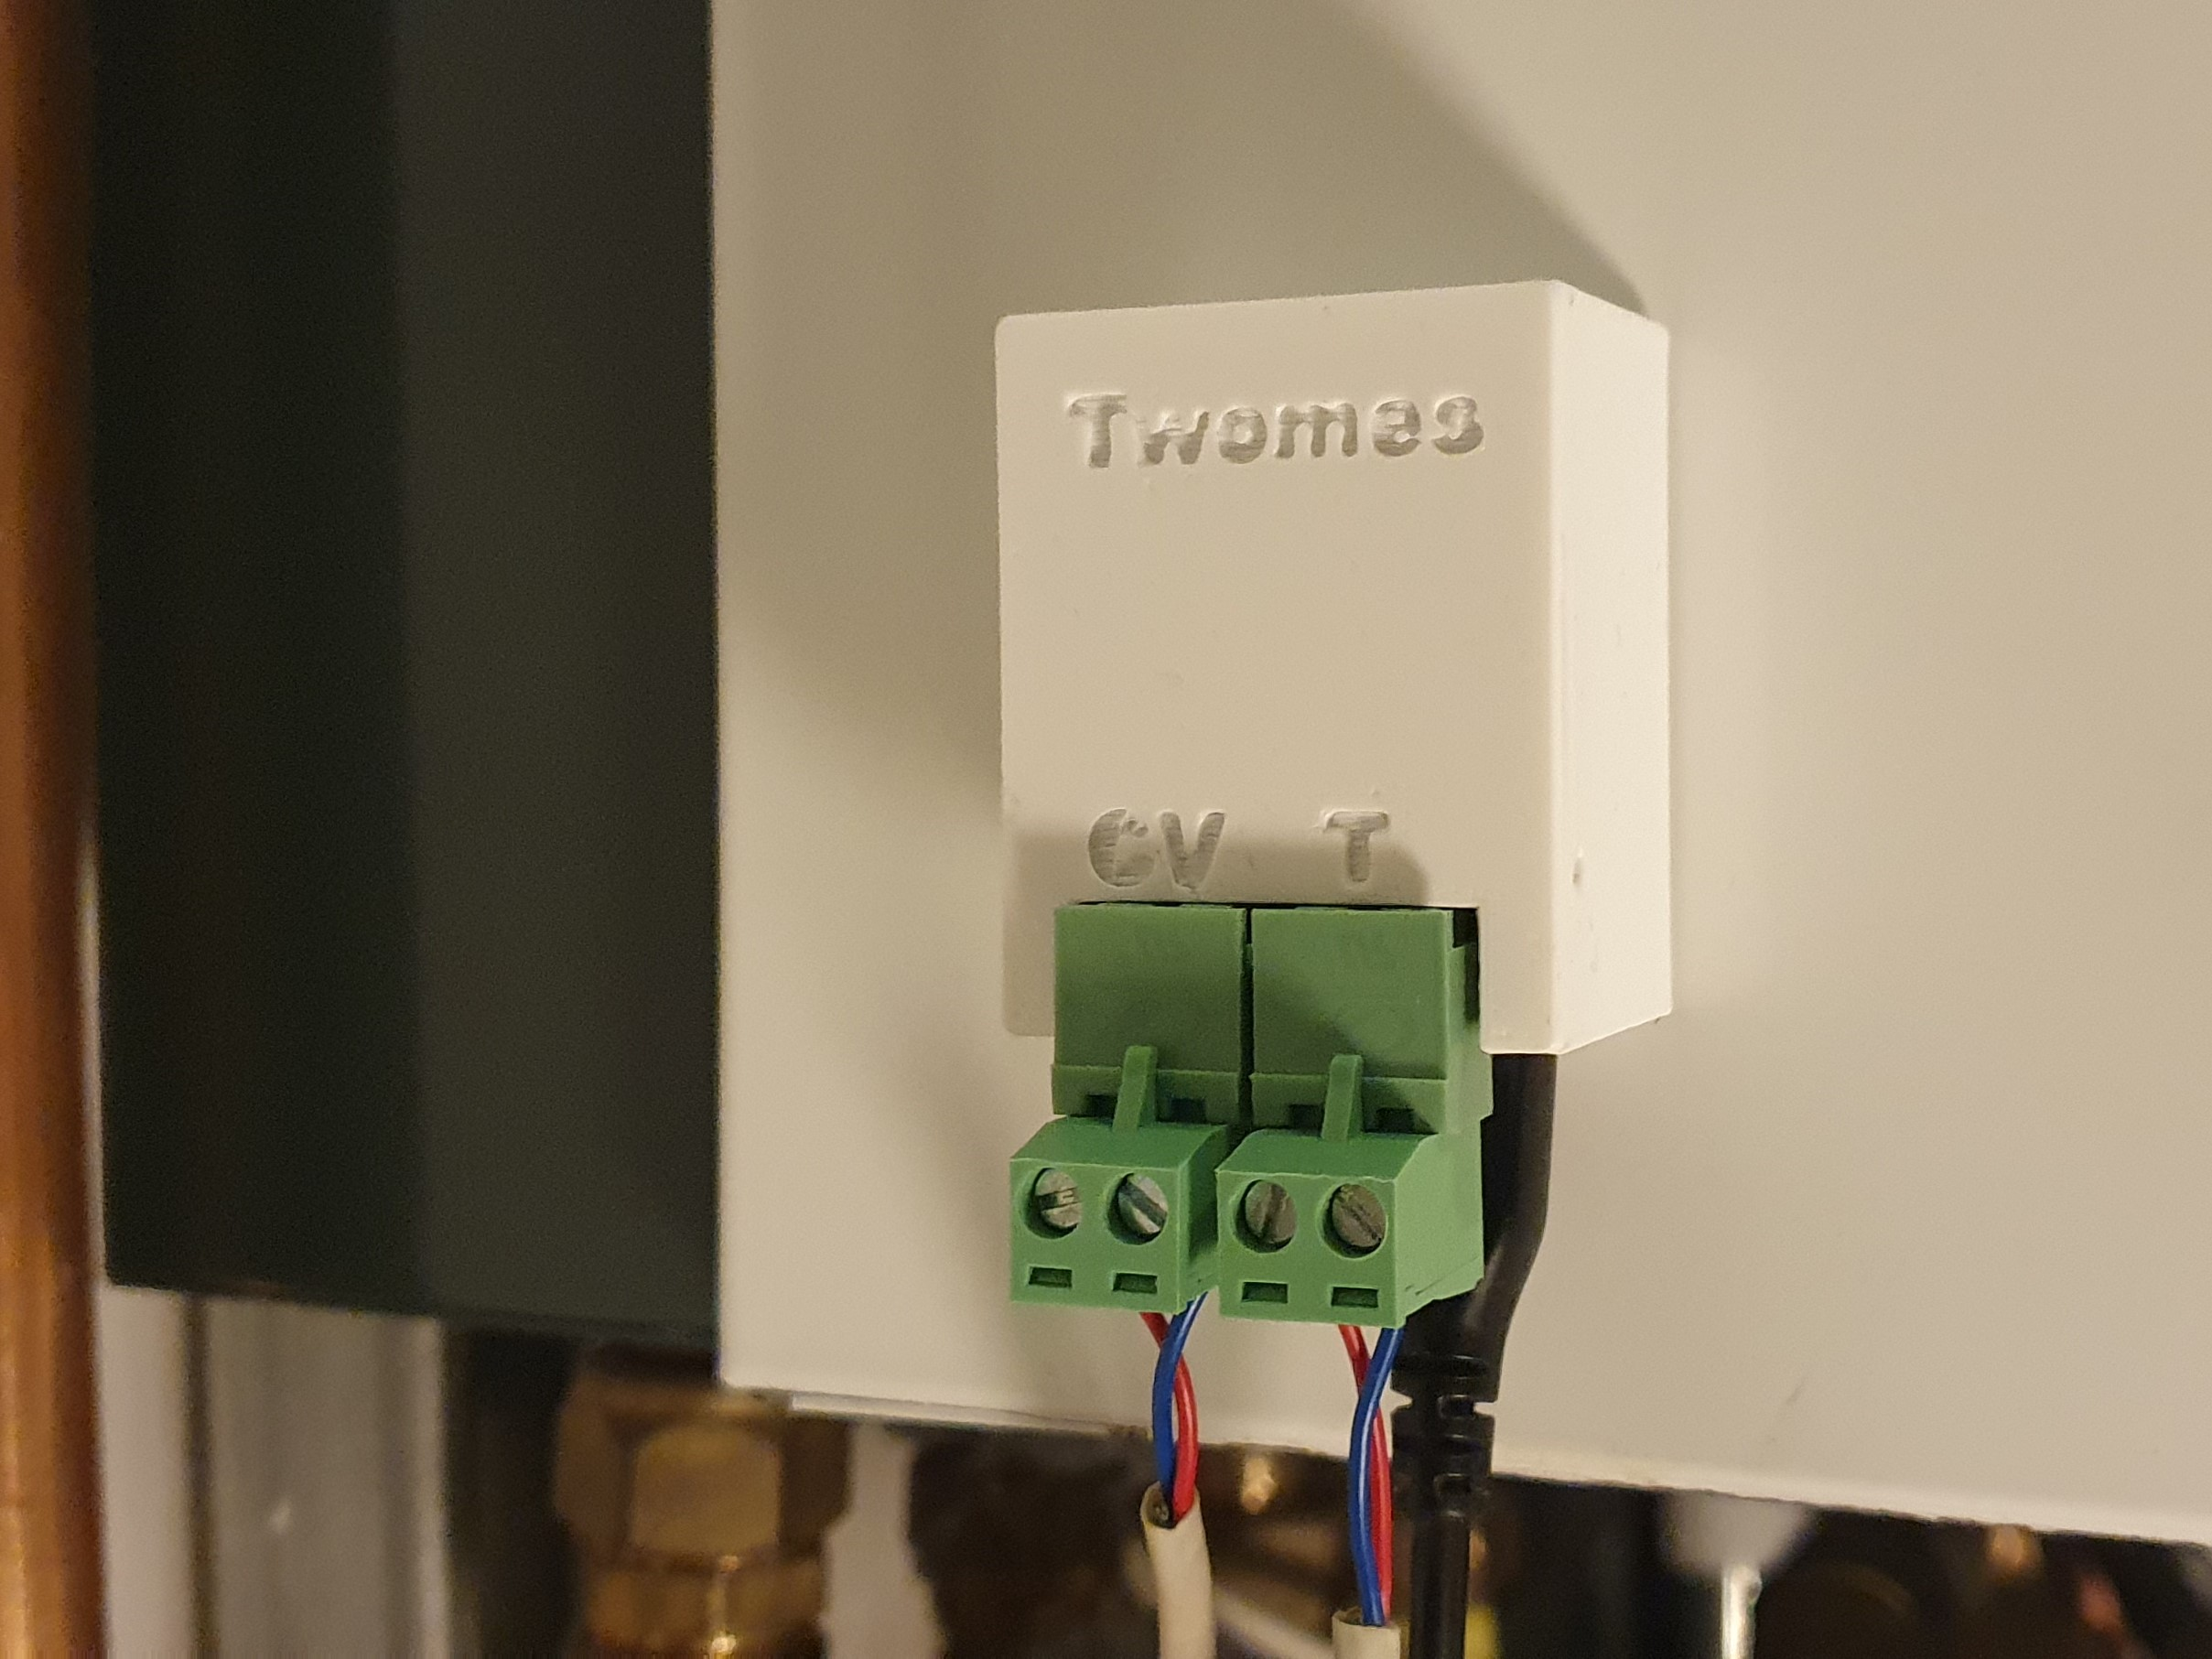
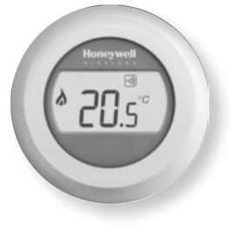
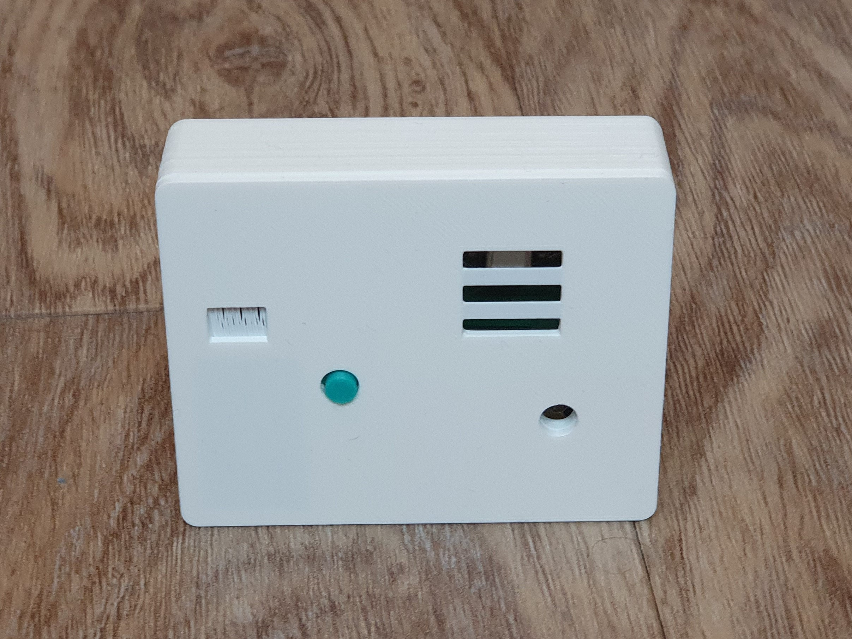
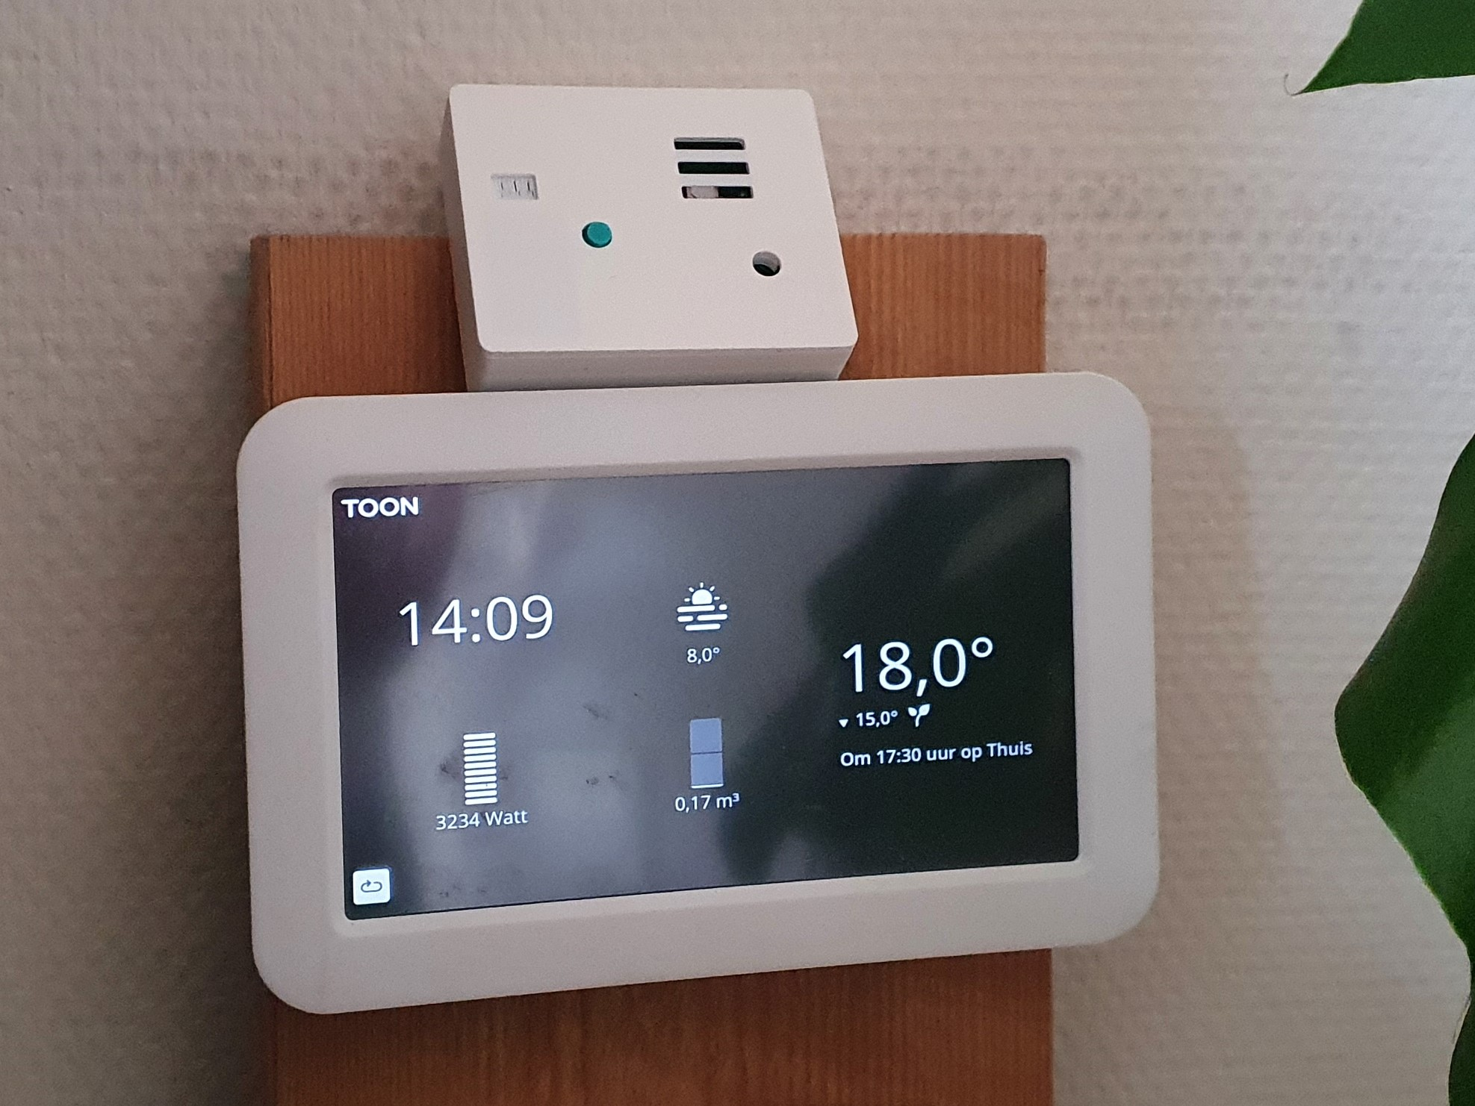

Architecture
Twomes WP2: Data collection
Twomes
Backoffice
Twomes
Analysis pipeline
advisor
boiler
Enelogic (ODA)
T_{s +} T_{r}
occupant
P4
app
Enexis (DSO)
OpenTherm Monitor
smart meter module
smart meter
P3
Internet
open data about buildings (BAG, AHN, energy labels)
T_{in}
WiFi router
weather data

Slide 15
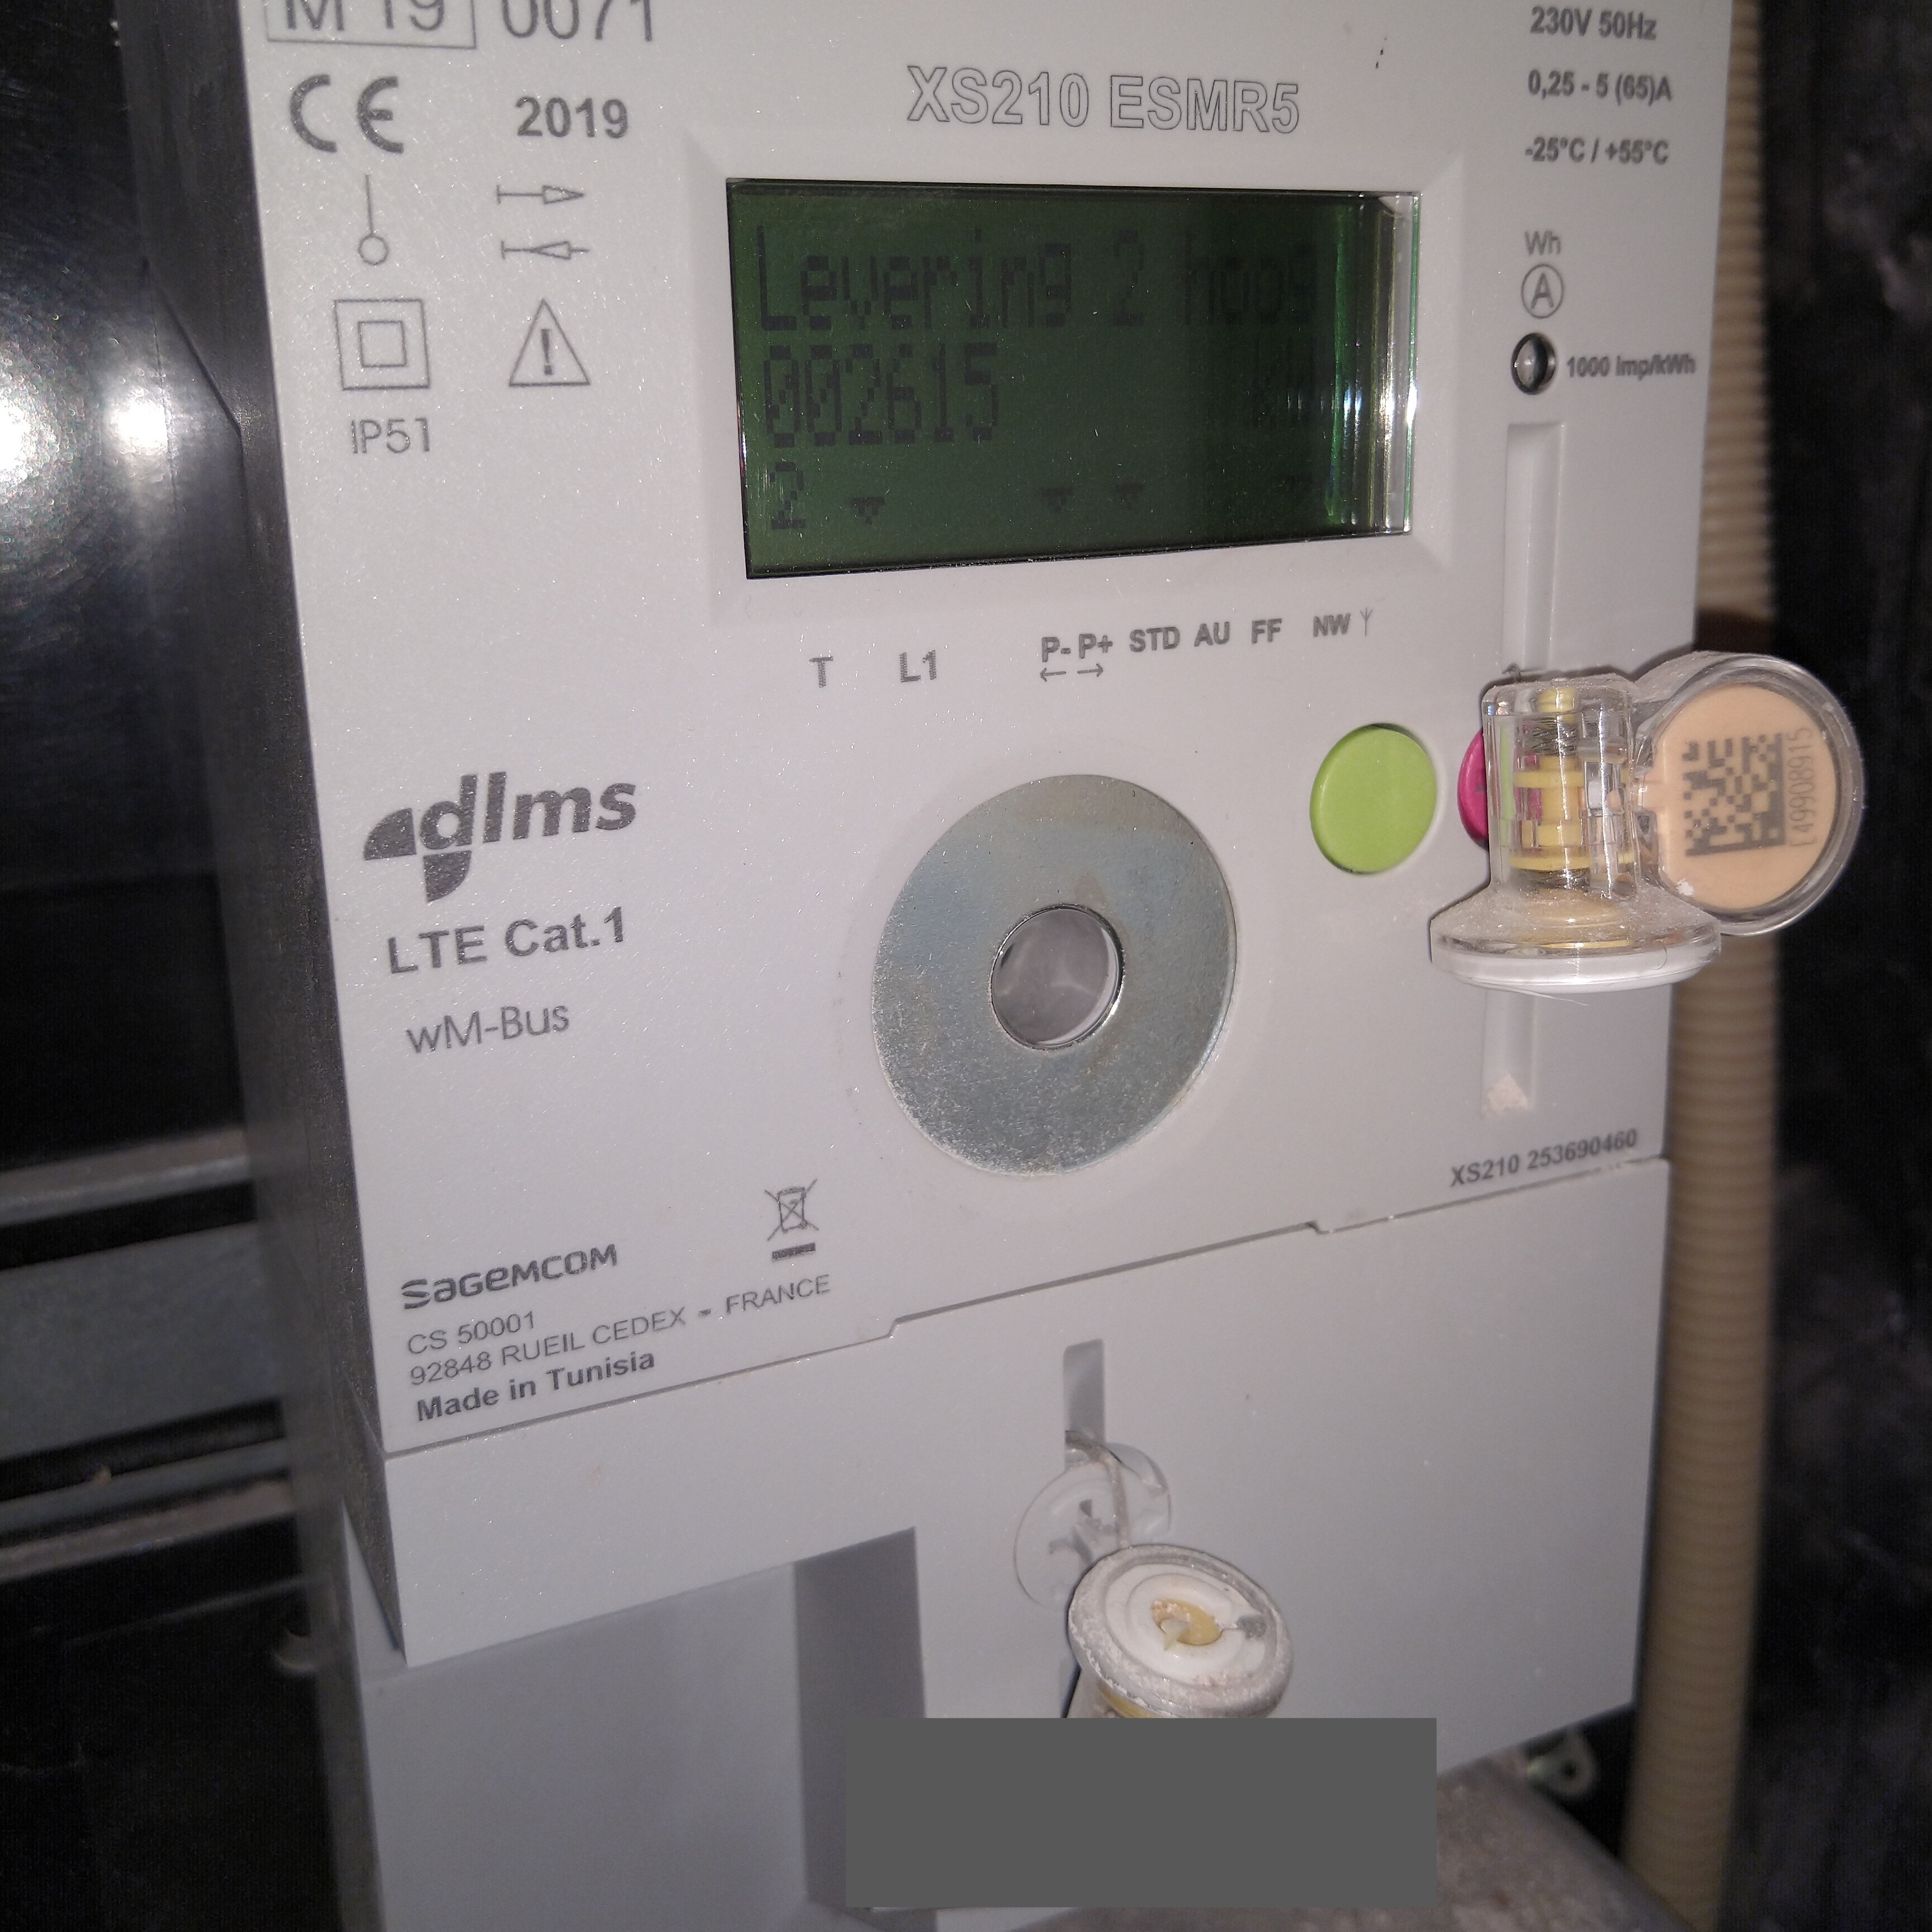
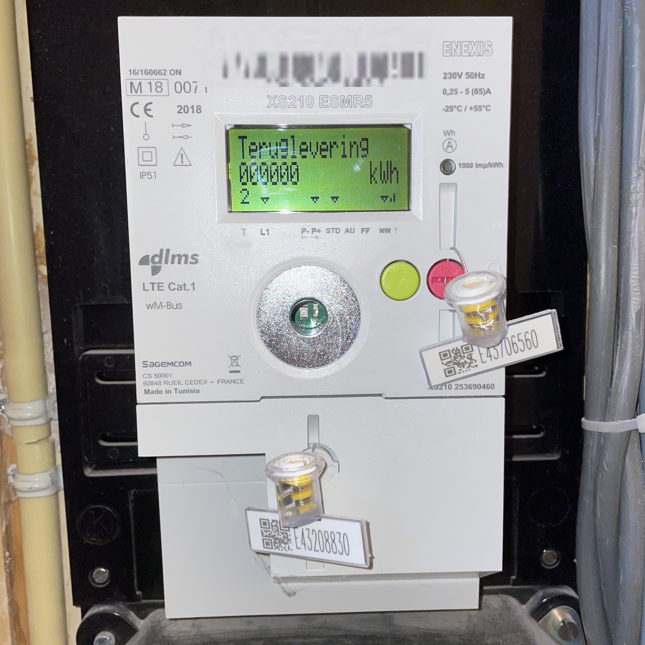
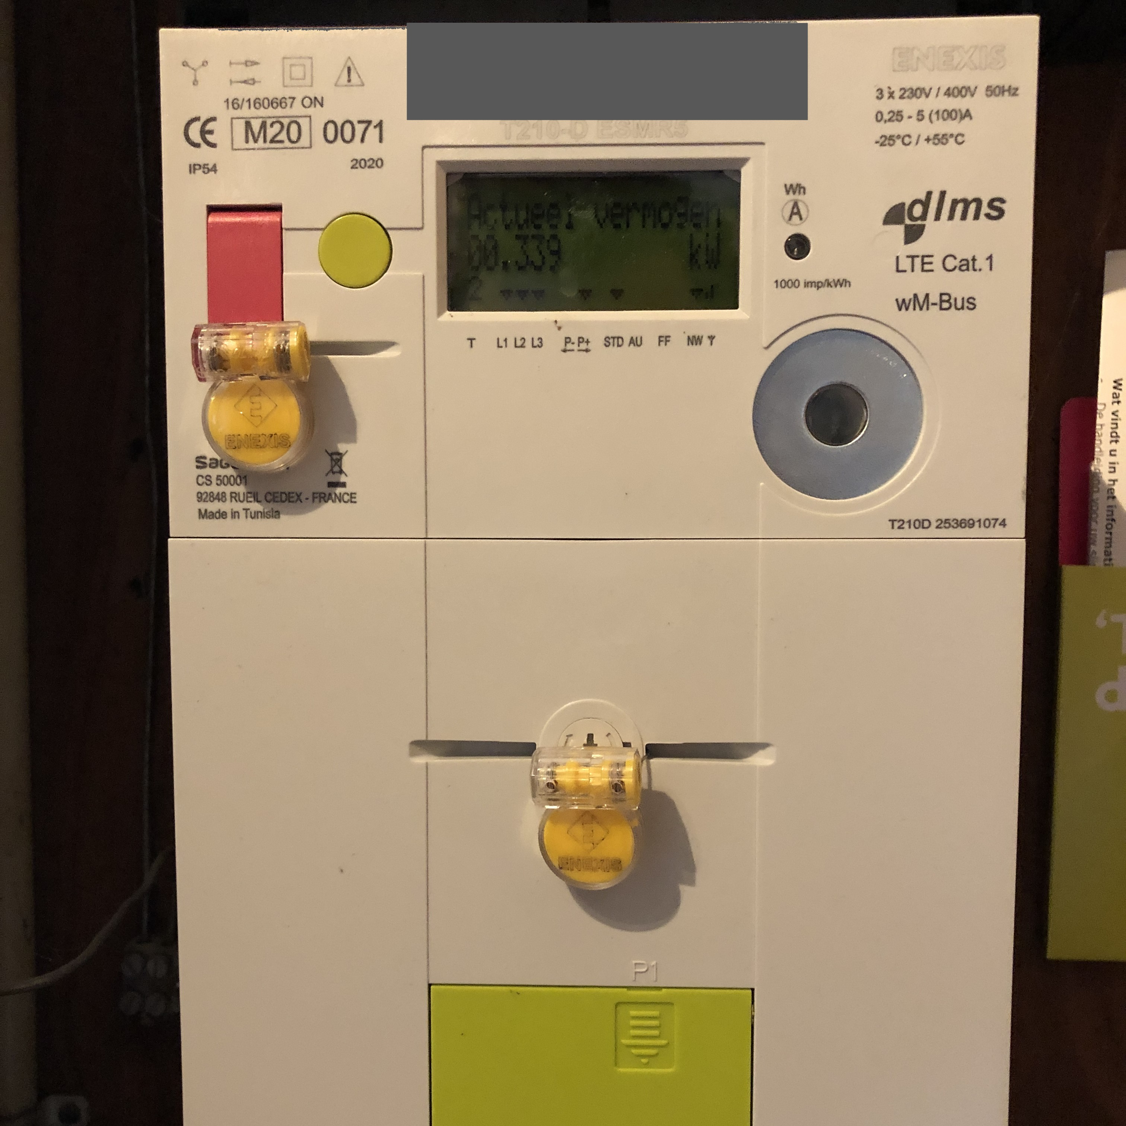
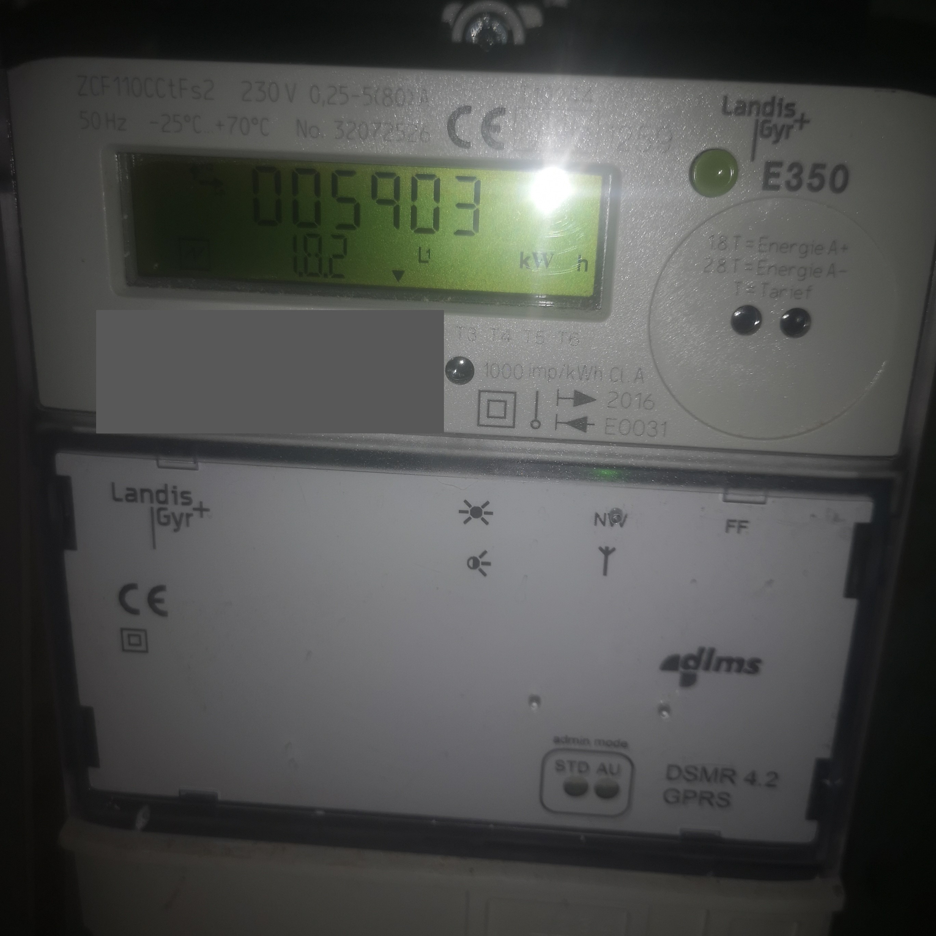
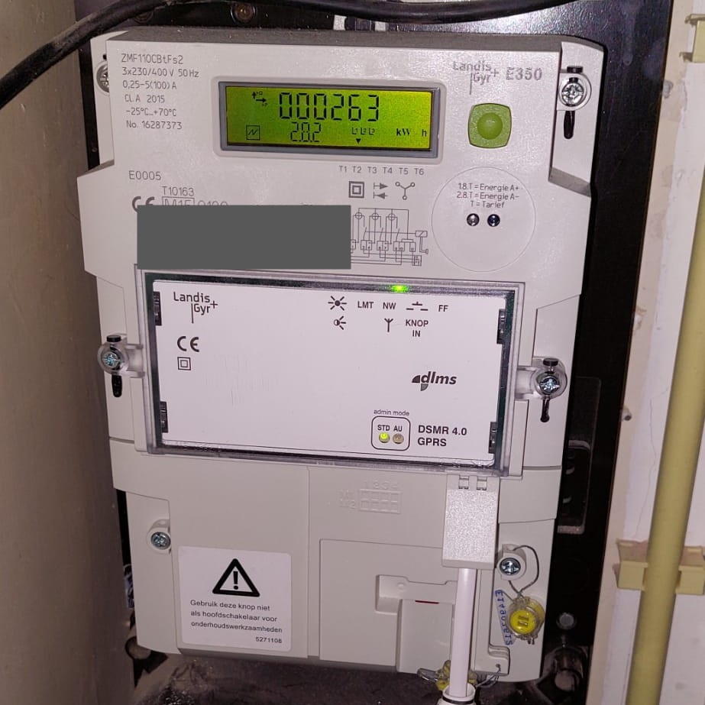
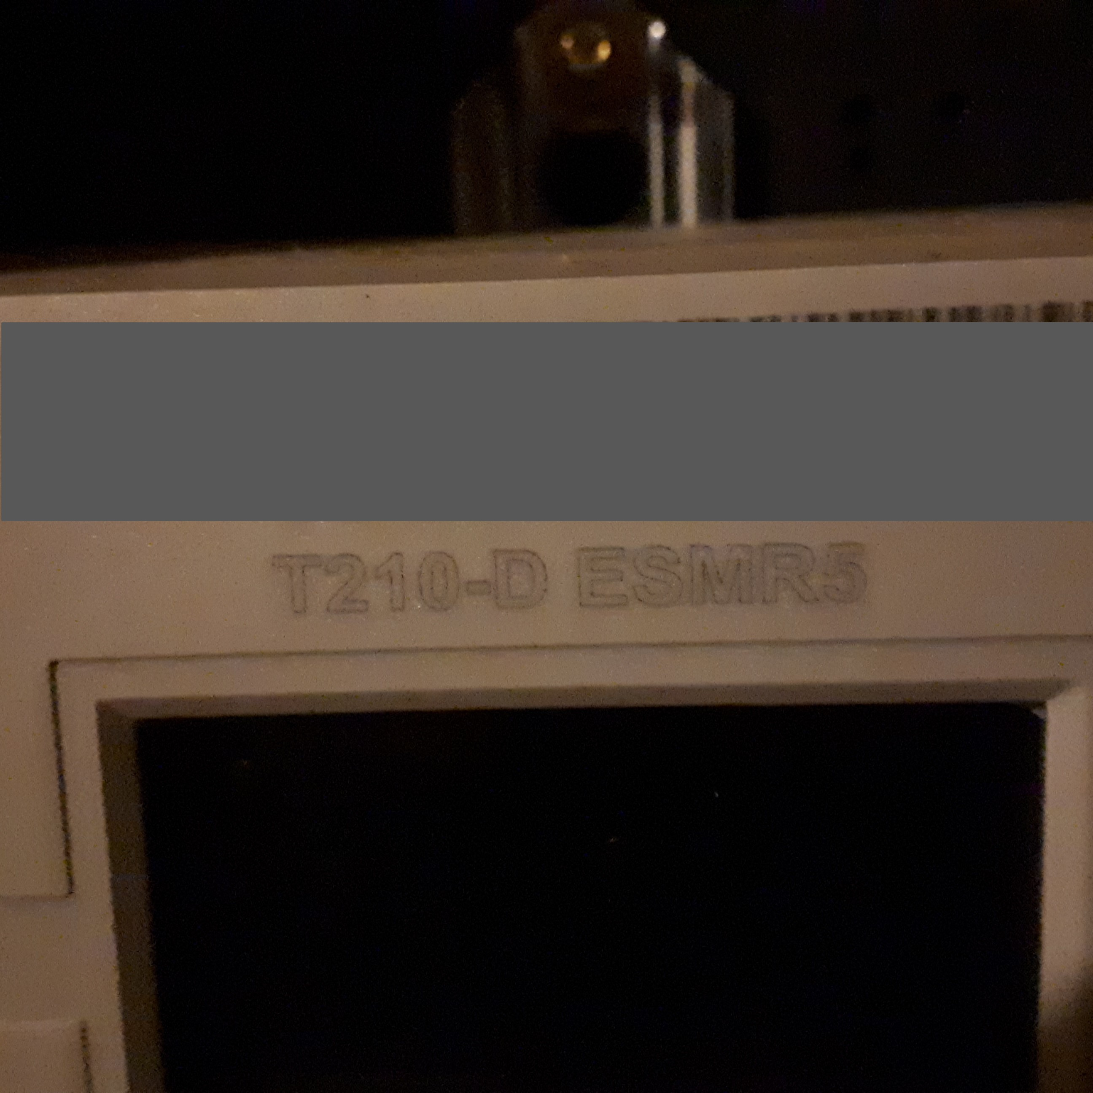
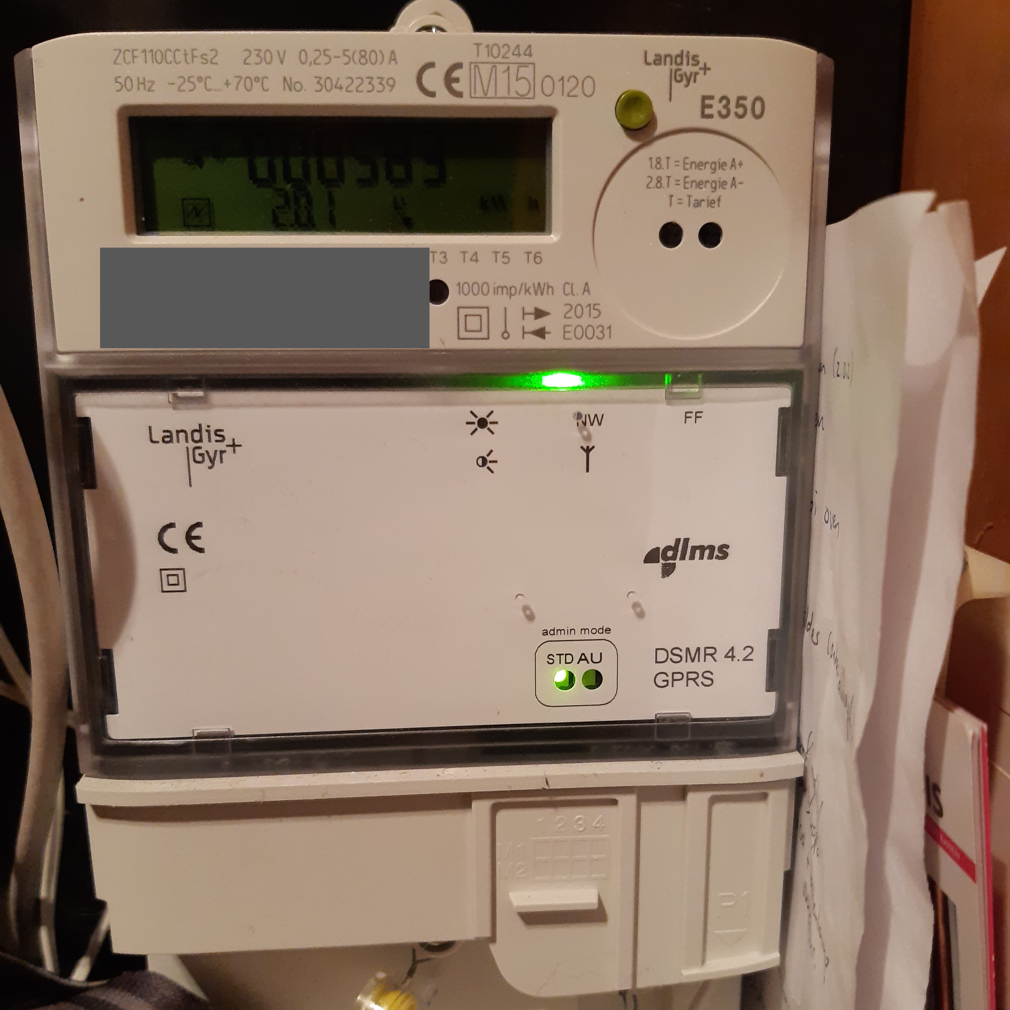
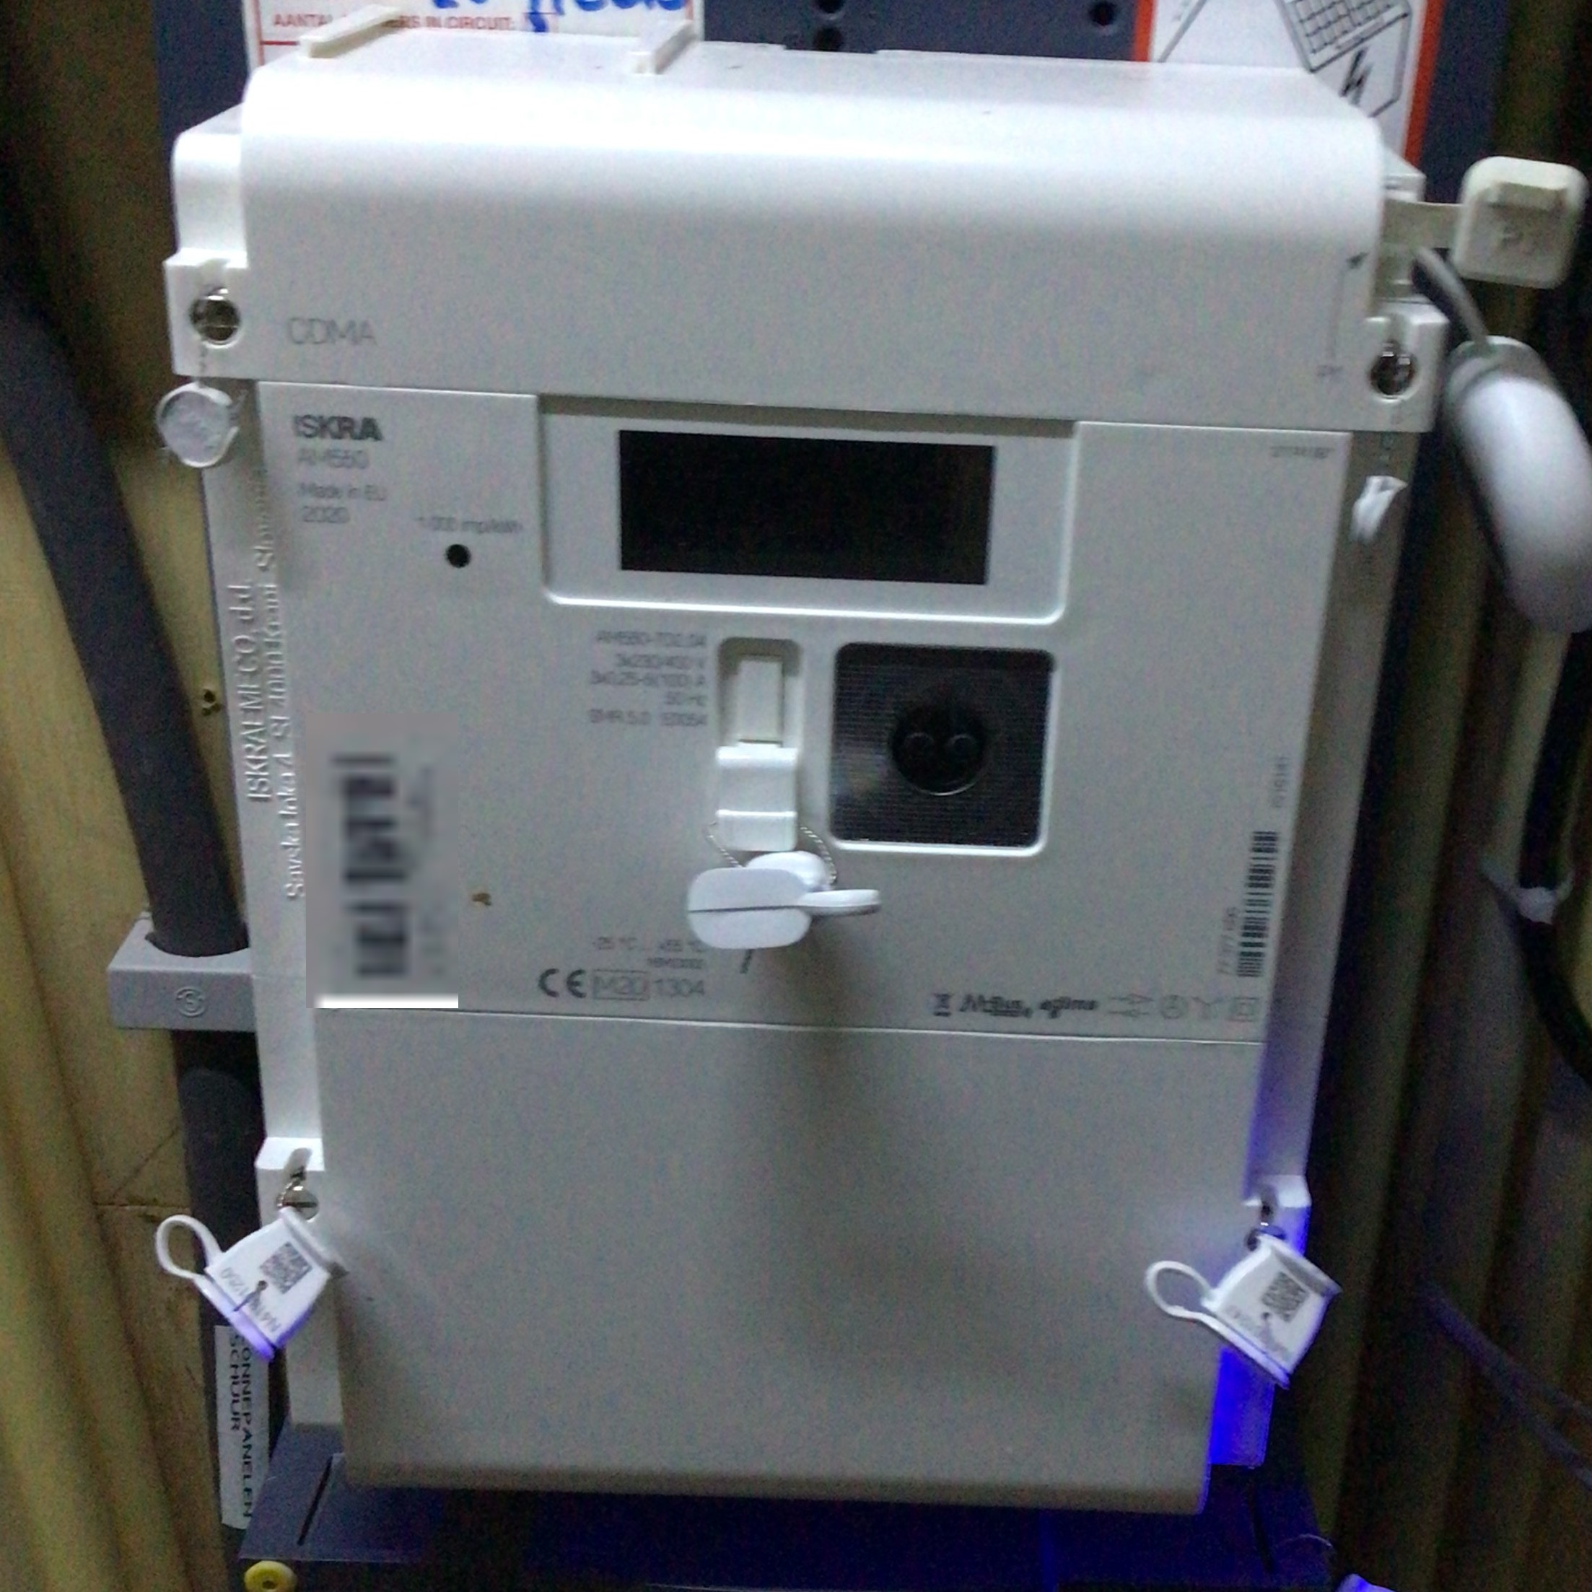
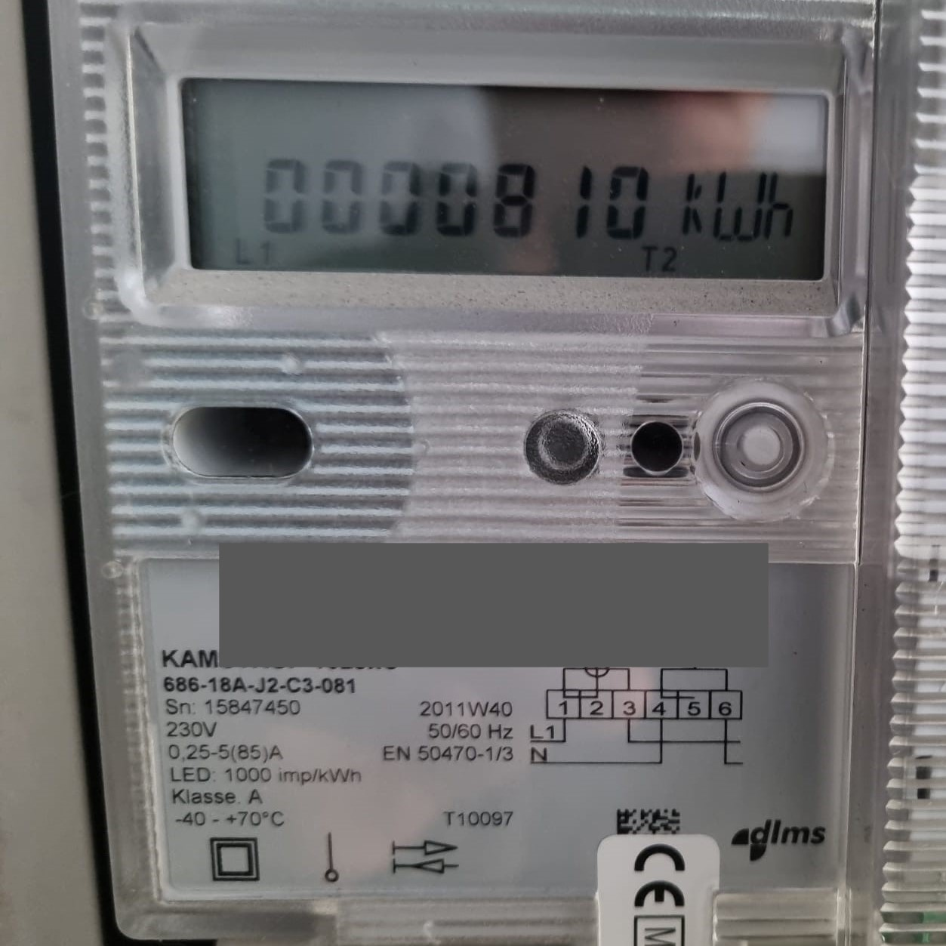
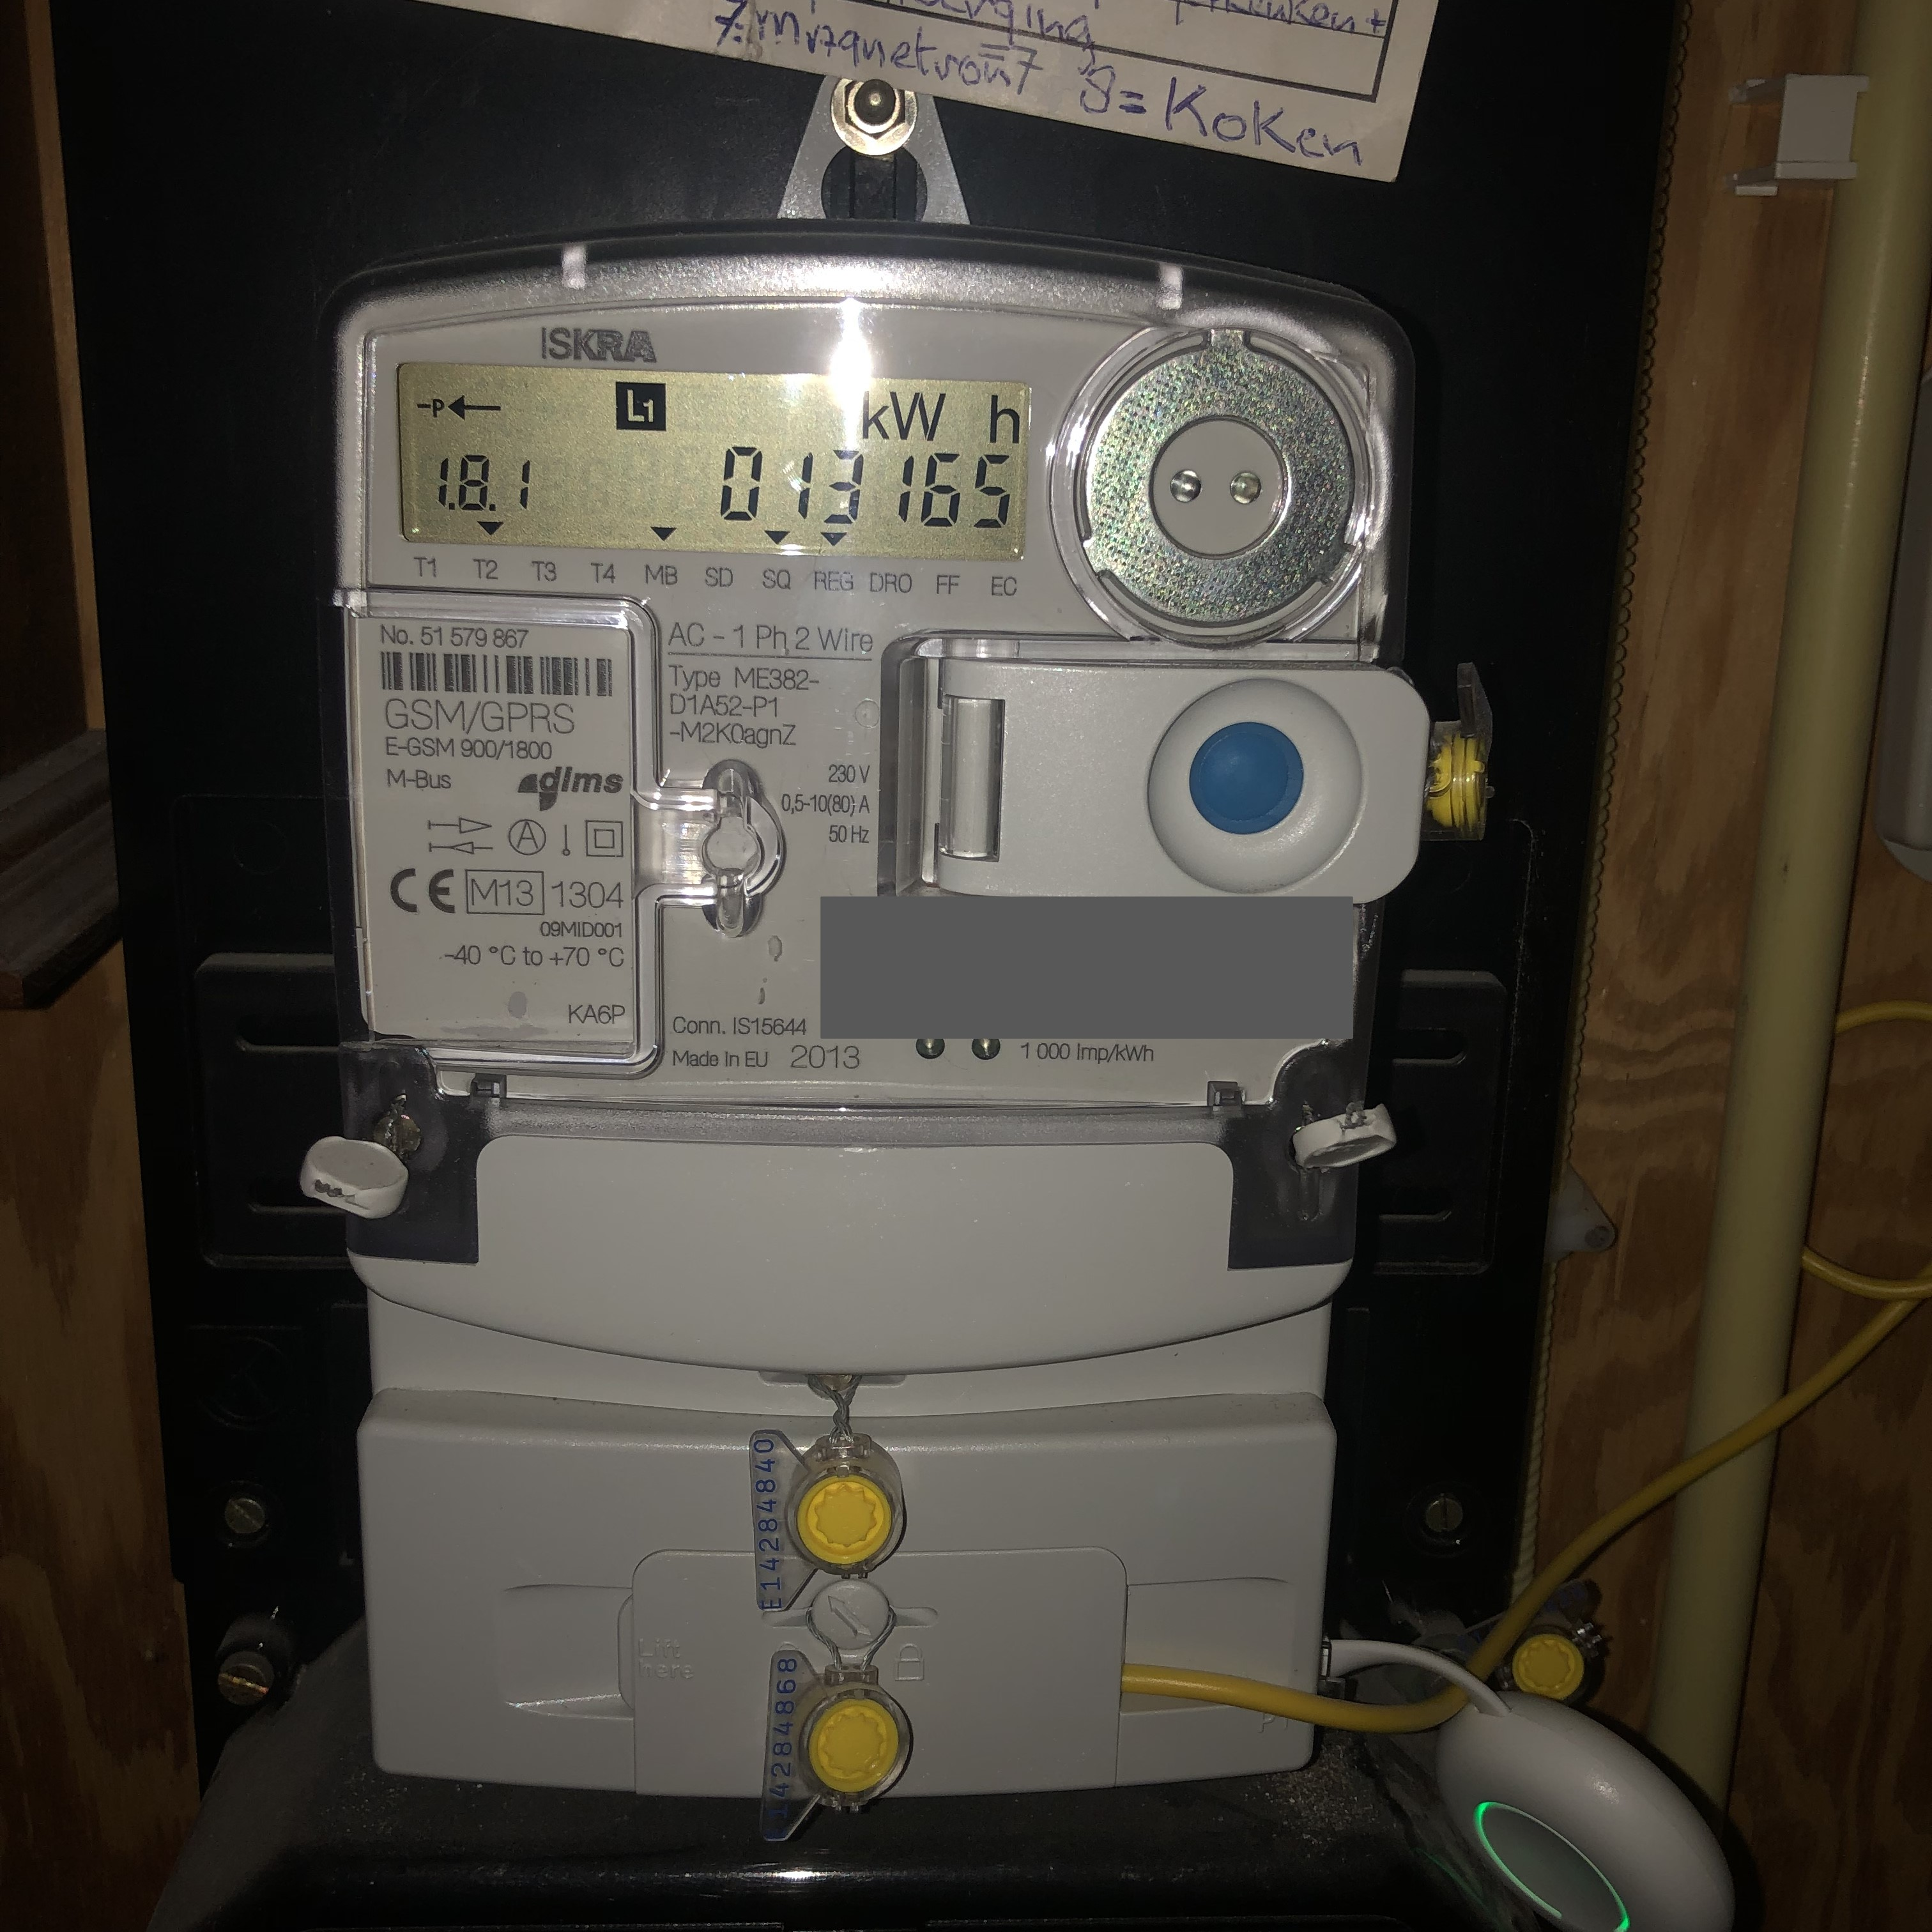
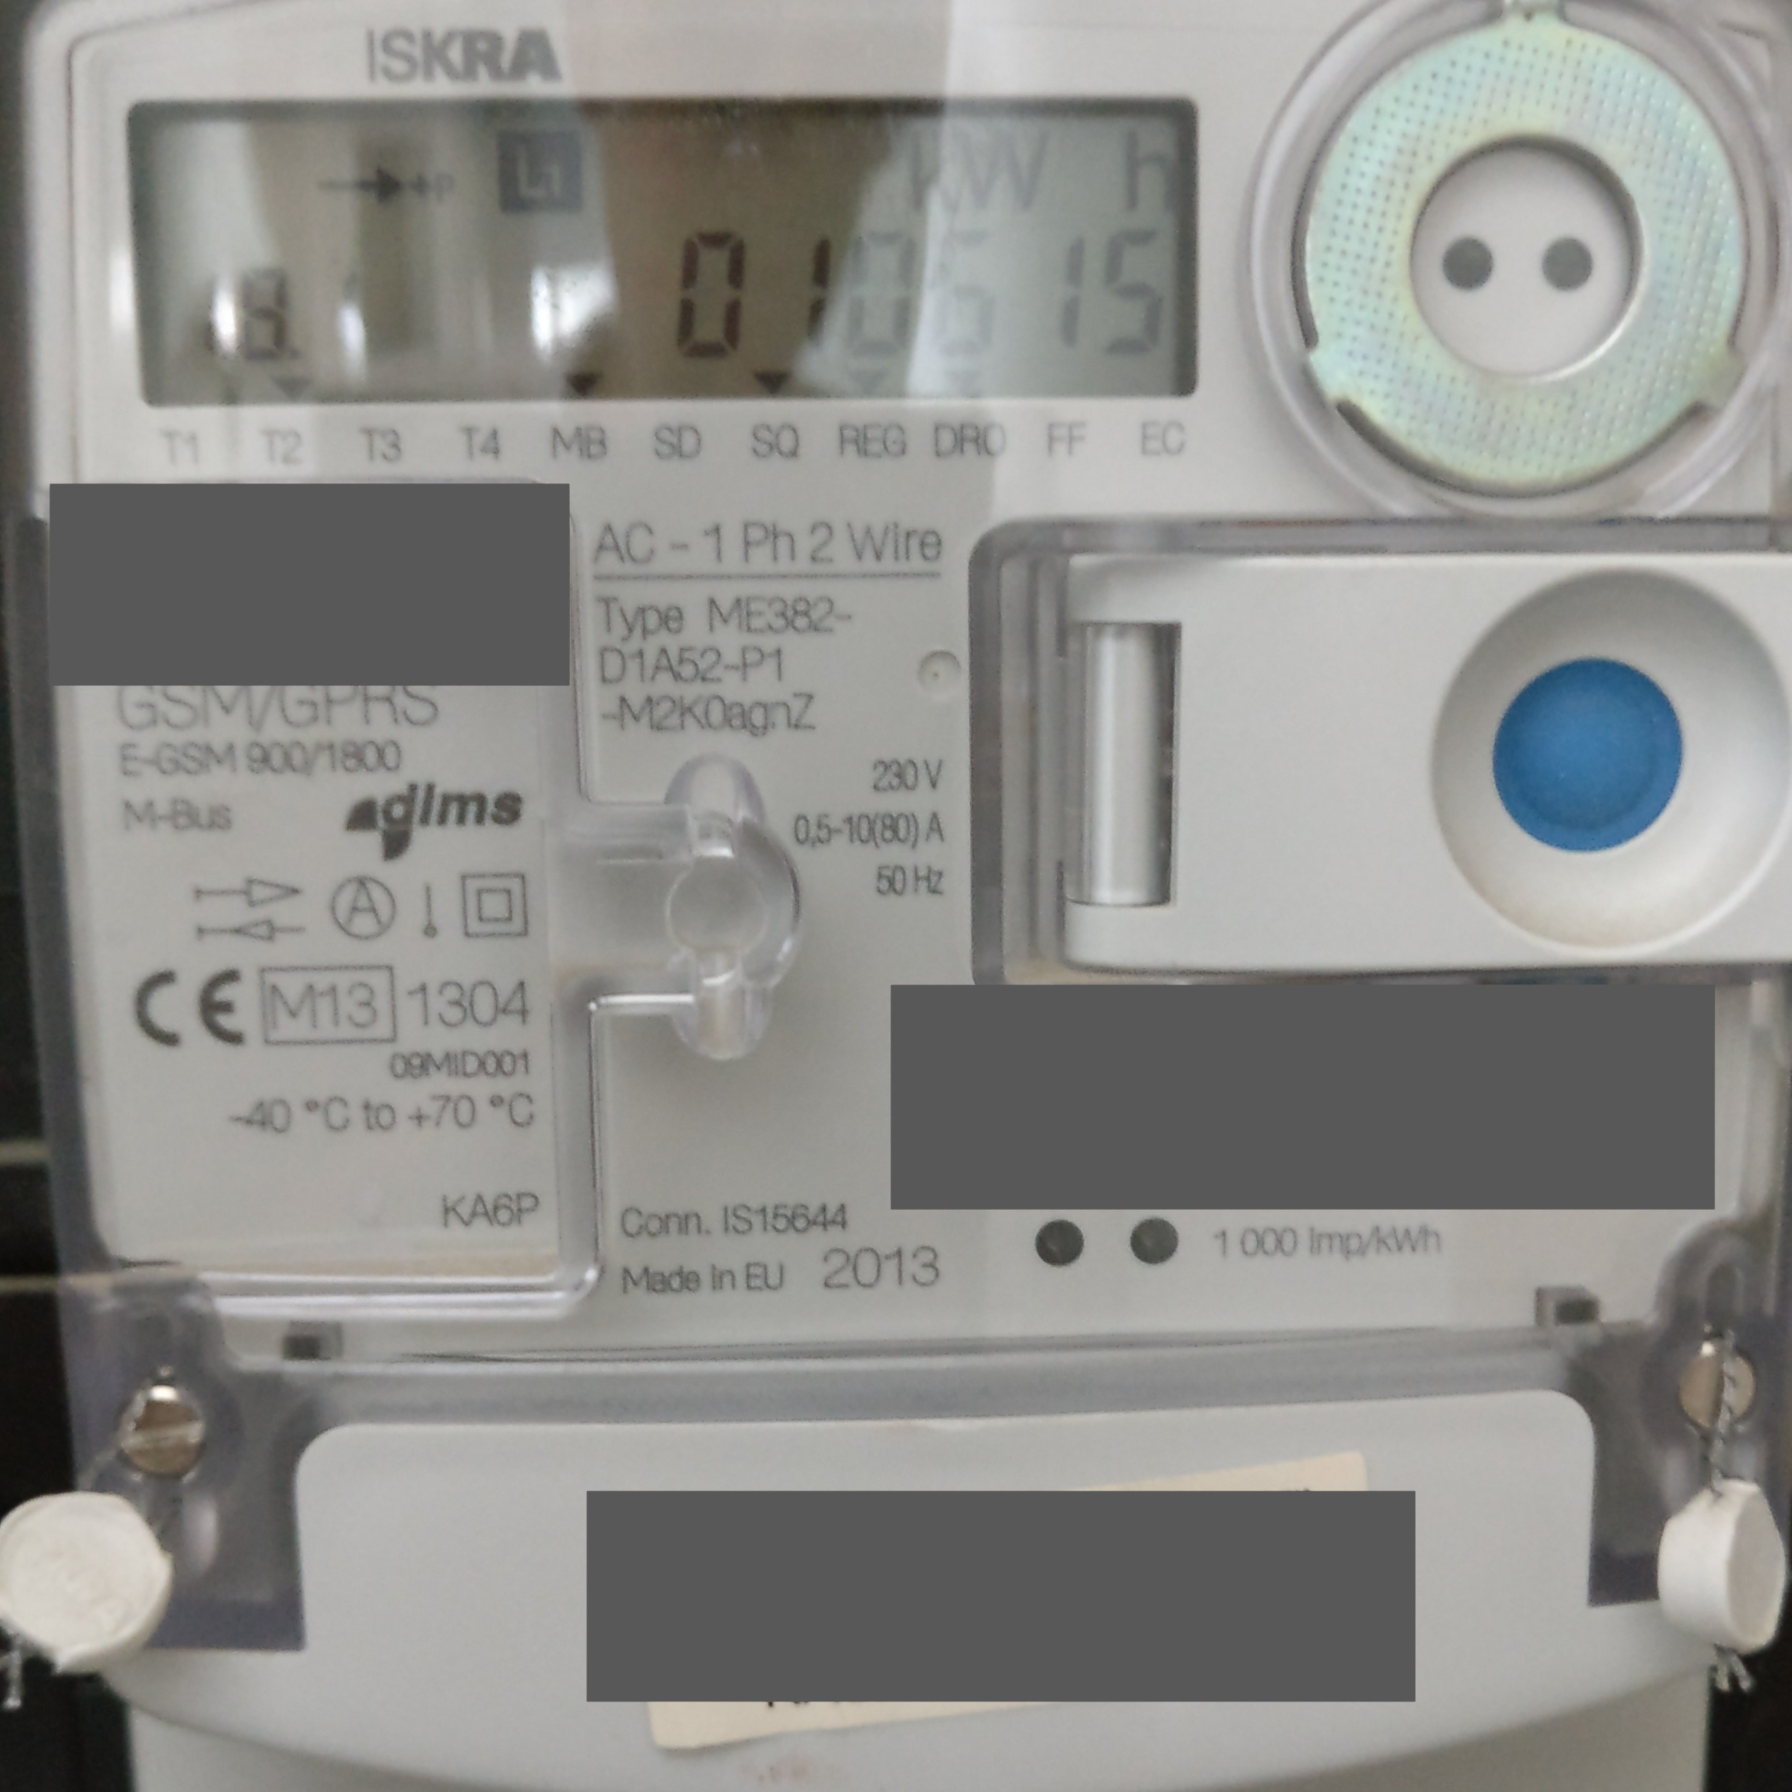
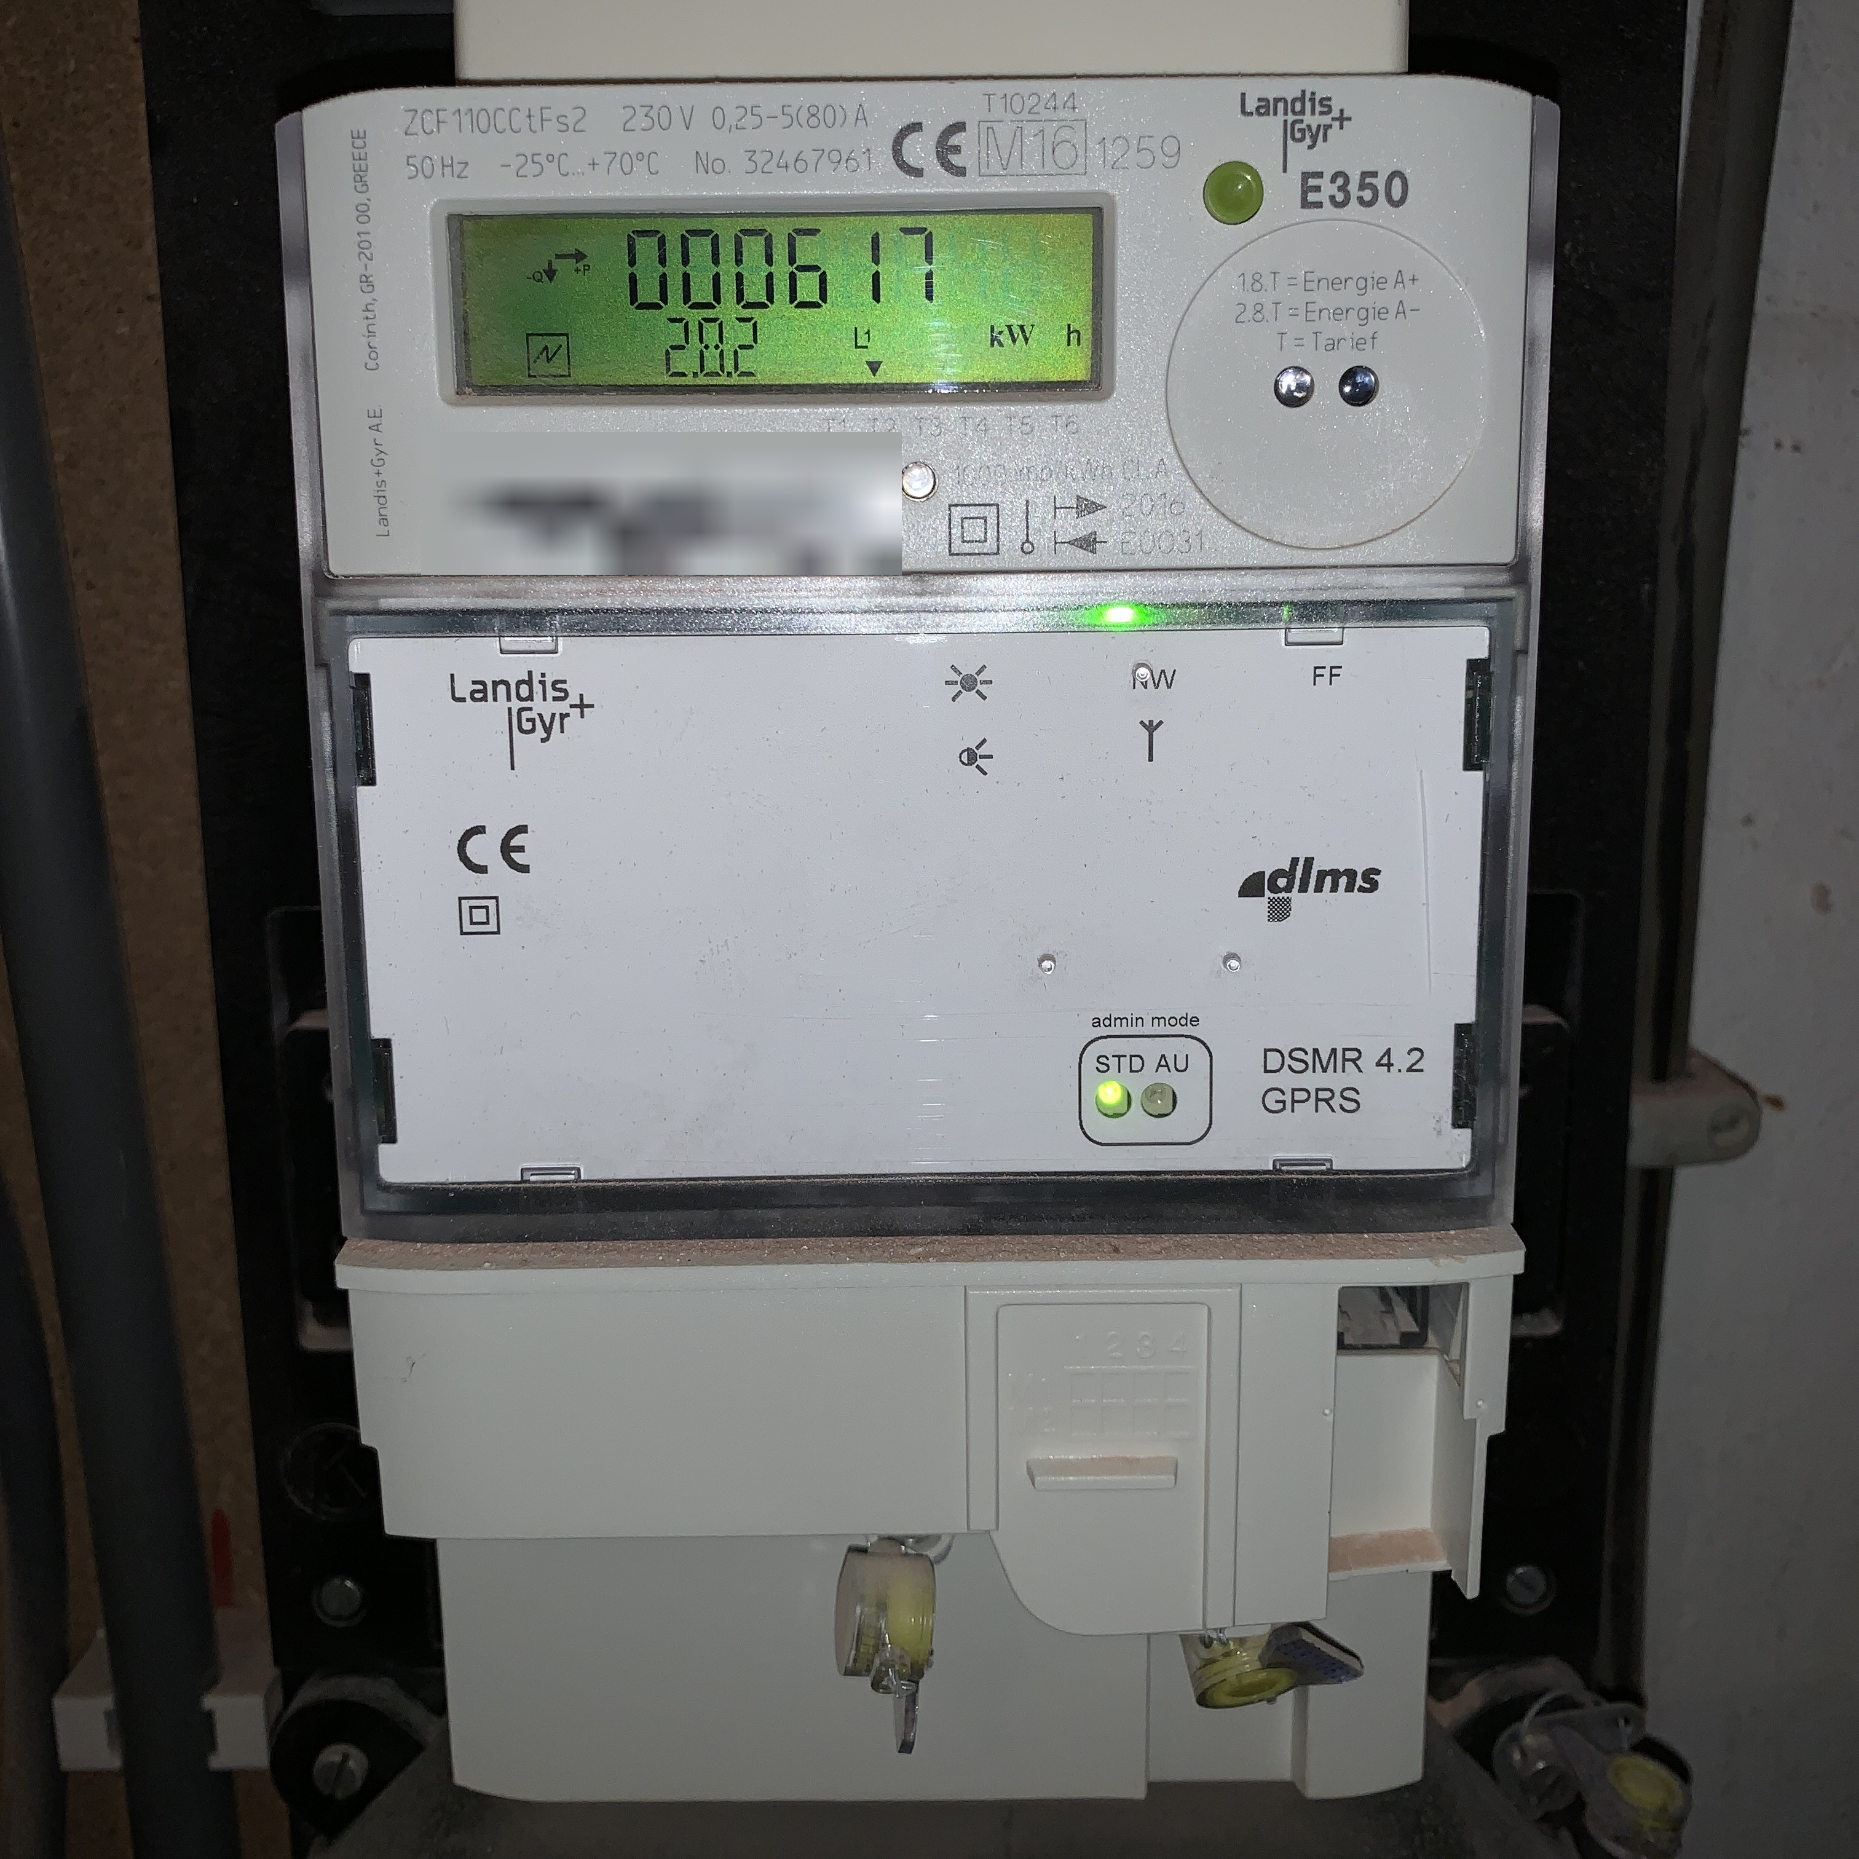
Recruitment: variety in smart meters
Twomes WP2: Data collection
6 brands
13 models
3 versions DSMR standard
P1-poort: 9 in use; 31 not

Slide 16
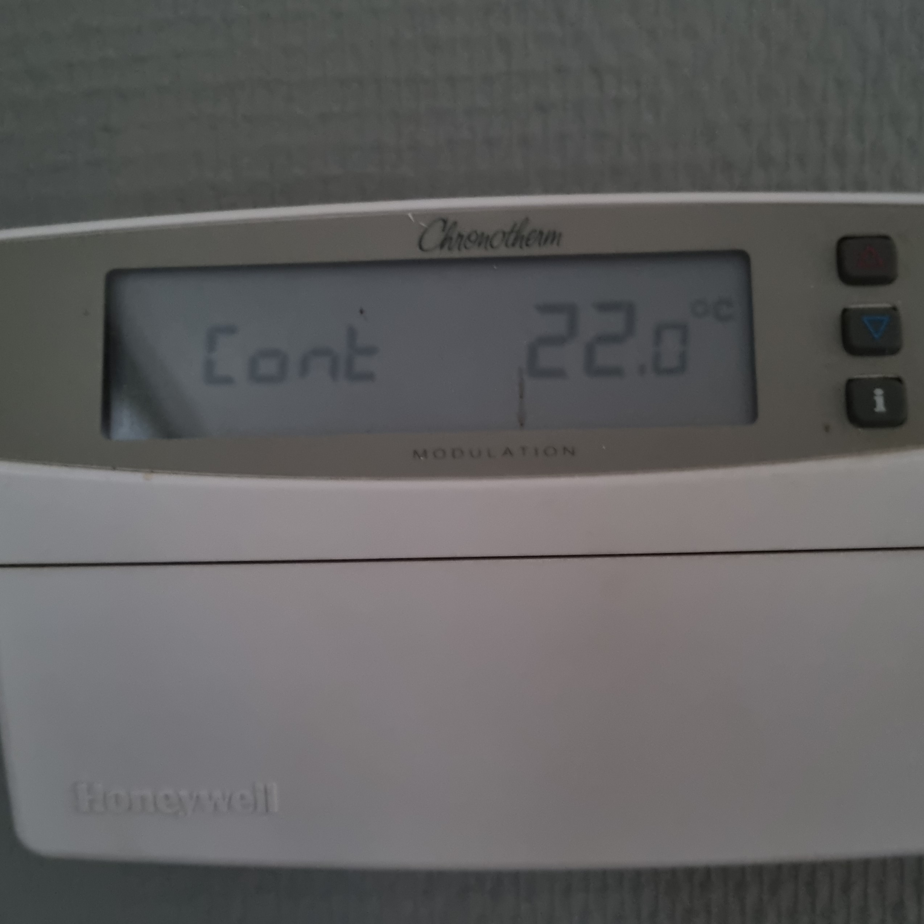
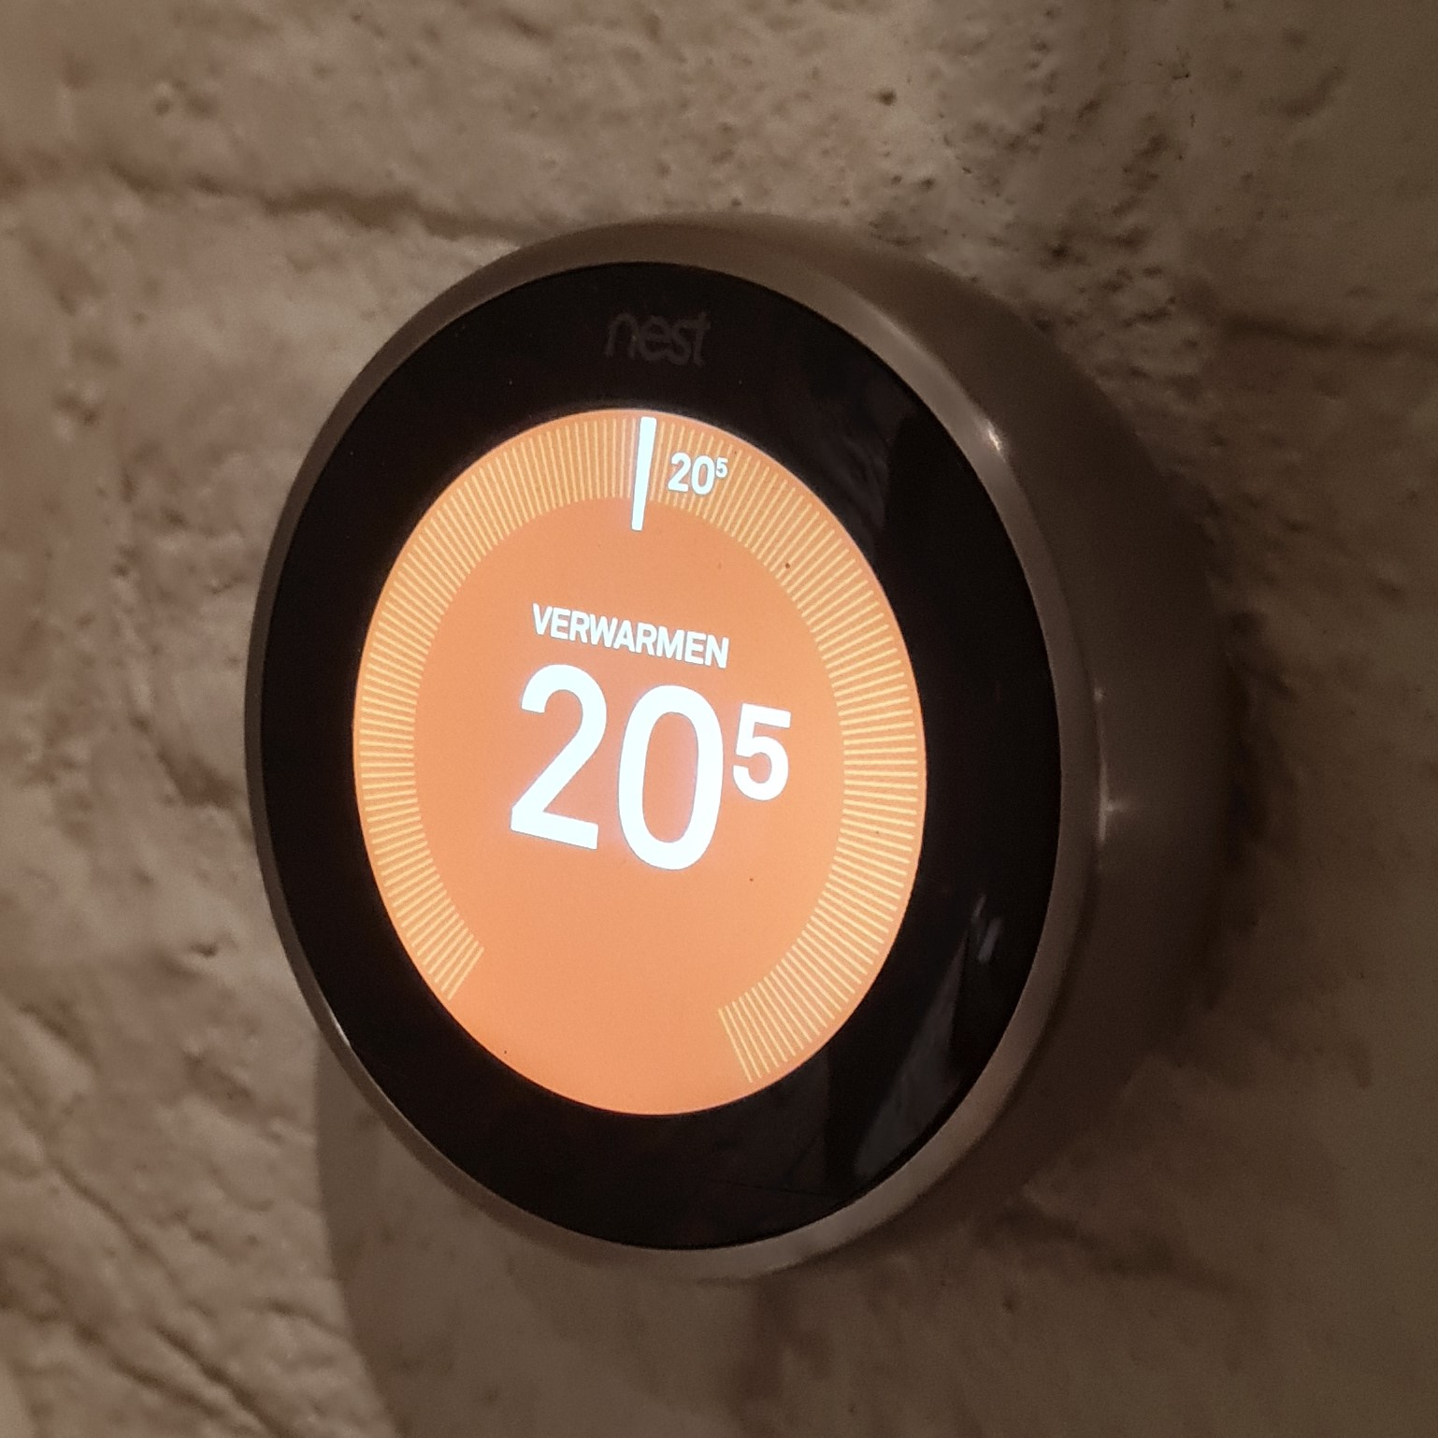
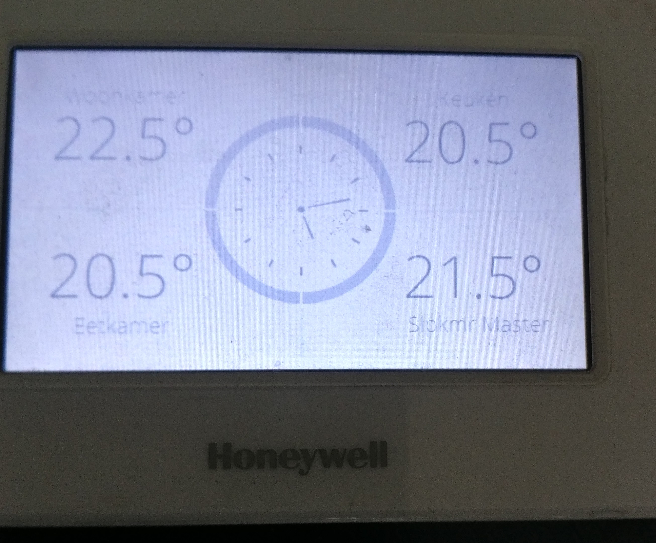
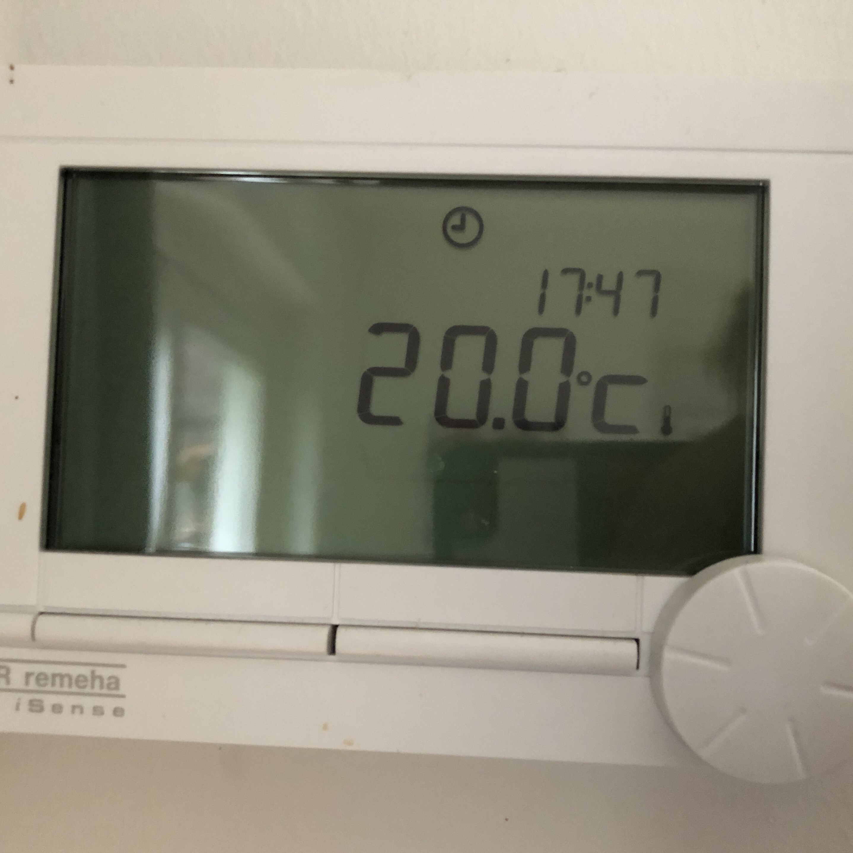
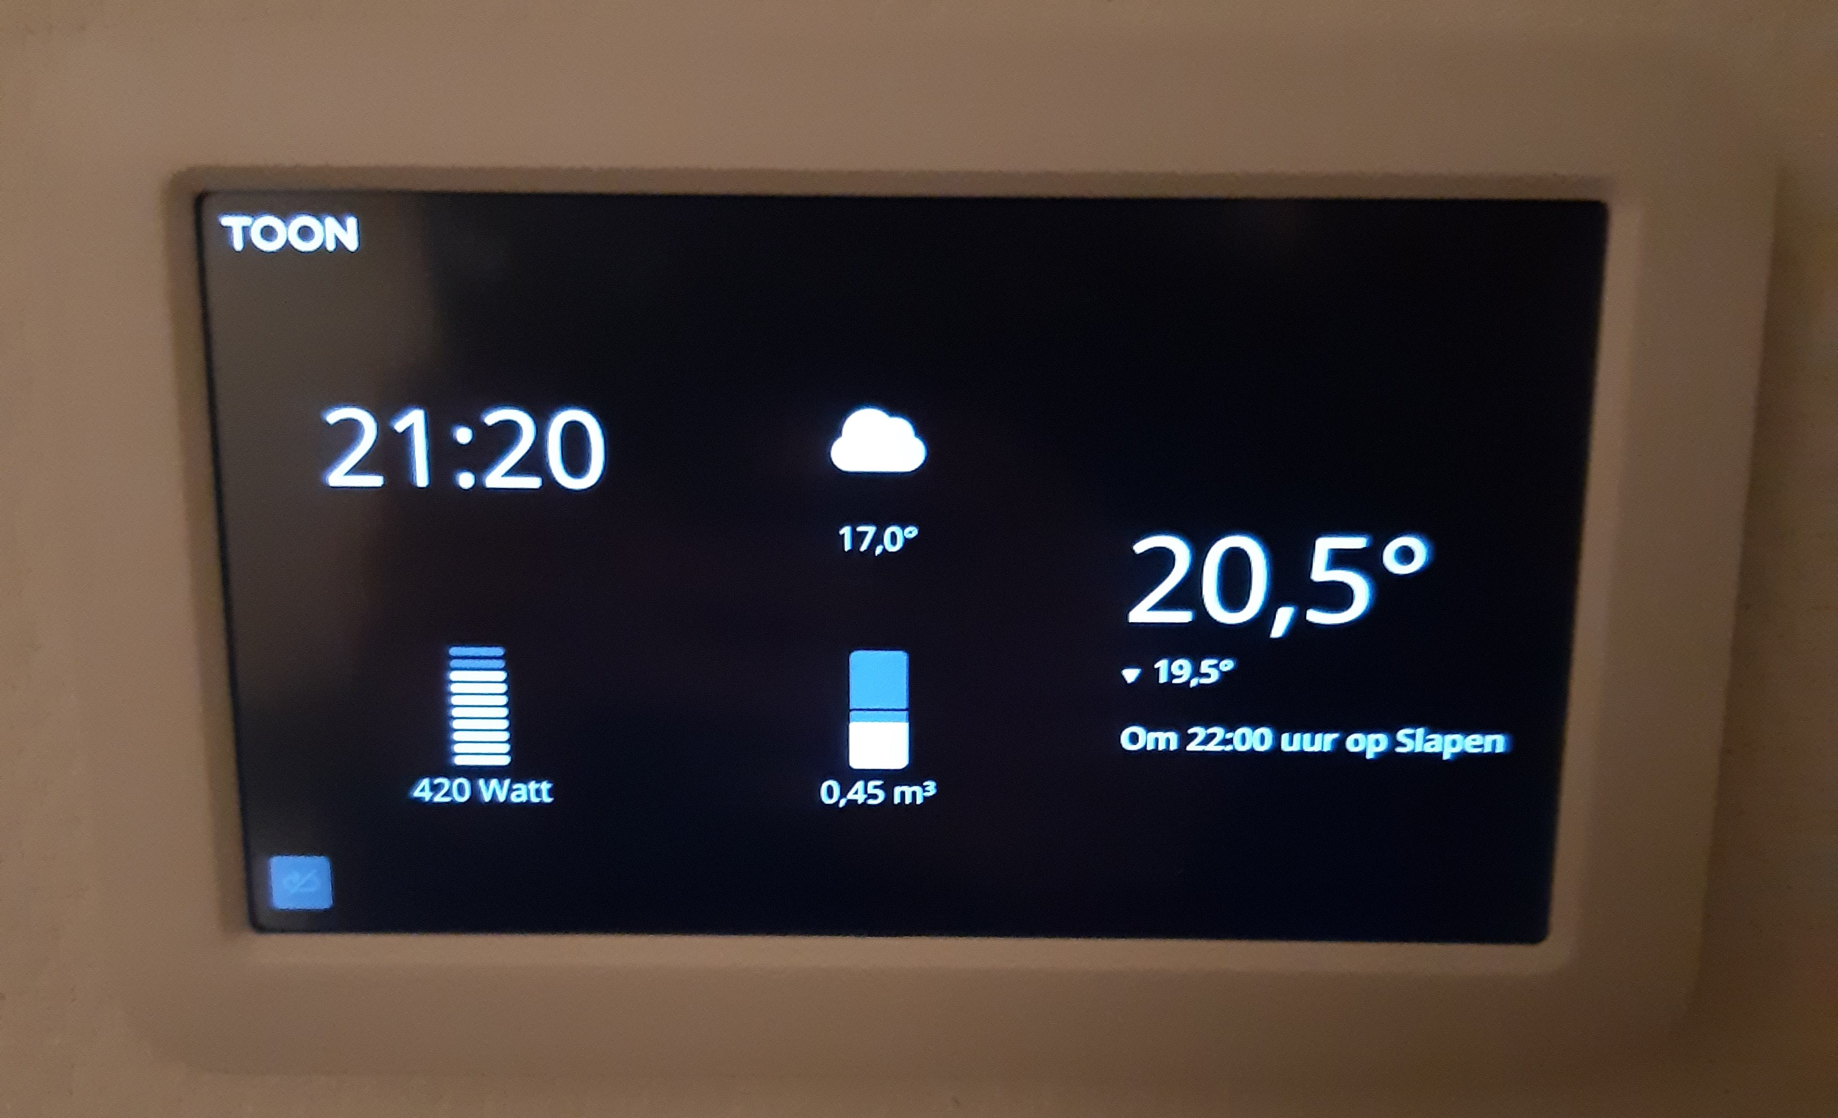
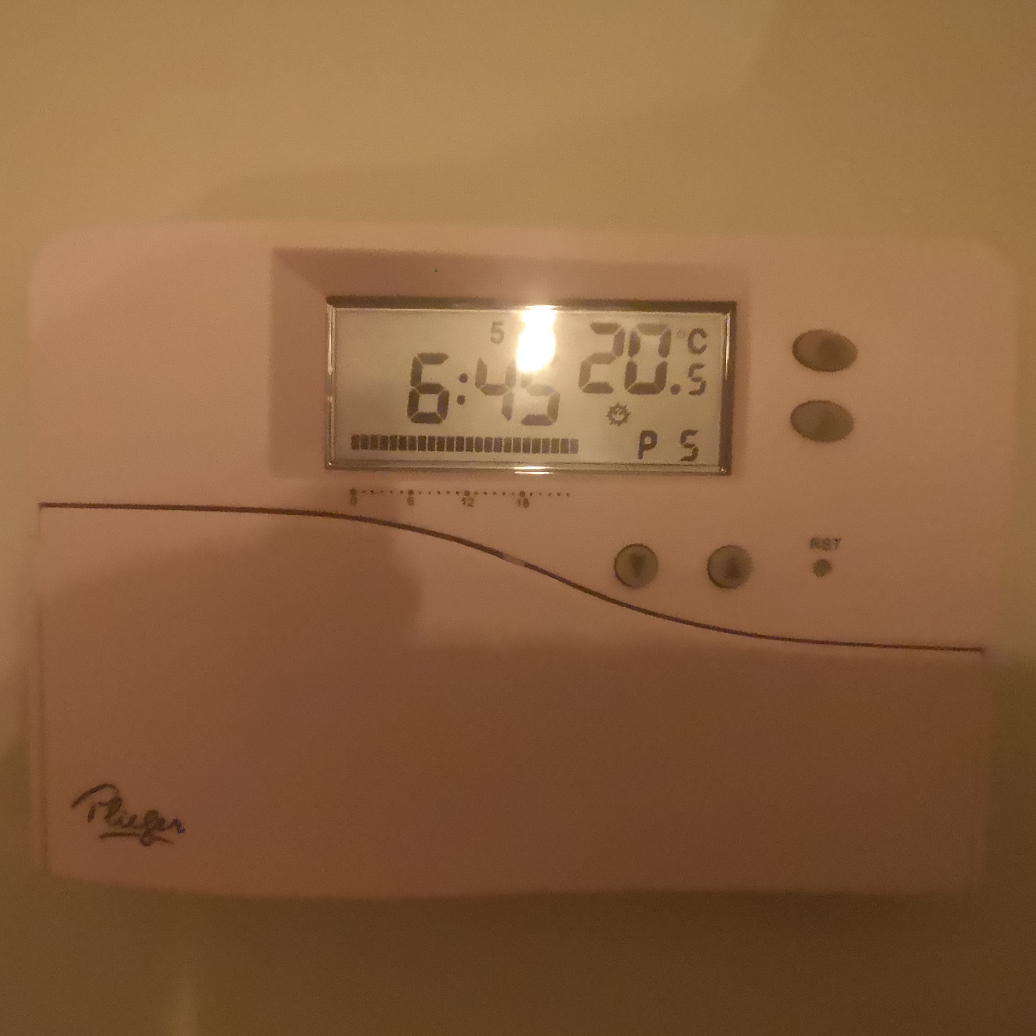
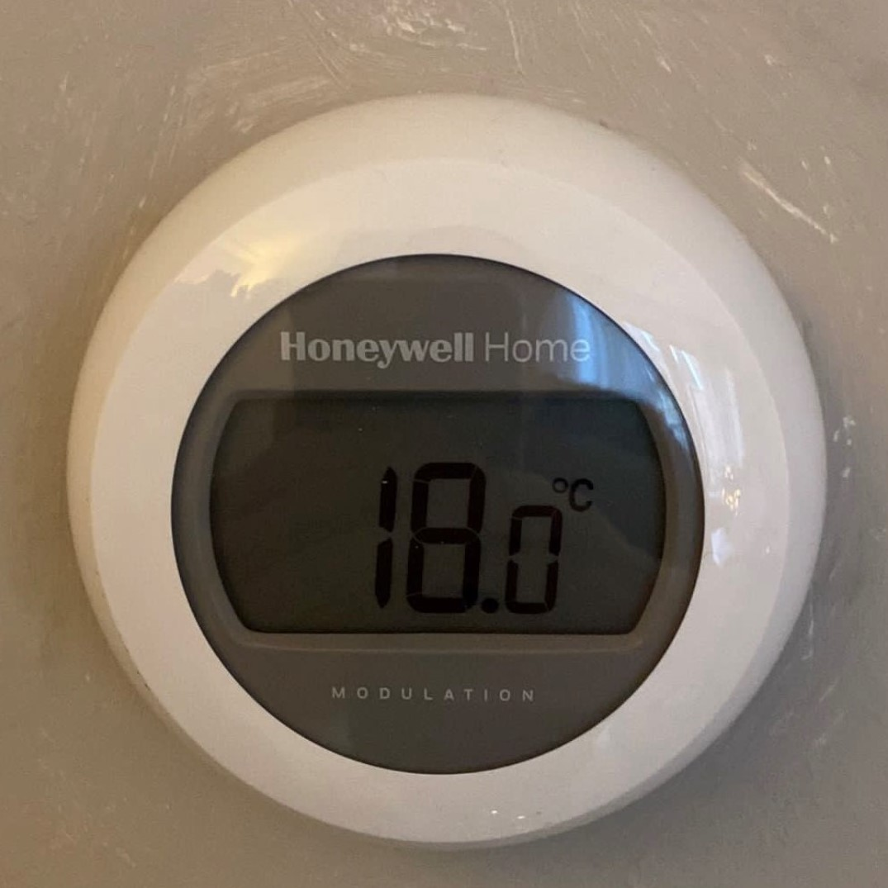
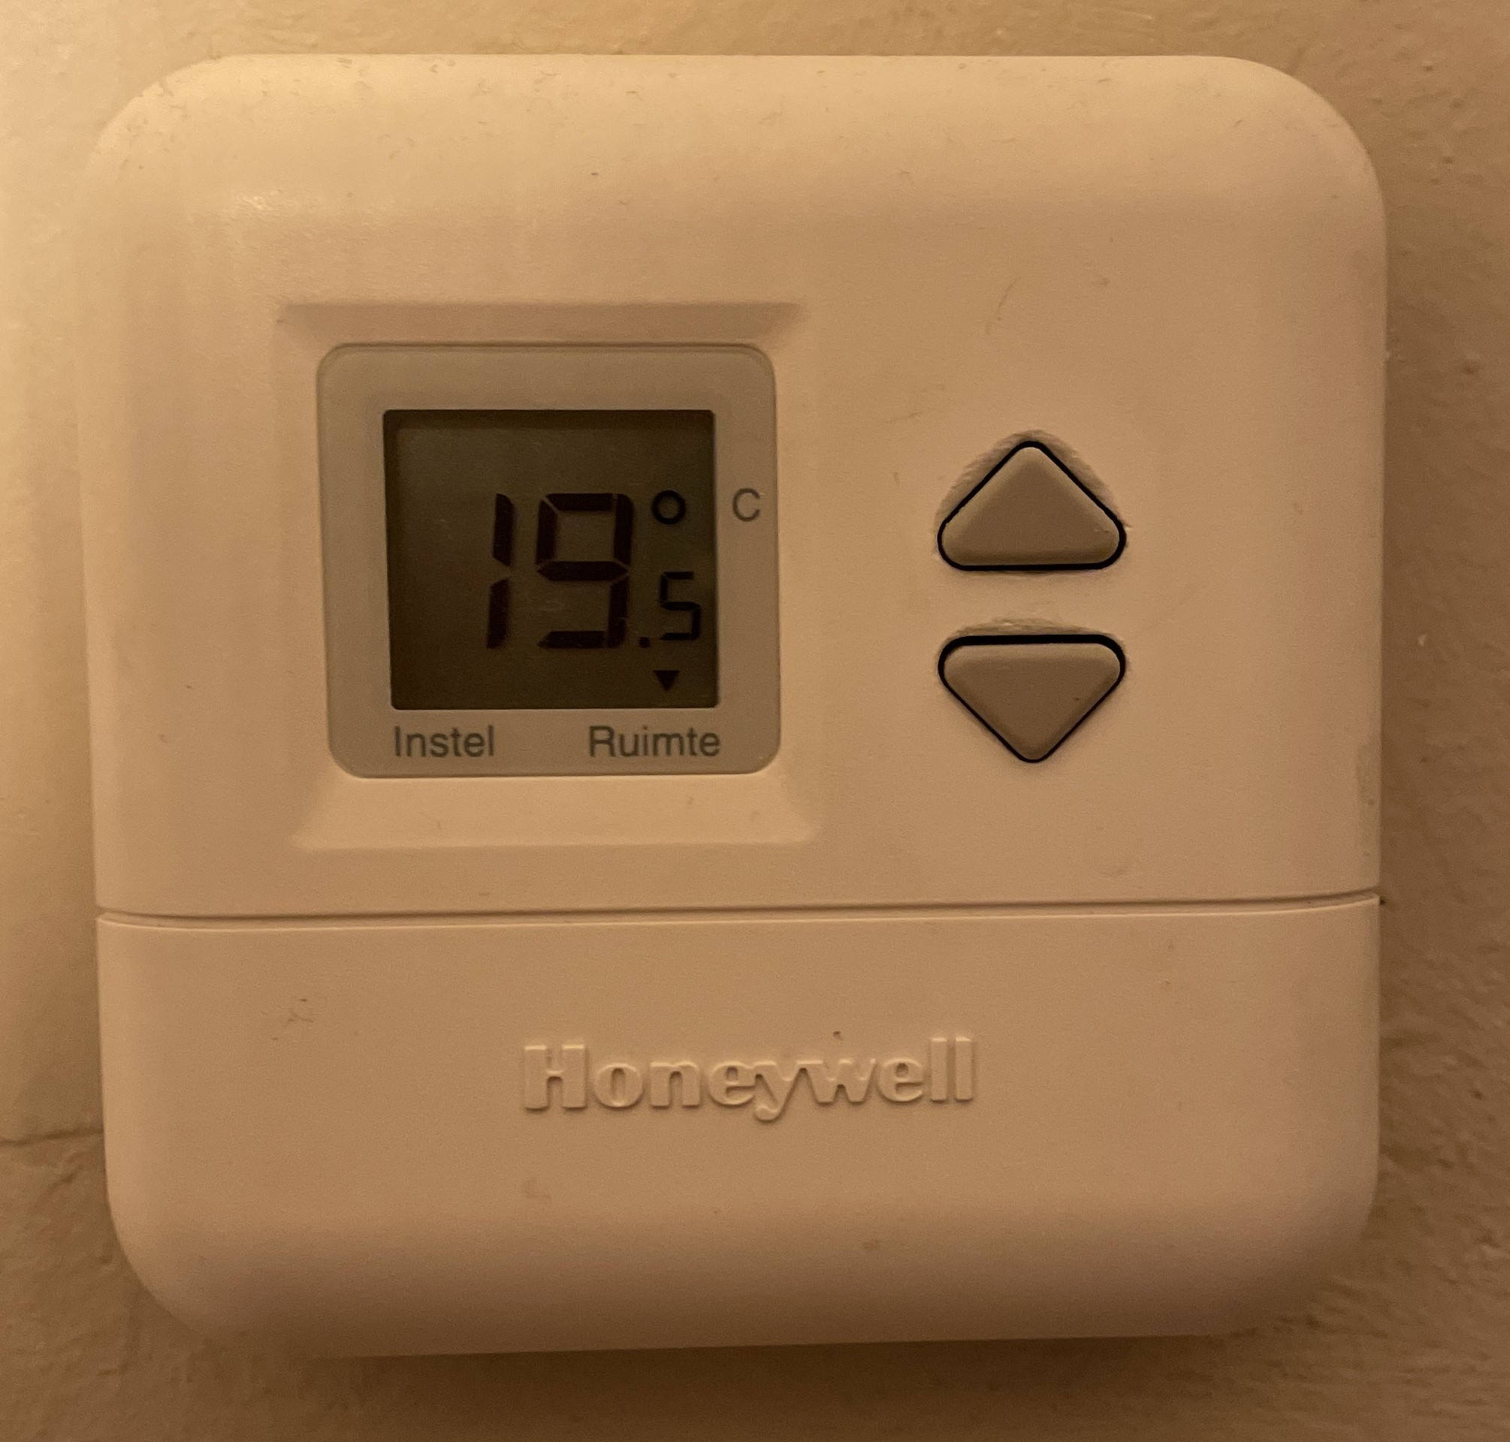
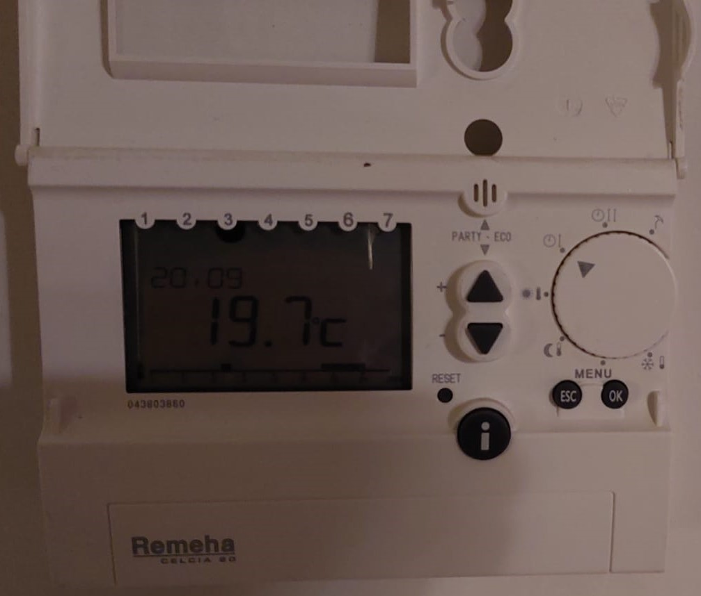
Recruitment: variety in thermostats
Twomes WP2: Data collection
10 brands / 25 models

Slide 17
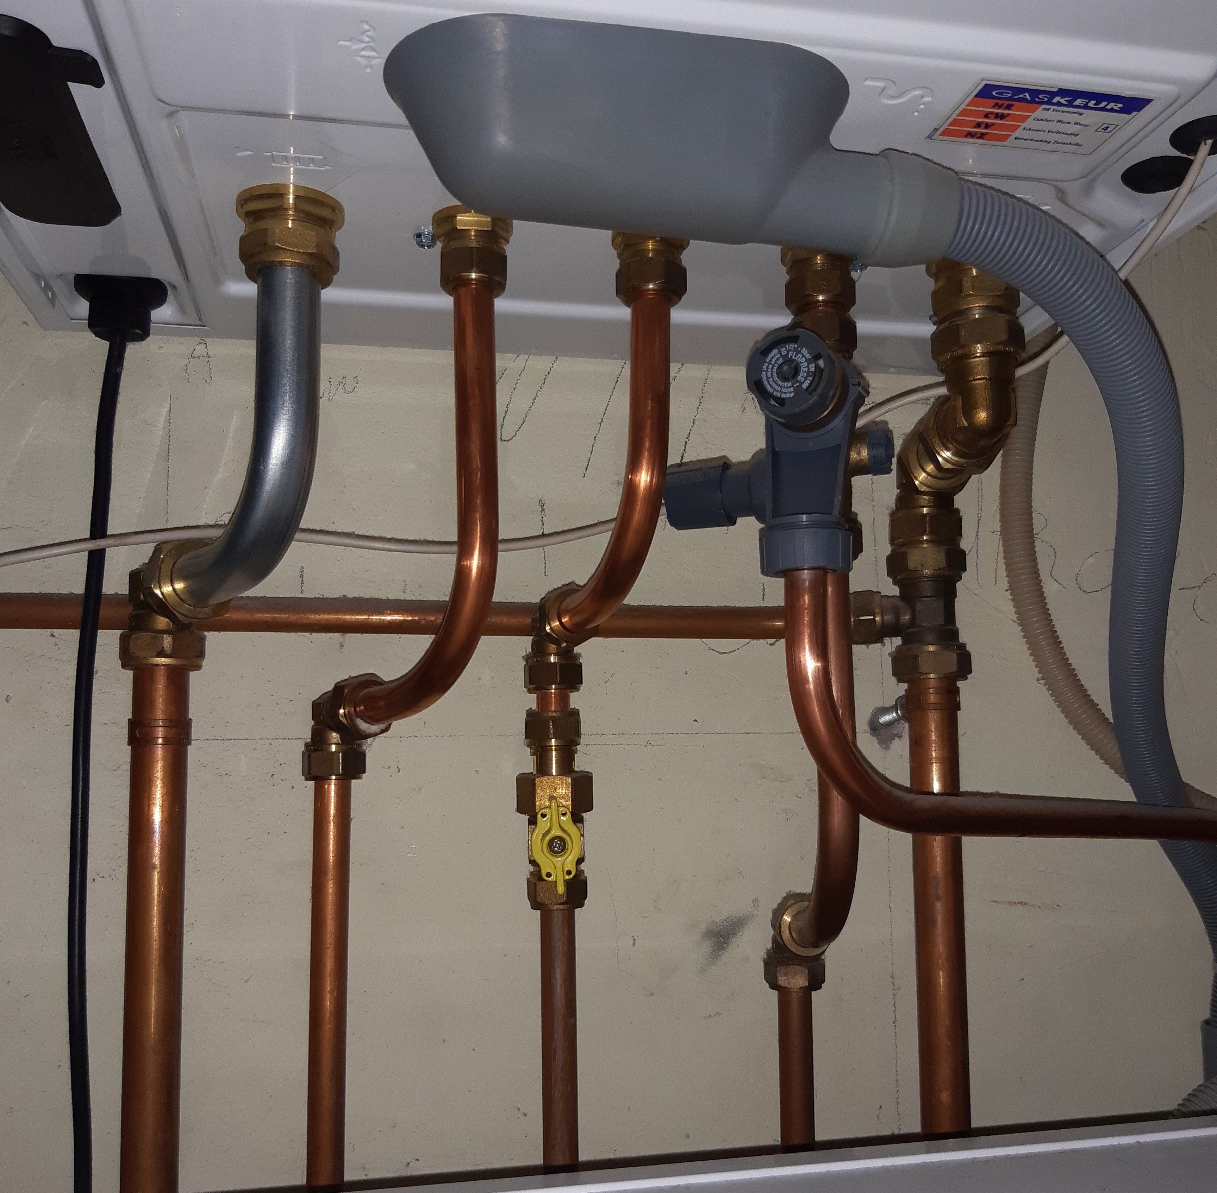
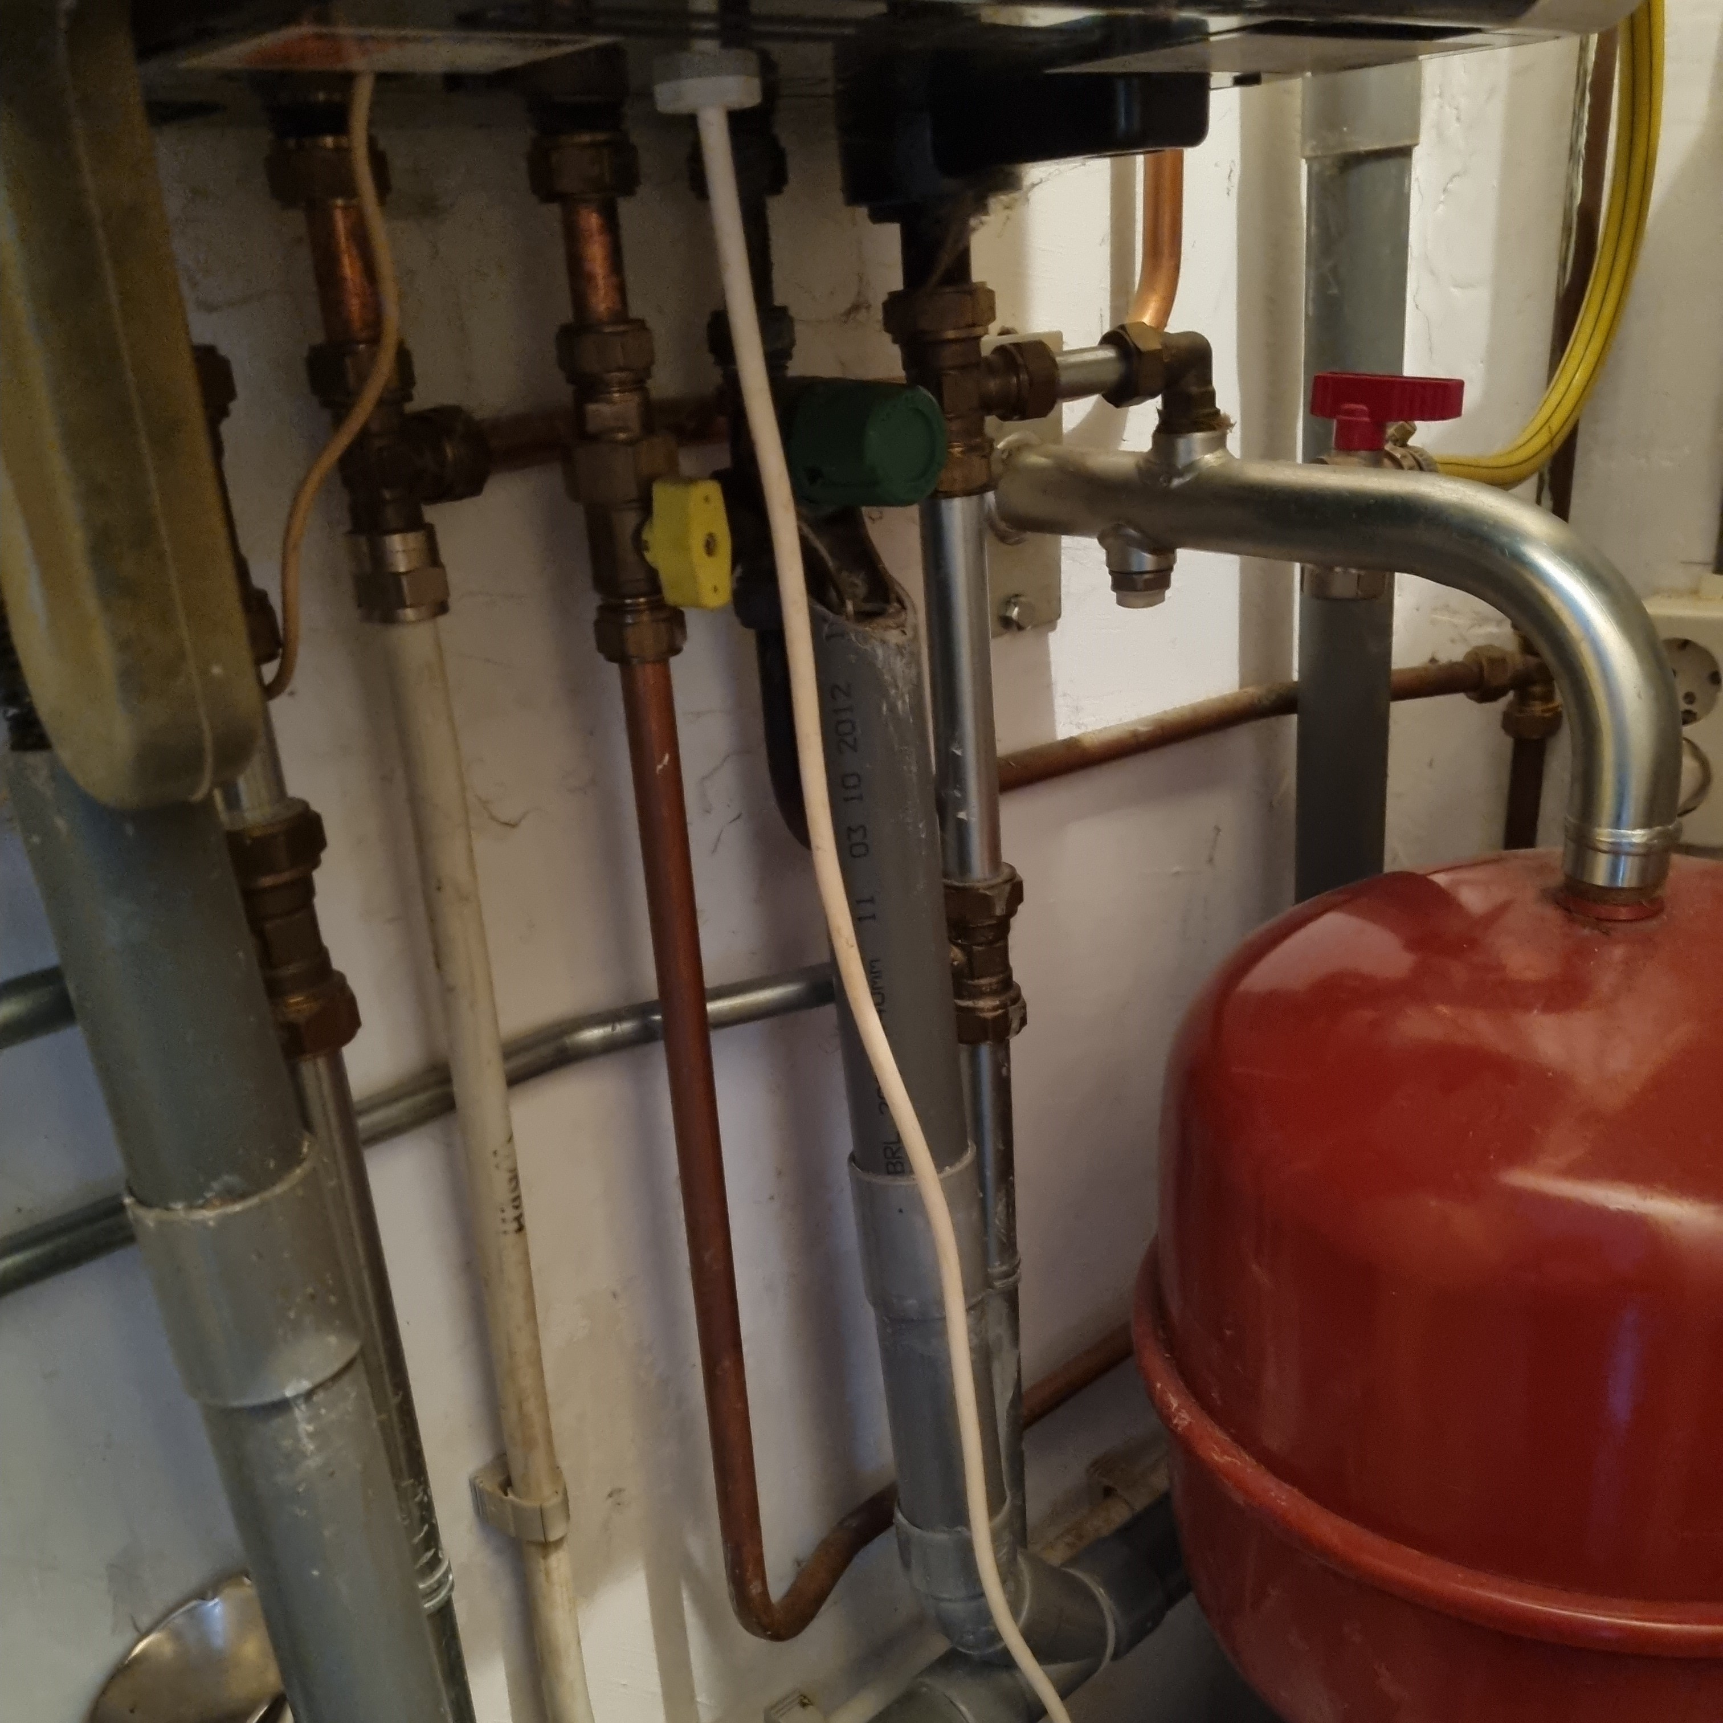
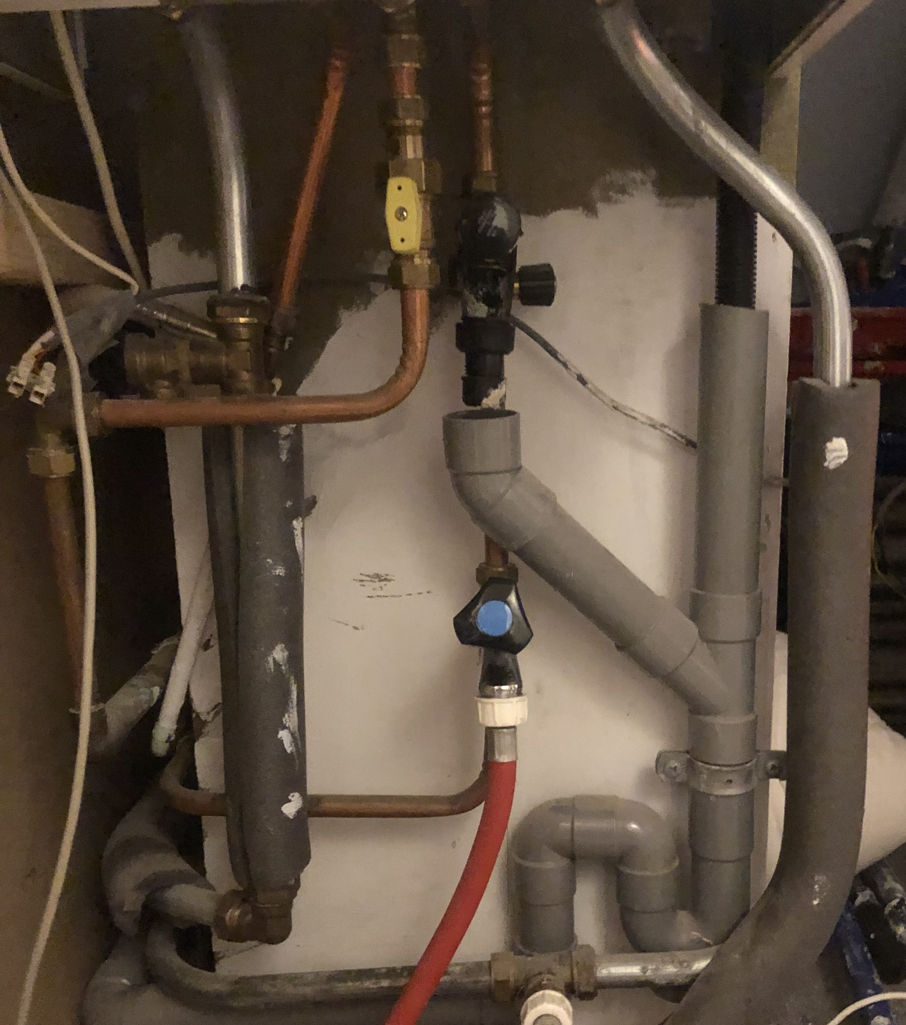
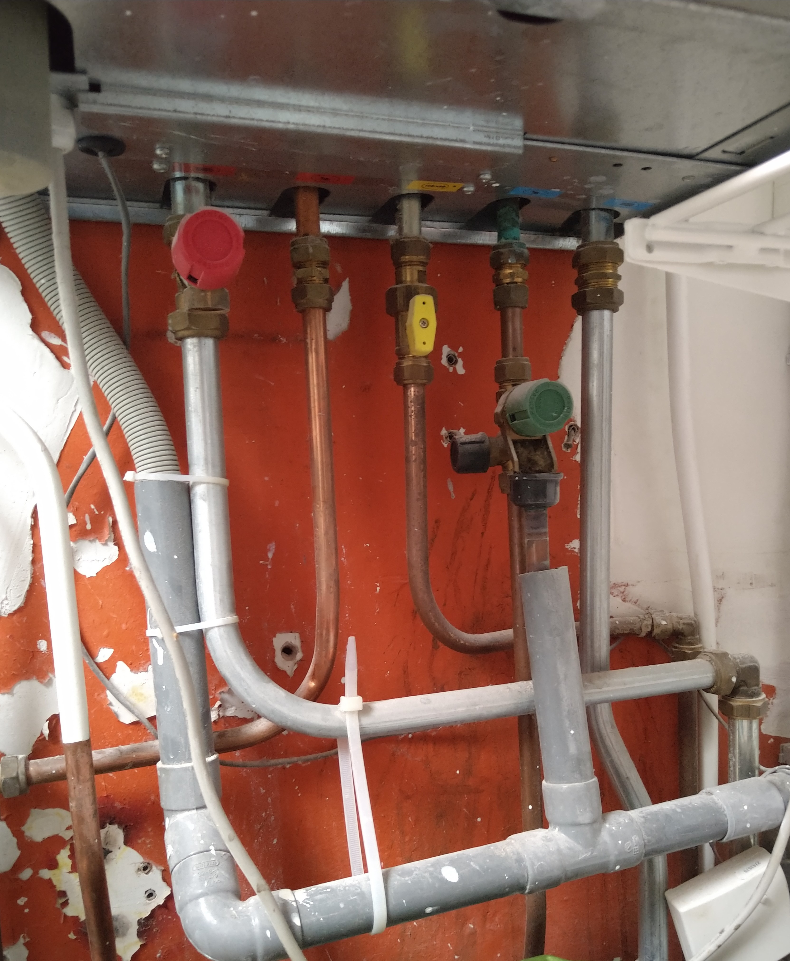
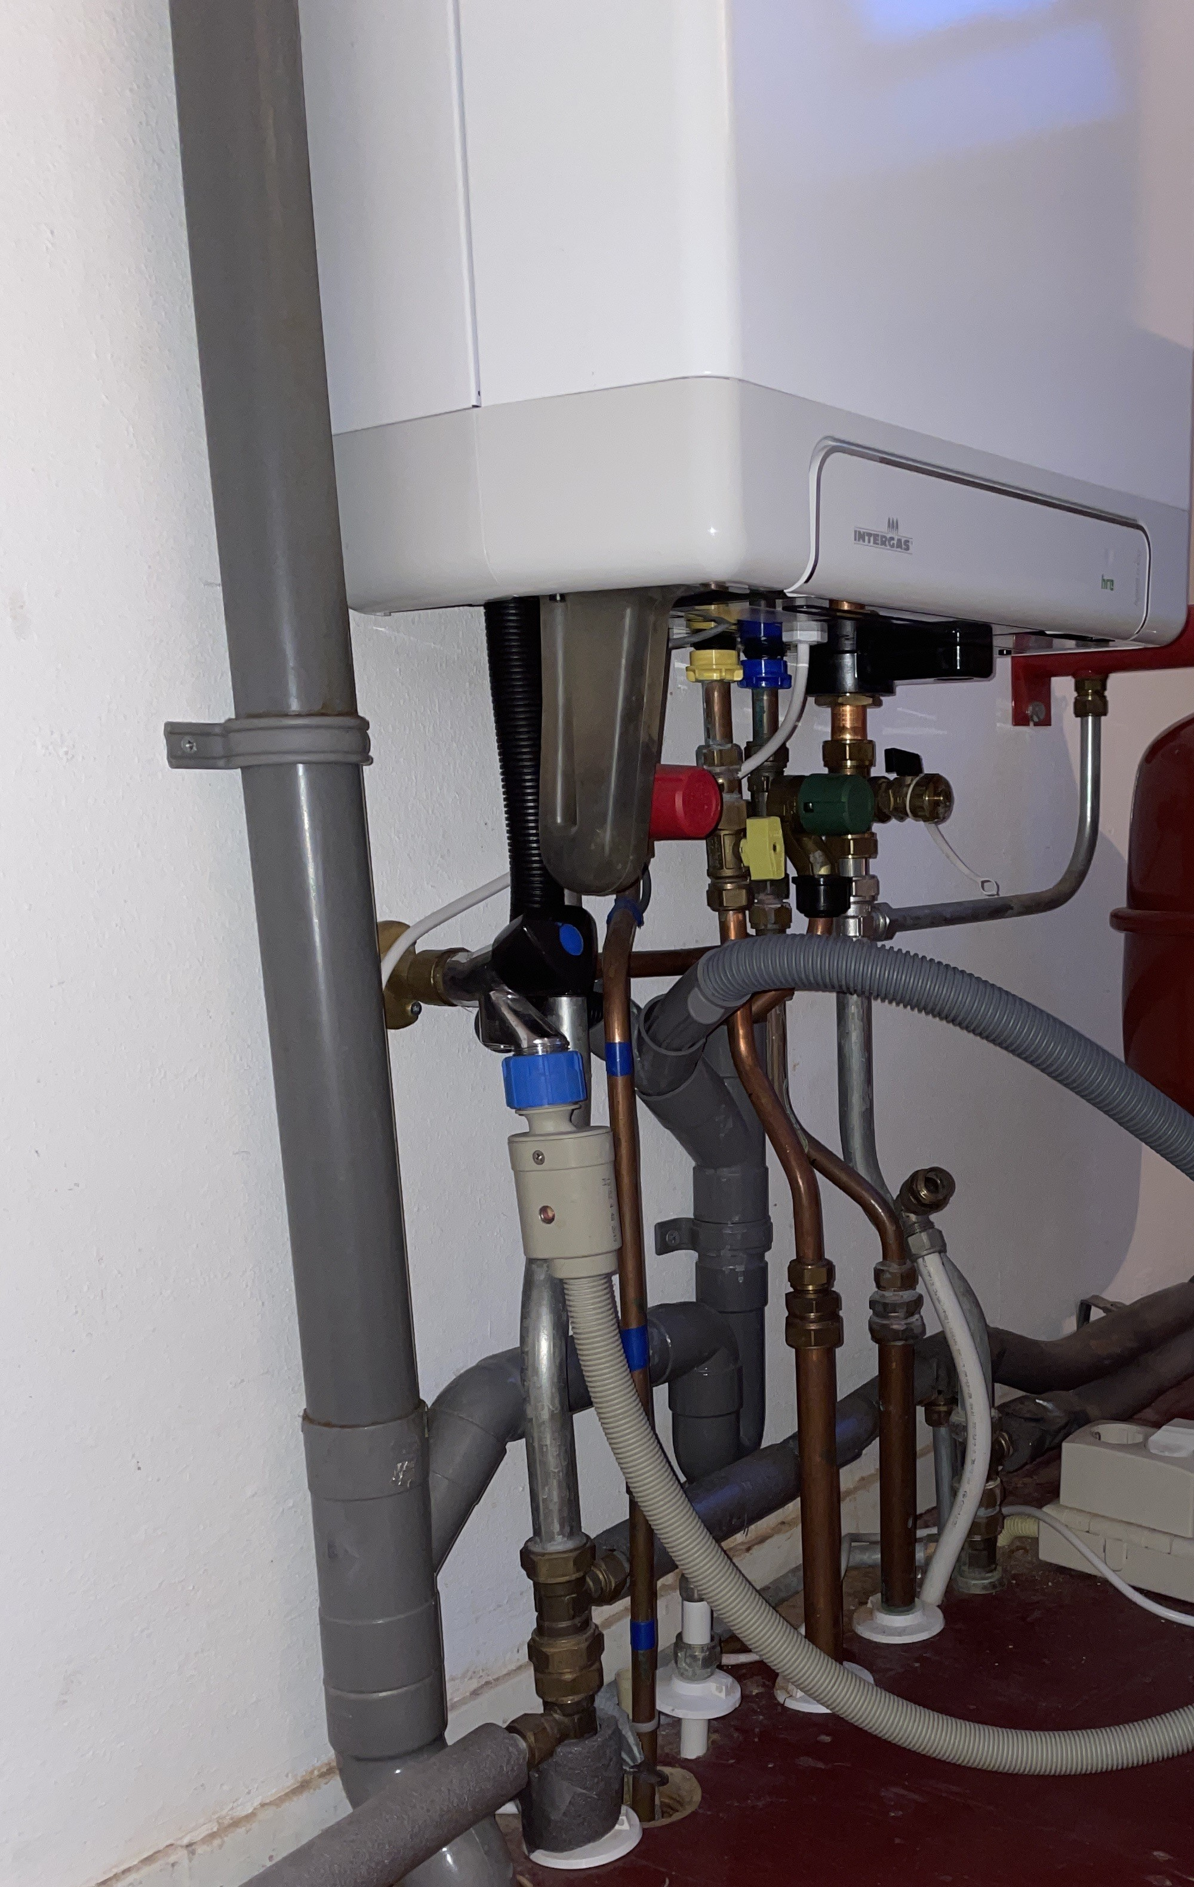
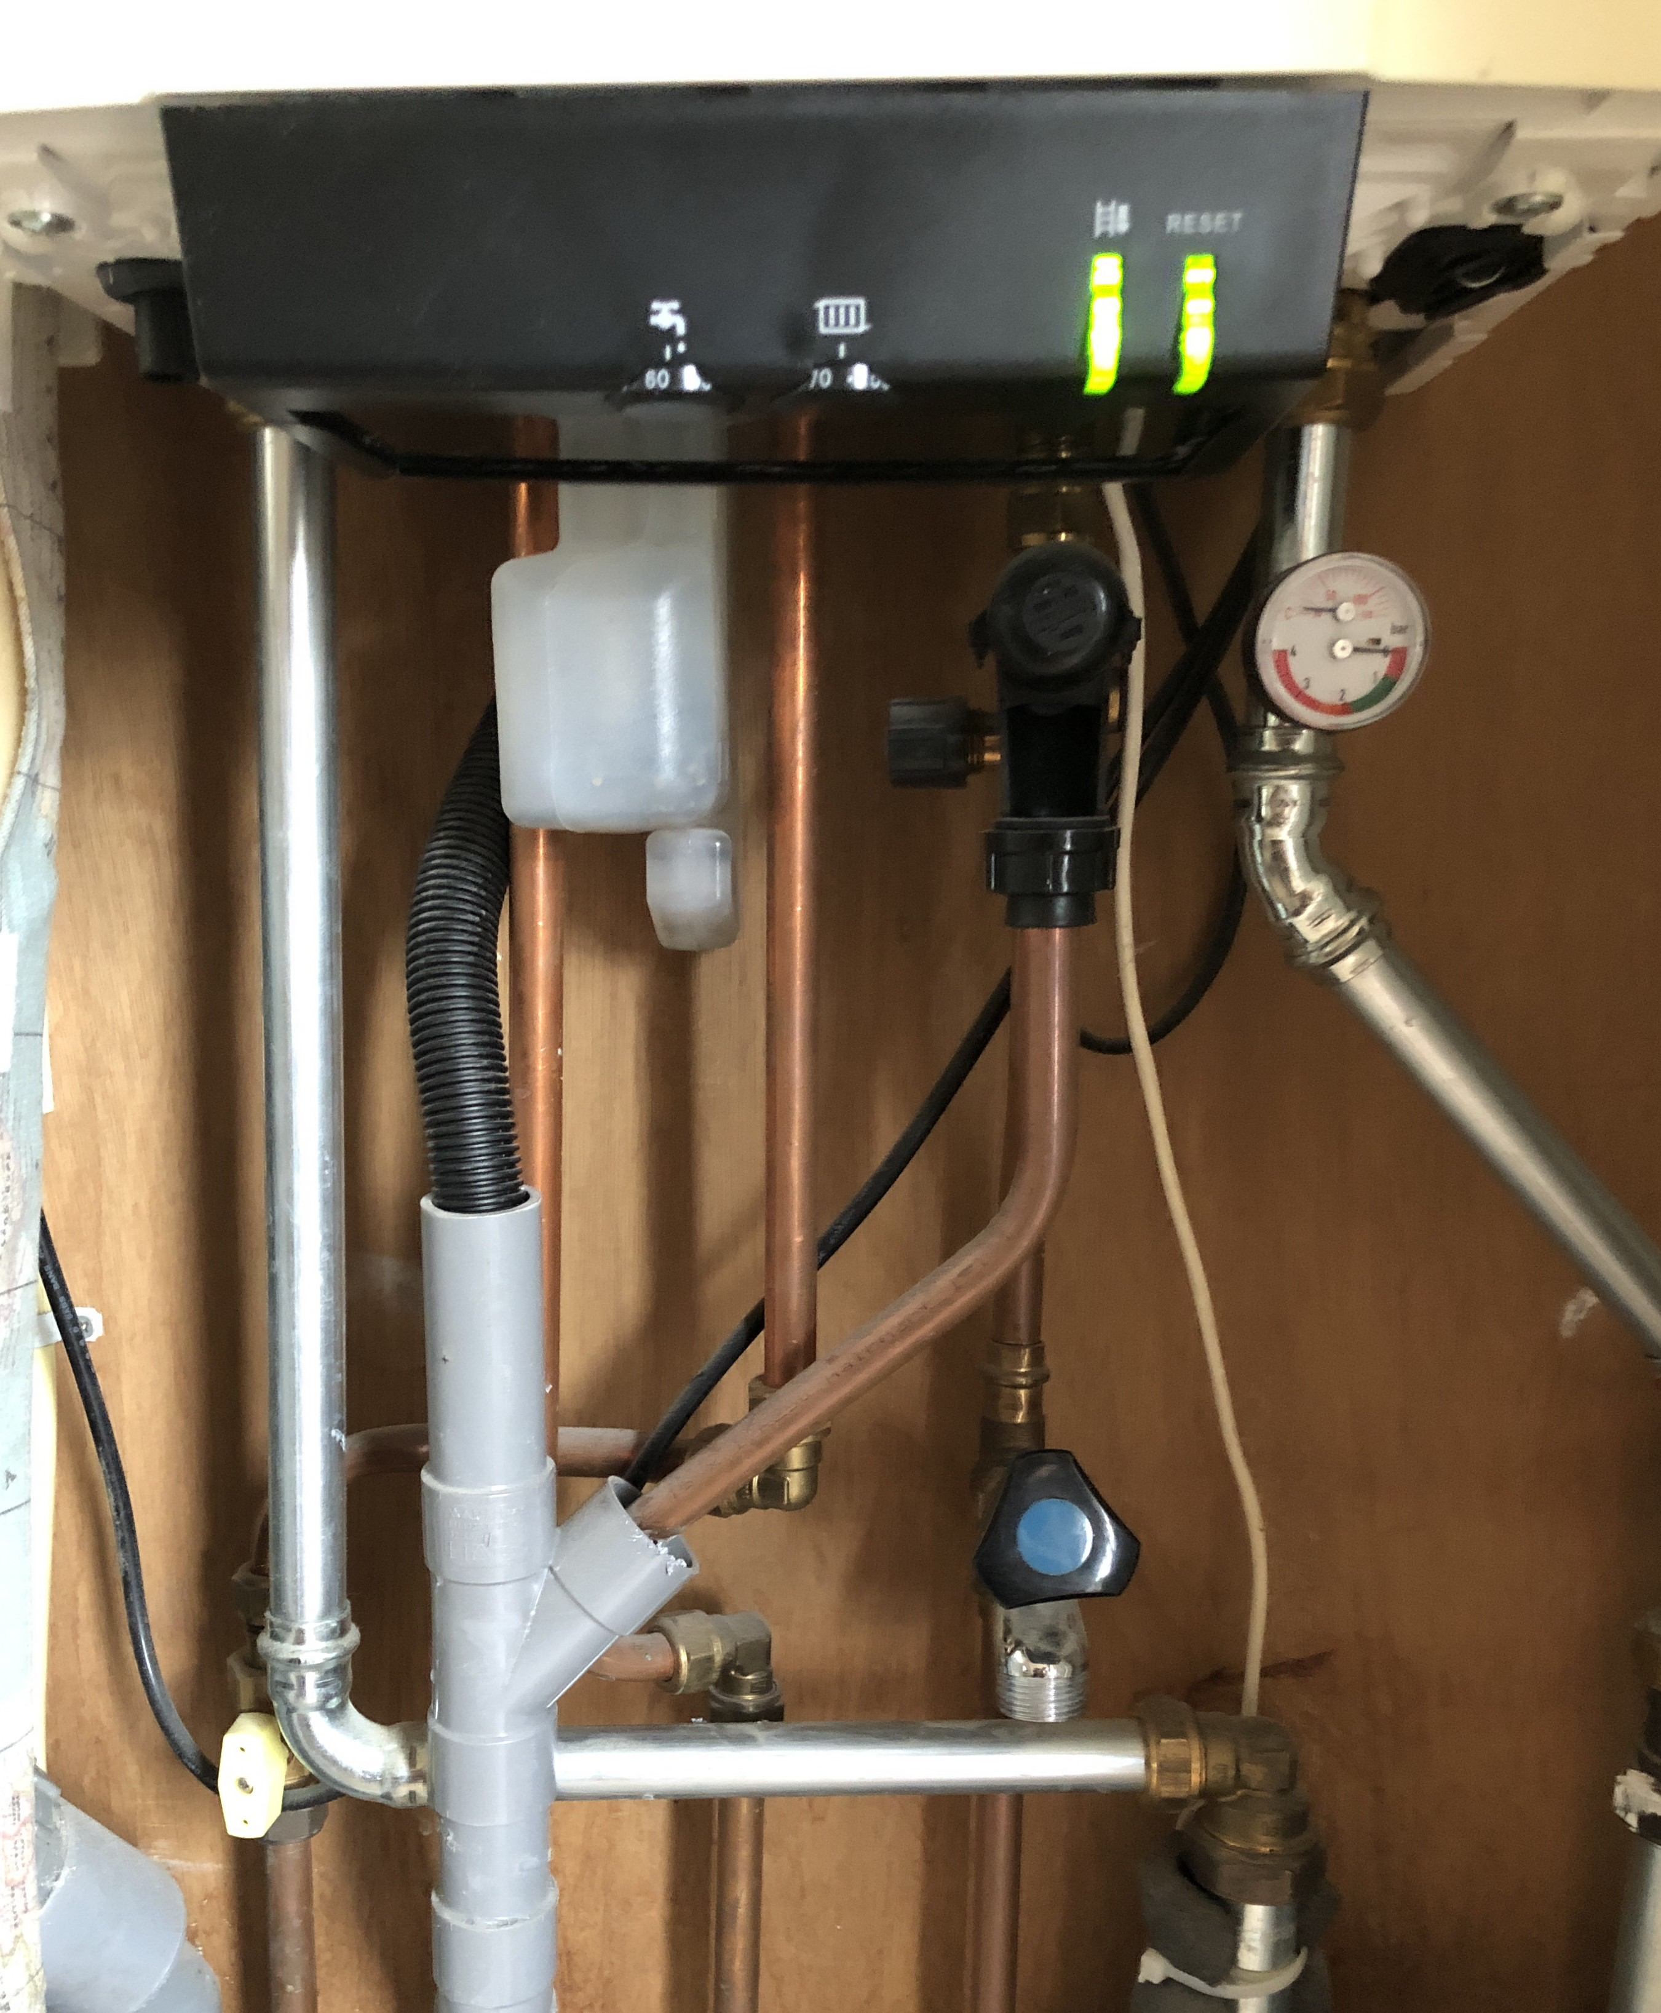
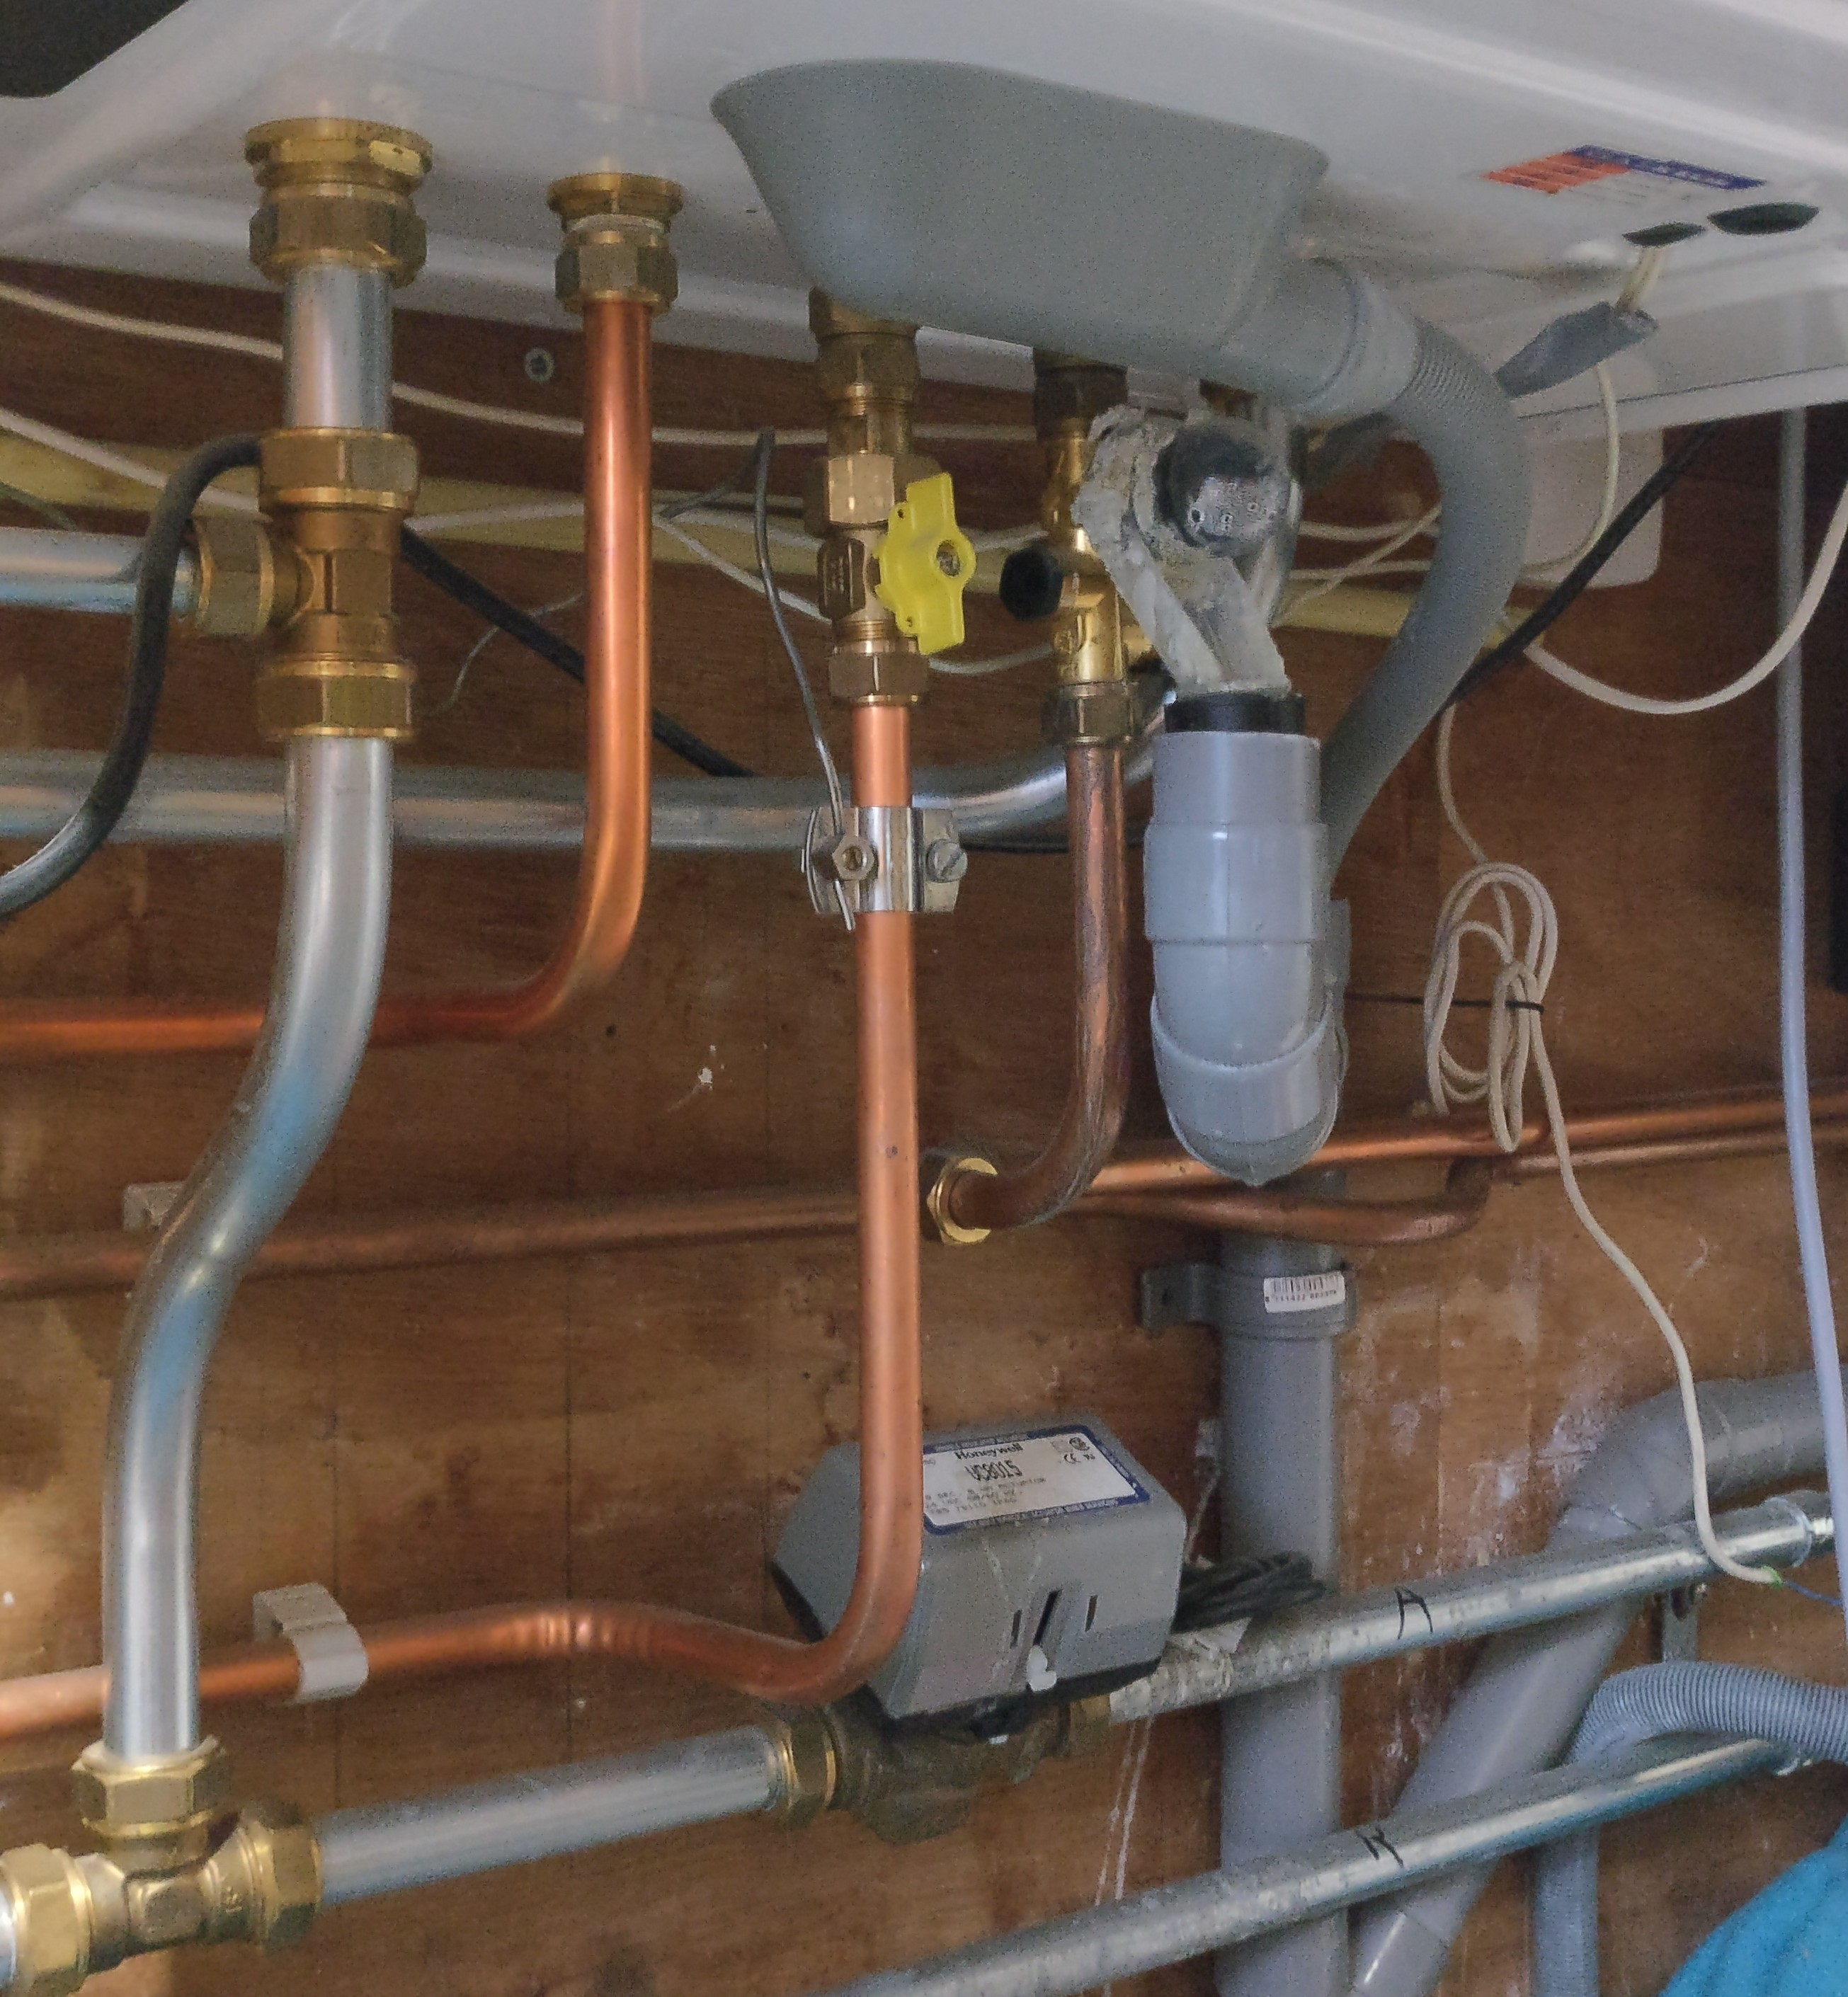
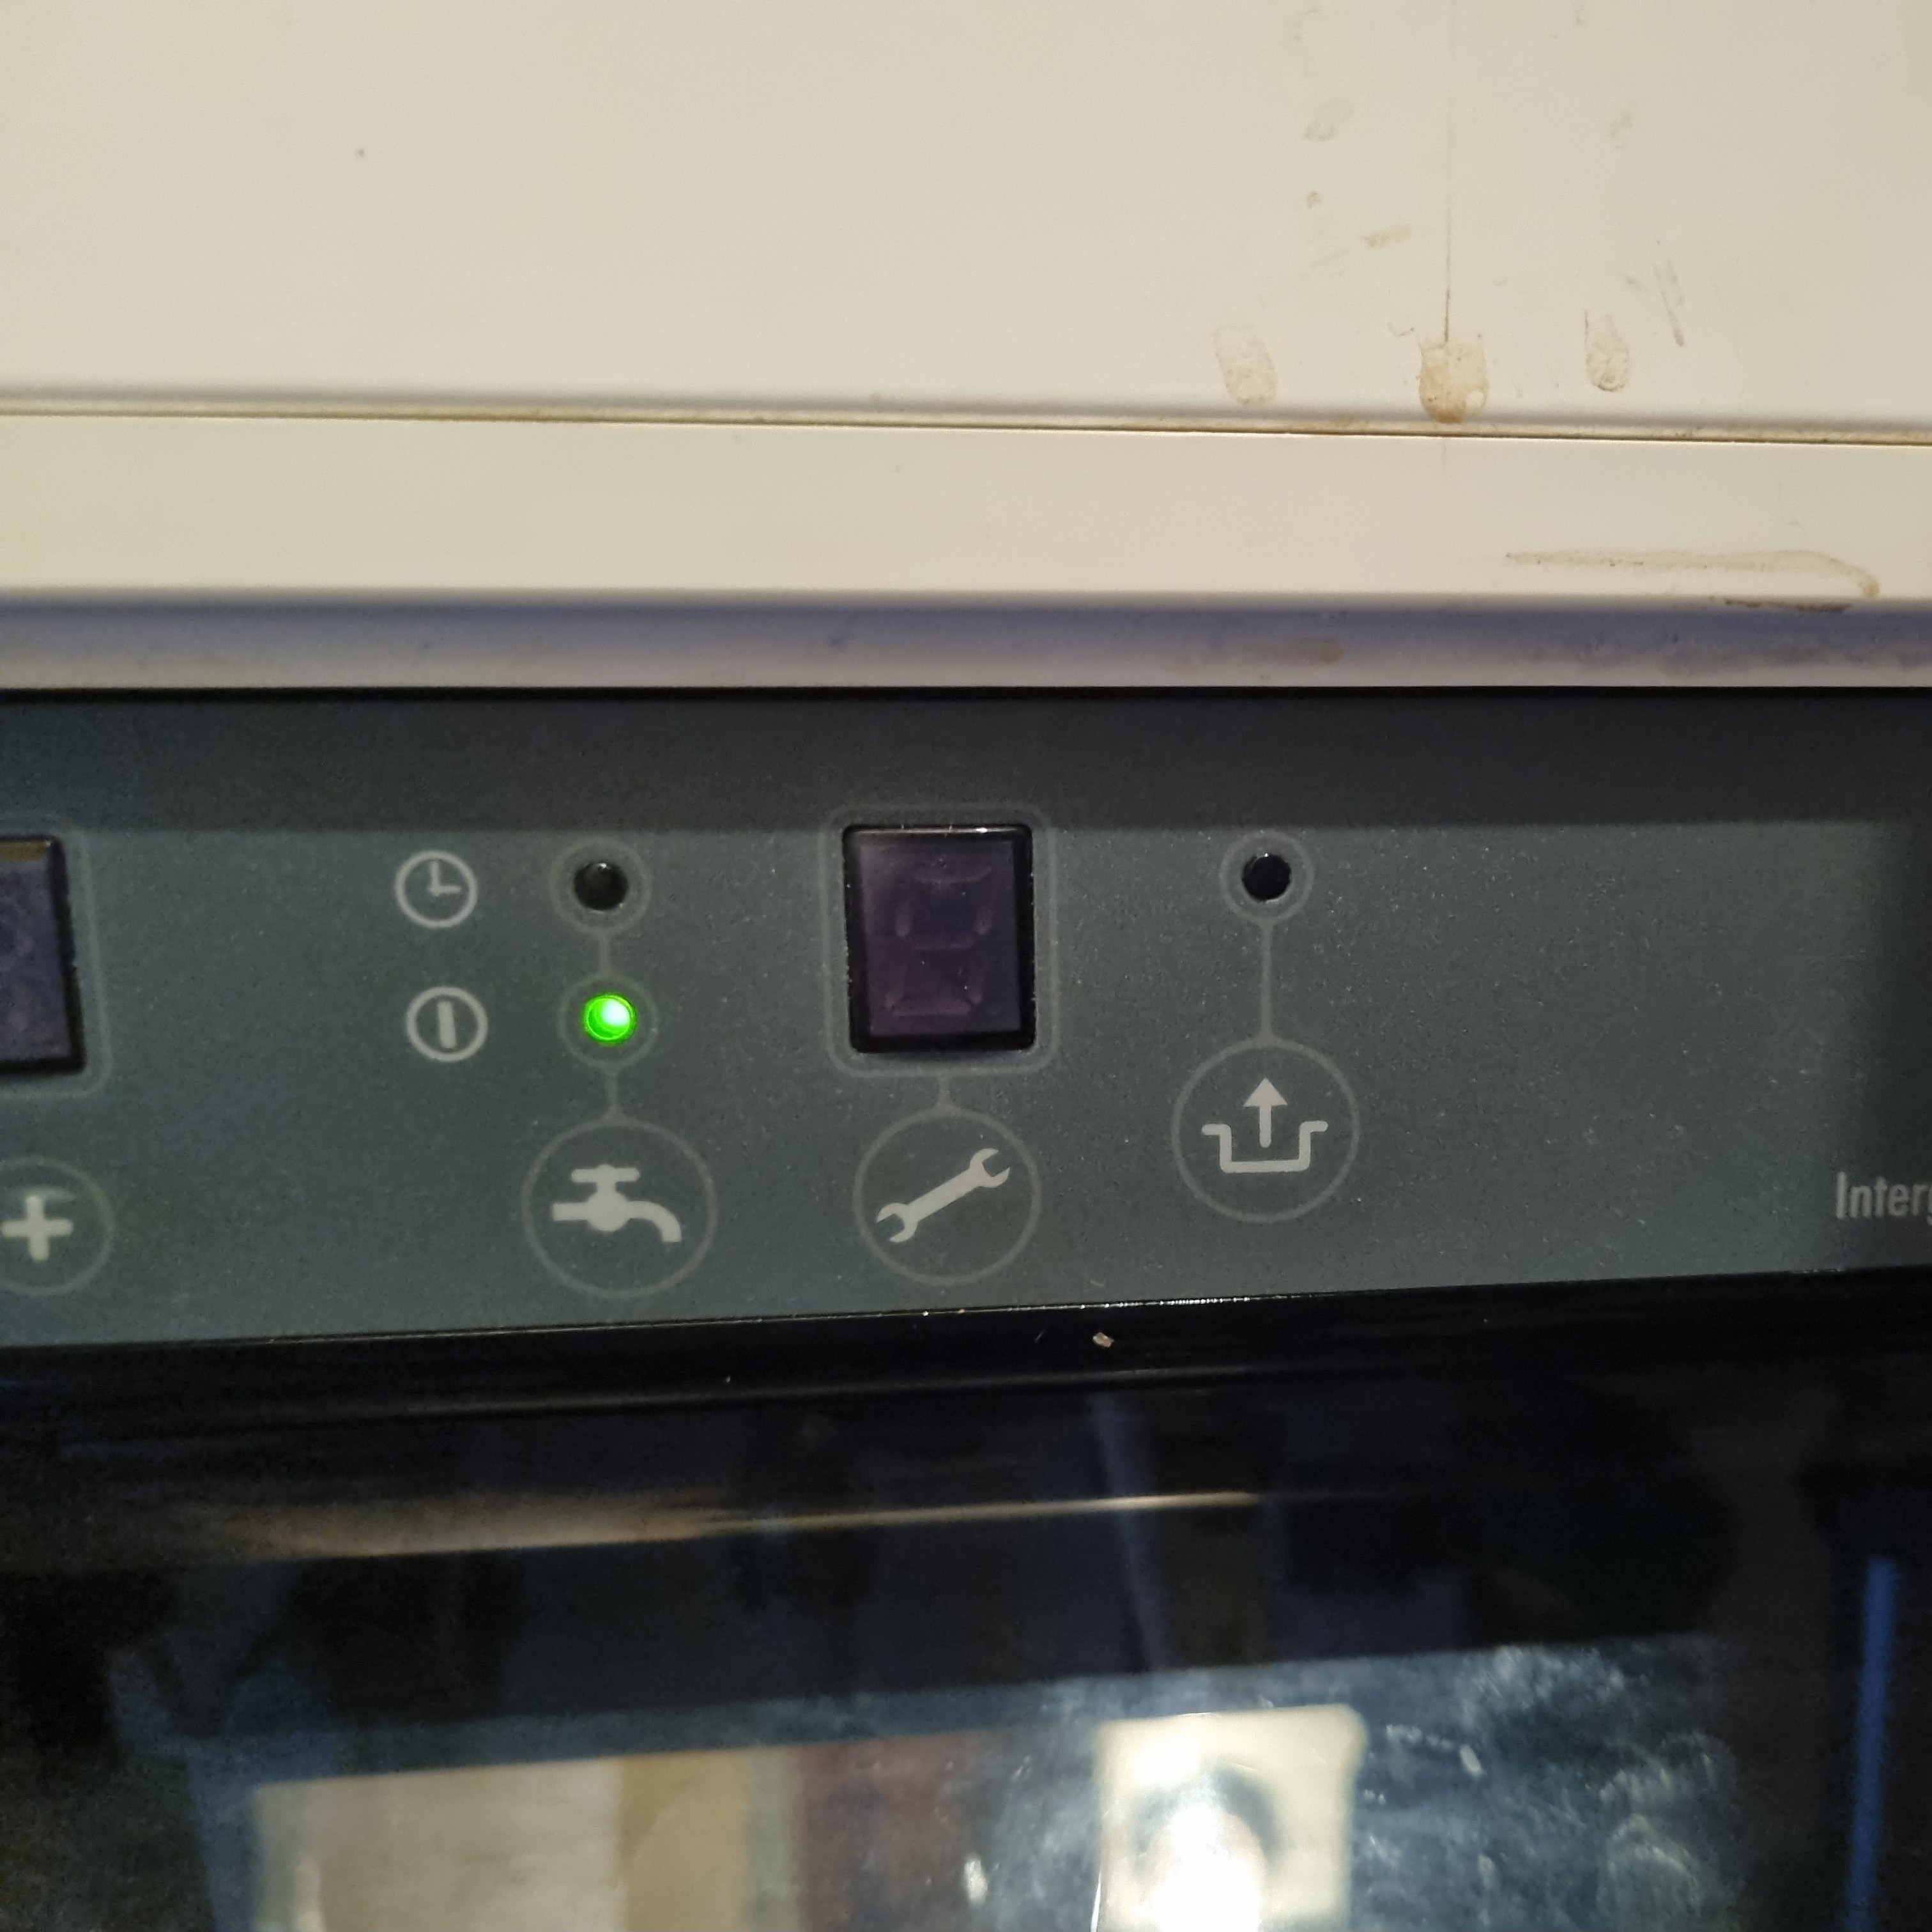
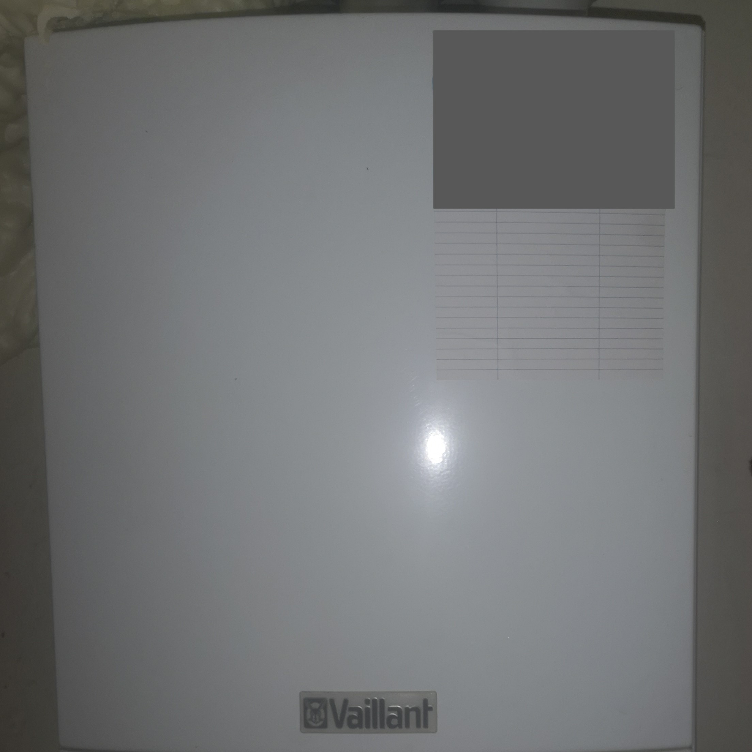
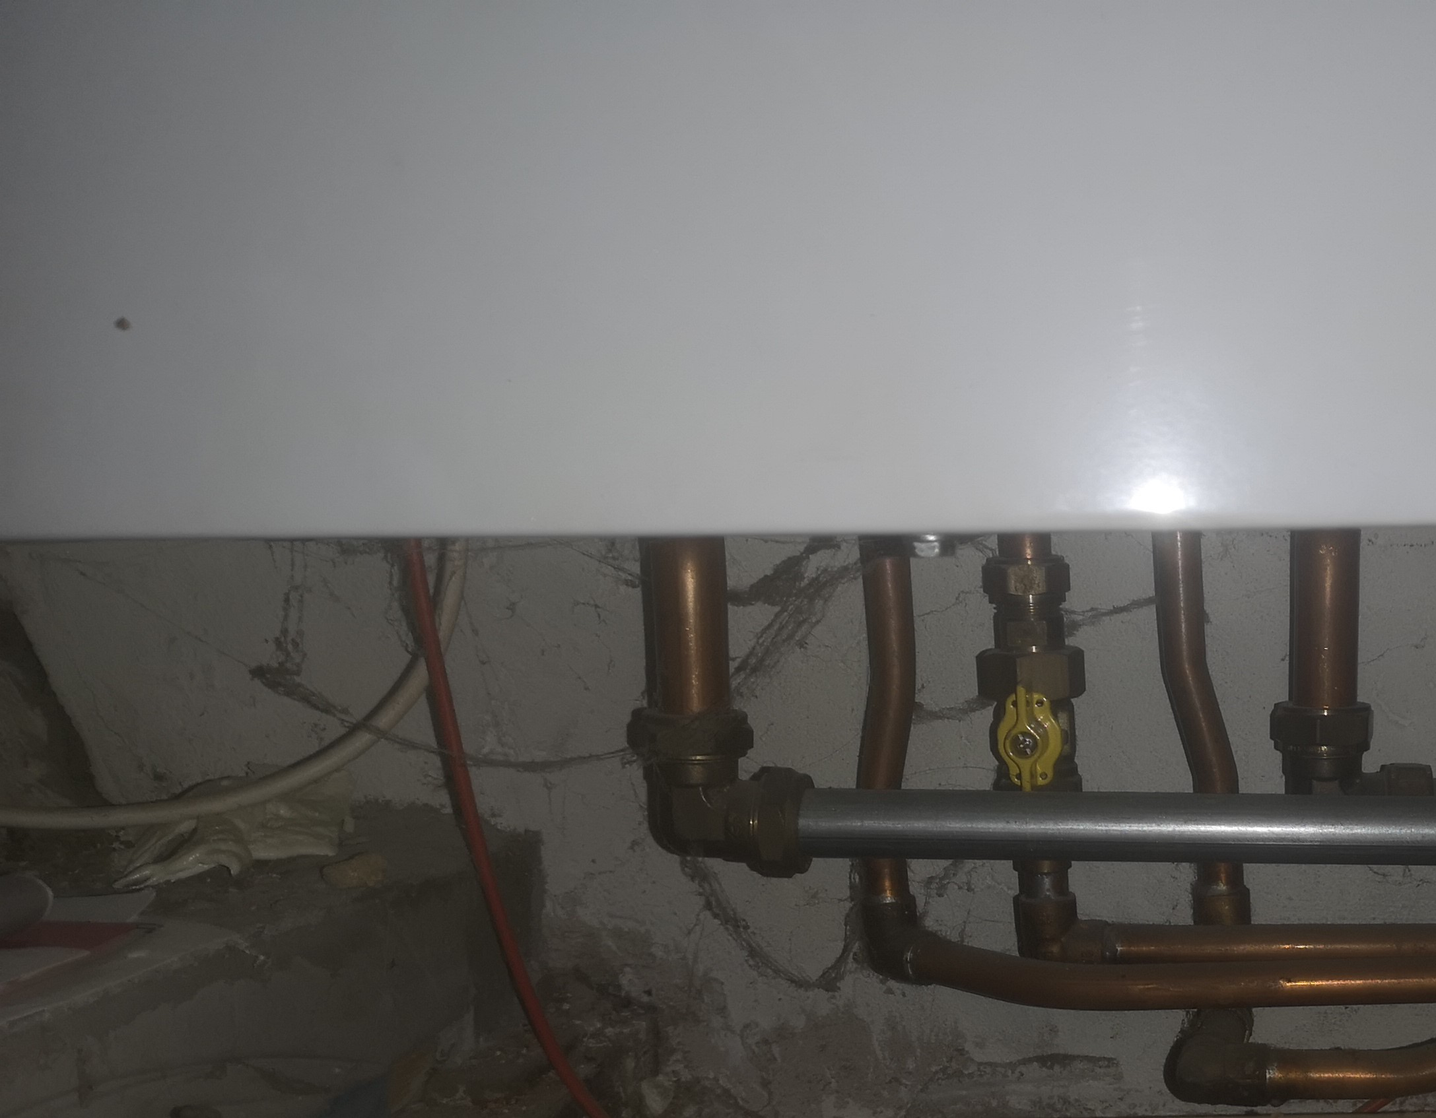
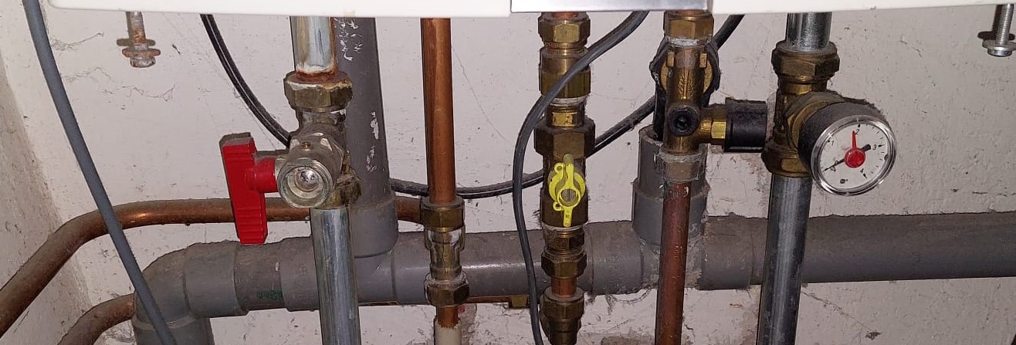
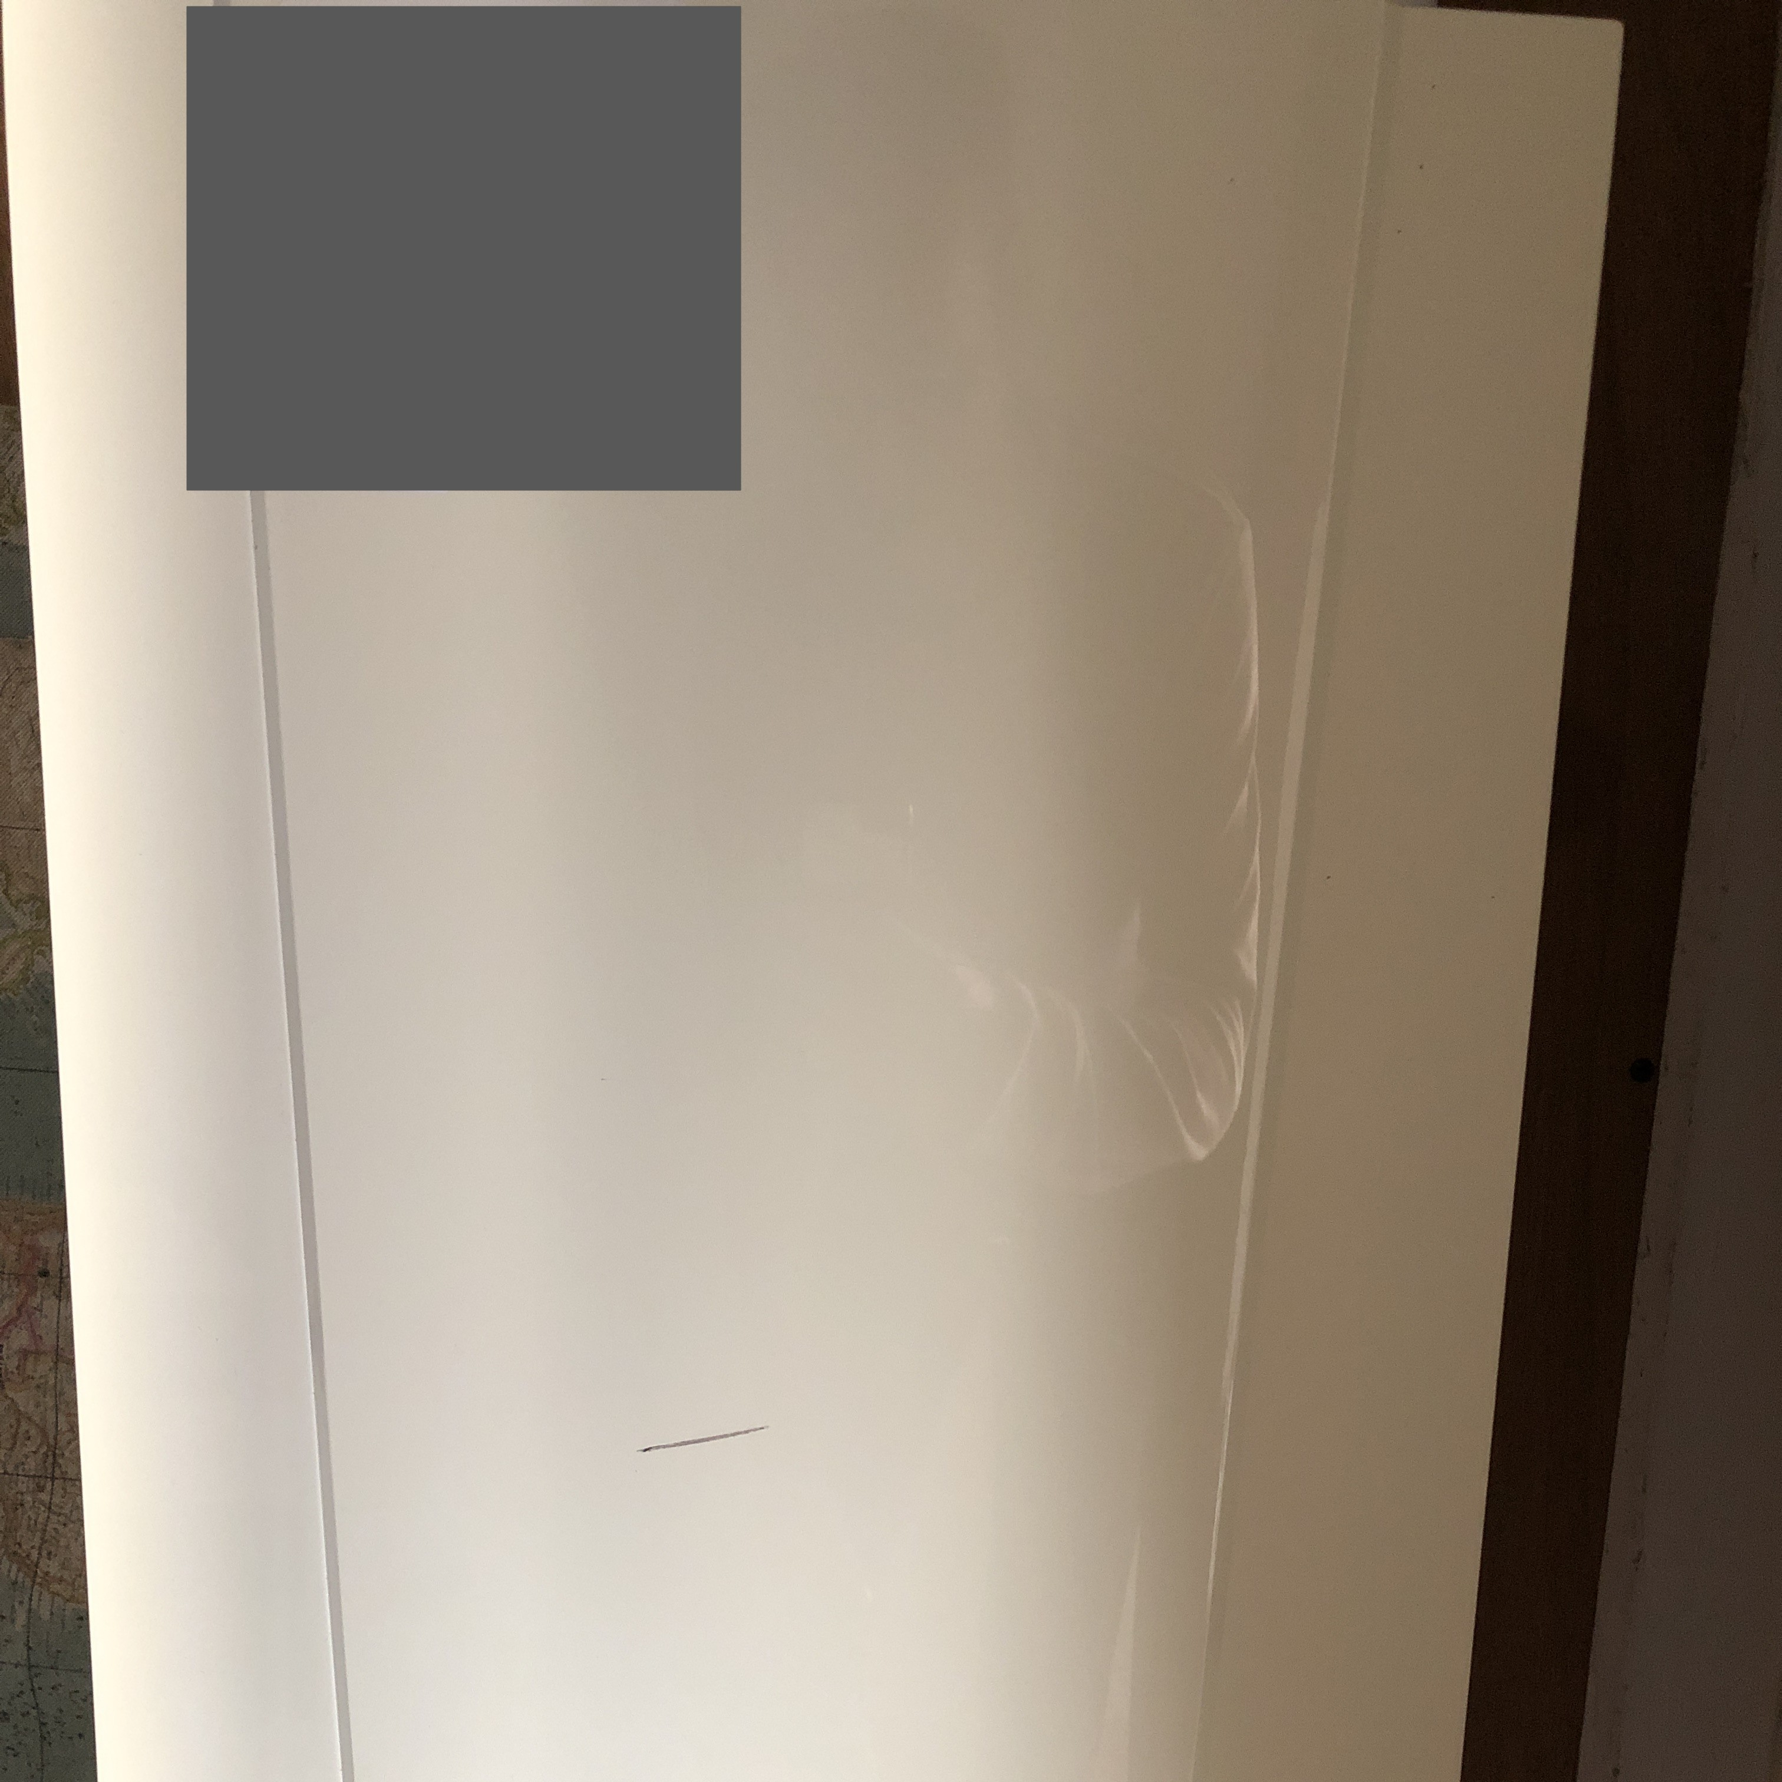
Recruitment: variety in boilers (+thermostats)
Twomes WP2: Data collection
boiler: 6 brands / 10 models
OpenTherm compatible: 27 yes / 13 no
boiler-thermostat-combis: 17 brand-brand 35 model-model

Slide 18
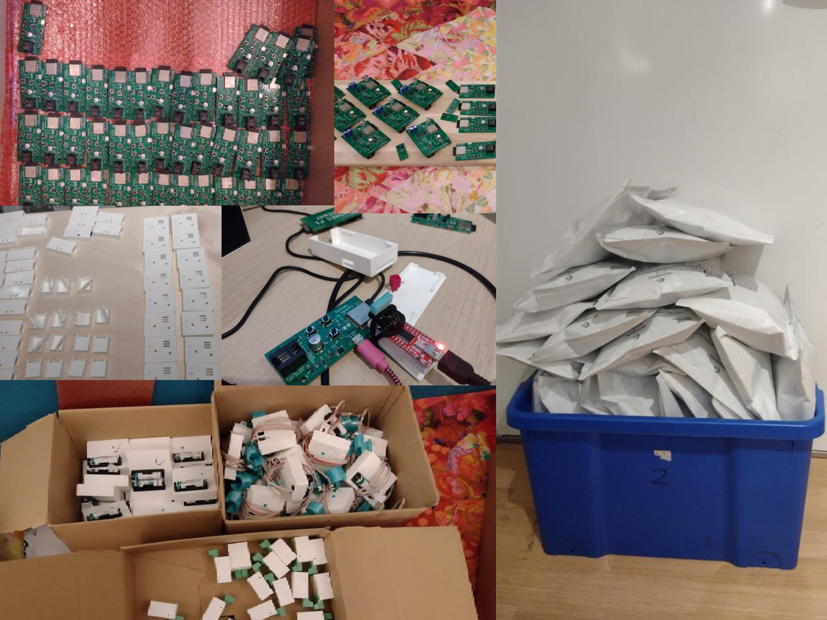
Device preparation
Twomes WP2: Data collection

Slide 19
Device deployment
Twomes WP2: Data collection

Slide 20
Device deployment: 04-jan-22
Twomes WP2: Data collection
Status | # homes | # step loss | step success % | remaining %
Invited | 40 |  |  | 100 %
did not end participation | 37 | 3 | 93 % | 93 %
app activated | 32 | 5 | 86 % | 80 %
≥ 1 device activated | 24 | 8 | 75 % | 60 %
all devices activated | 20 | 4 | 83 % | 50 %
≥ 1 data source ok | 19 | 1 | 95 % | 48 %
all data sources ok | 8 | 11 | 42 % | 20 %
all data sources still ok | 4 | 4 | 50 % | 10 %

Slide 21
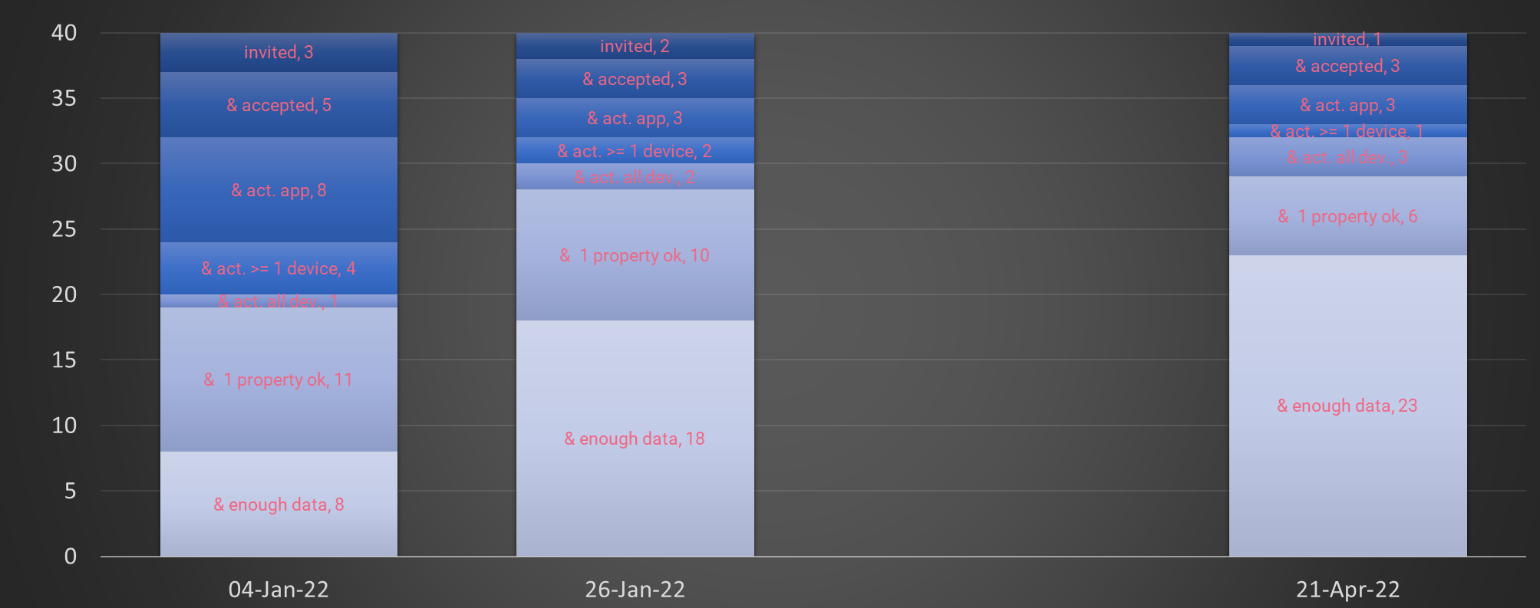
Device deployment; follow-up
Twomes WP2: Data collection

Slide 22
Data collection & pre-processing
Twomes WP2: Data collection
23 homes with >3 wk essential data
> 35 million data points
35% sane
4,5 y sane measurements (~ 70 d/home)

Slide 23









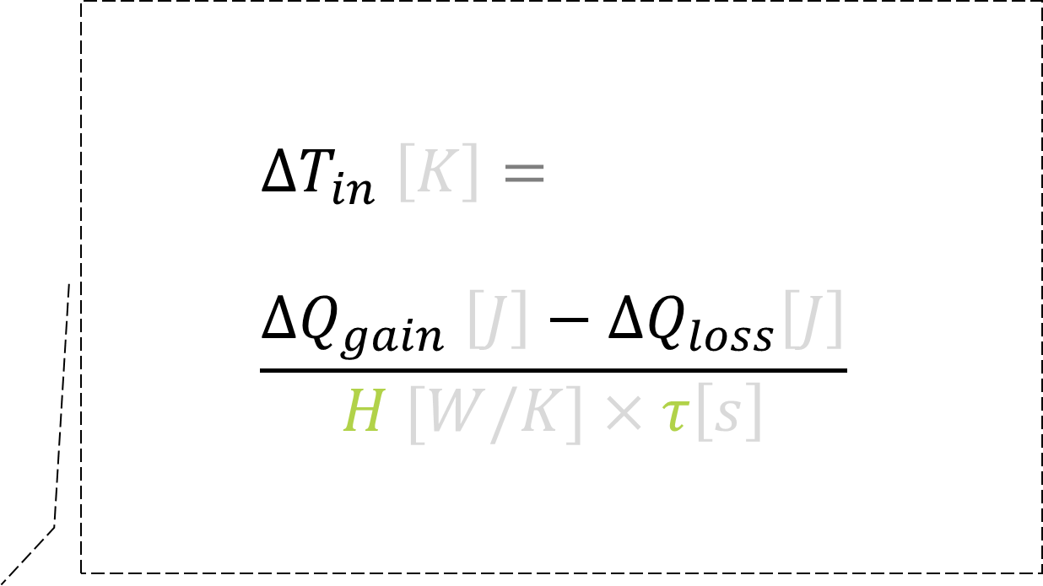
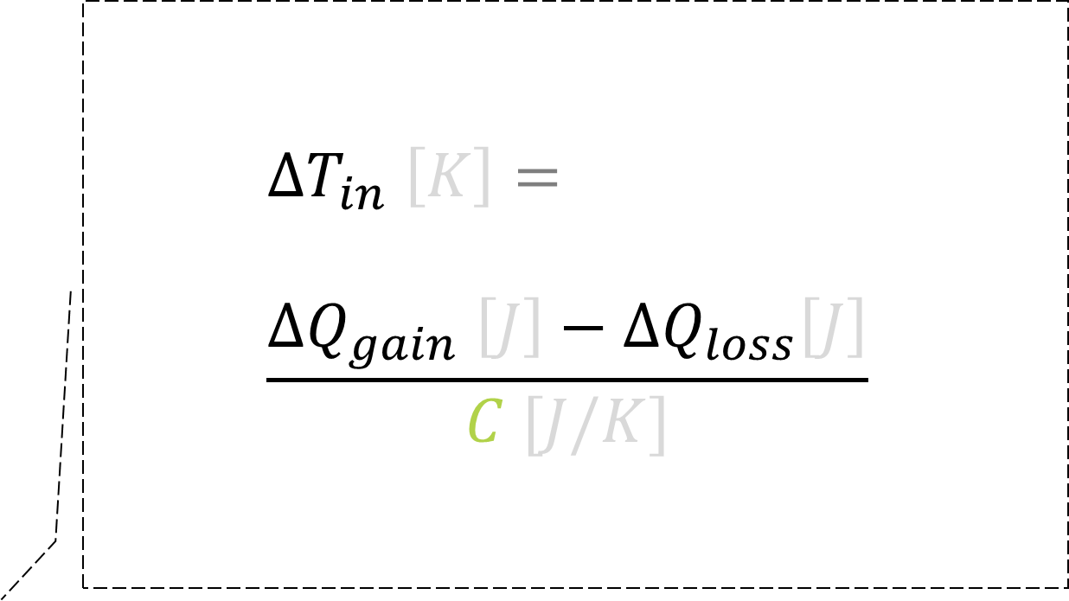
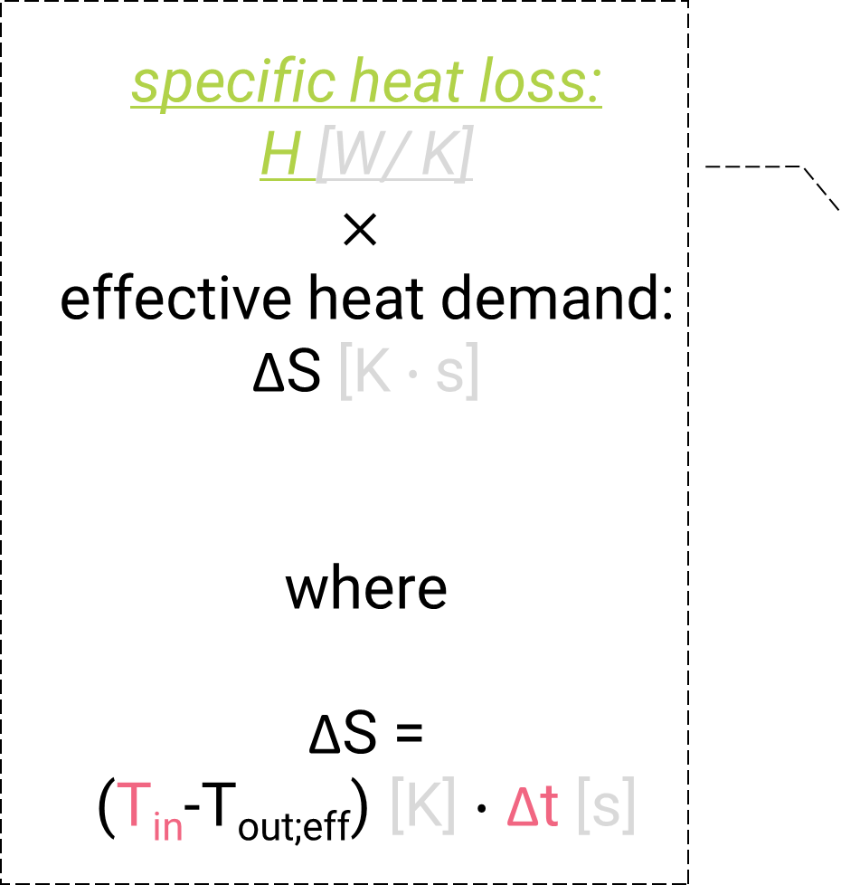
Model: heat balance in interval
$${∆T}_{in} \left[K\right]= \\ \frac{{∆Q}_{gain} \left[J\right]−{∆Q}_{loss}\left[J\right]}{ C [J/K] }$$
$${∆T}_{in} \left[K\right]= \\ \frac{{∆Q}_{gain} \left[J\right]−{∆Q}_{loss}\left[J\right]}{H [W/K]×τ\left[s\right]}$$
WP3 Data Analysis & Prediction
transmission + infiltration + ventilation
temperature drop
heating system (boiler + distribution)
specific heat loss: H [W/ K] $$×$$ effective heat demand: ΔS [K $∙$s] where ΔS = (T_{in}-T_{out;eff}) [K] $∙$ Δt [s]
solar irradiation
‘internal’ heat
occupants, electric appliances, domestic hot water (dhw)
heat loss: ΔQ_{loss} [J]
heat gain: ΔQ_{gain} [J]

Slide 24
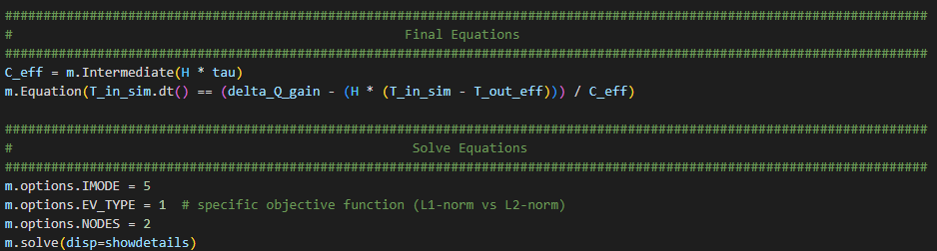
Analysis model equations (GEKKO Python)
WP3: Data Analysis & Prediction

Slide 25

Analysis: weather in Assendorp, Zwolle
WP3: Data Analysis & Prediction

Slide 26

Analysis: weather in Assendorp, Zwolle
WP3: Data Analysis & Prediction

Slide 27

Analysis: data fora single home single week
WP3: Data Analysis & Prediction

Slide 28

Analysis results (example; Berkum data; 1 week)
WP3: Data Analysis & Prediction

Slide 29
Model parameters we wanted to learn
Twomes WP3: Data Analysis & Prediction
symbol | scope | parameter | unit
H | building | specific heat loss | W/K
τ | building | thermal inertia | s (or h)
C | building | thermal mass (C = H × τ) | J/K
A | building | apparent window area (imaginary horizontal window in roof) | m²
P_{max} | installation | maximum heating system power (boiler+distribution) | W
η_{s;CH} | installation | central heating system efficiency (superior value) | %
<T_{set;h;d}> | comfort needs | weekly thermostat setpoints (home/away/asleep) | Ks

Slide 30

Learning H [W/K] (specific heat loss) A = 6,0 [m²] (assumed; not learnt)
WP3: Data Analysis & Prediction

Slide 31

Learning τ [h] (thermal inertia) A = 6,0 [m²] (assumed; not learnt)
WP3: Data Analysis & Prediction

Slide 32

Combining H [W/K] & τ [h] each week one dot A = 6,0 [m²] (assumed; not learnt)
WP3: Data Analysis & Prediction

Slide 33

Combining H [W/K] & τ [h]; multi-week average A = 6,0 [m²] (assumed; not learnt)
WP3: Data Analysis & Prediction

Slide 34
Model parameters we wanted to learn
Twomes WP3: Data Analysis & Prediction
symbol | scope | parameter | unit
H | building | specific heat loss | W/K
τ | building | thermal inertia | s (or h)
C | building | thermal mass (C = H × τ) | J/K
A | building | apparent window area (imaginary horizontal window in roof) | m²
P_{max} | installation | maximum heating system power (boiler+distribution) | W
η_{s;CH} | installation | central heating system efficiency (superior value) | %
<T_{set;h;d}> | comfort needs | weekly thermostat setpoints (home/away/asleep) | Ks

Slide 35

Learning A [m²] τ [h] (thermal inertia) / H [W/K] (specific heat loss) also learnt
WP3: Data Analysis & Prediction

Slide 36

Learning H [W/K] (specific heat loss) A [m²] (apparent window area) & τ [h] (thermal inertia) / H [W/K] (specific heat loss) also learnt
WP3: Data Analysis & Prediction

Slide 37

Learning τ [h] (thermal inertia) A [m²] (apparent window area) & H [W/K] (specific heat loss) also learnt
WP3: Data Analysis & Prediction

Slide 38

Combining H [W/K] & τ [h] each week one dot A [m²] (apparent window area) also learnt
WP3: Data Analysis & Prediction

Slide 39

Combining H [W/K] & τ [h]; multi-week average A [m²] (apparent window area) also learnt
WP3: Data Analysis & Prediction

Slide 40
Conclusions
WP3: Data Analysis & Prediction
Data collection experience in practice: challenging!
Home (installation)s are varied!
Every step in installation counts! (Local help helps a lot)
Data analysis experience in practice: challenging!
Big data; lots of preprocessing; run time learning ~0,5 hour per homeweek
What we achieved
Data collection method & tools; 13 open source software & open hardware GitHub repos; WarmteWachter app
Indications that some building parameters can be learned: specific heat loss H [W/K], thermal inertia τ [s]
Work in progress: apparent window area: A [m²]
Project time ran out before we could:
analyze boiler efficiency η_{s} [%]
Compare: simulate based on learned parameters / parameters calculated from a.o. building year, floor area

Slide 41
hich questions do you have?
transmission infiltration ventilation
heating
solar irradiation
‘internal’ heat
heat loss
heat gain

Slide 42
ill not present this hidden slide and others after this one. Slides may be used to answer questions.

Slide 43
In a nutshell; questions
Twomes: Digital Twins for the Home Heating Transition
What are crucial physical parameters for the home heating transition of a home?
Can we collect energy monitoring data for this with a few measurement devices?
Can we learn the crucial parameters per home automatically from ~ 2 weeks of measurement data?

Slide 44
Agenda
Twomes: Digital Twins for the Home Heating Transition
Summary
Who?
Why?
How? (method & tools we developed)
Data Collection (WP2)
Data Analysis (WP3)
So? (results, conclusion)
Now what?

Slide 45








Research Group Energy Transition, Windesheim University of Applied Sciences
Vertalingen checken
Civil Engineering
HBO-ICT
education
Electrical Engineering
Mechanical Engineering
research
practice

Slide 46


Slide 47


Slide 48


Slide 49
We need to stop burning fossil fuels (gas) for home heating in the Netherlands within one generation! Meaning: switch to another energy source
Why?
80% of homes in 2050 already built now
Challenge: many homes (Klimaatakkoord, 2019)
2020 - 2030: 1,5 million homes in NL (> 600 homes per average working day)
2030 - 2050: 5,5 million homes in NL (> 1100 homes per average working day)
Options:
(hybrid) heat pump / district heating / biogas / biomass / hydrogen / infrared
NB Energy source MUST be CO₂-neutral within one generation!

Slide 50

Some interventions to reduce home heating CO₂-emissions
Introduction
Building interventions isolation, crack sealing, HR++ glass, …
Installation interventions
Installation: hardware high efficiency boiler, heat recovery, (hybrid) heat pump, district heating, biogas, biomass, hydrogen, infrared,…
Installation: settings night setback, day setback, hydronic balancing, supply temperature, …
Comfort interventions warm clothing?, get used to lower temperatures?, …
Weather climate change?
Notes:
Since space in diagrams is limited; I switched to collapsing instatataion hardware interventions and installation settings interventions into one category. In subsequent slides, this allows for model parameter categories to be collapsed in to ‘installation parameters’.
Installation settings, however are often much easier to change than installation hardware. For example, changing the supply temperature of a gas-fired boiler is much easier than changing the gas-fired boiler for a heat pump (which often also implies changing the hydronic heat distribution system and sometimes even requires changing heat distribution of the the building envelope.

Slide 51
elke bepalende parameters voor de warmtetransitie van specifieke woningen kunnen we leren met monitoringdata en welke vragen van huishoudens kunnen we daarmee beantwoorden?

Slide 52
at kunnen we besparen met isolatie en/of het dichten van kieren van onze woning?

Slide 53
at kunnen we besparen met betere instellingen van onze verwarming?

Slide 54

Intro
Twomes: Digital Twins for the Home Heating Transition

Slide 55
Energy monitoring data we collect
Twomes WP2: Data collection
category | measured data | symbol | unit | API | sensor
comfort | setpoint | T_{set} | °C |  | ✓
weather | outdoor temperature | T_{out} | °C | ✓(KNMI)
 | wind | W | m/s
 | global horizontal irradiation | I | W/m²
indoor | indoor temperature | T_{in} | °C |  | ✓
installation | supply temperature | T_{s} | °C |  | ✓
 | return temperature | T_{r} | °C |  | ✓
energy use for heating | electricity | E | kWh | ✓ (Enelogic) | ✓
 | gas | G | m³
occupancy/ventilation | CO₂ concentration | CO₂ | ppm |  | ✓
 | Bluetooth presence | BT_{pres} | #pp |  | ✓

Slide 56
Measurement devices we designed & made
Twomes WP2: Data collection
Device | Module | Cost incl. PCB, enclosure, power supply, cale | QR | Package A | Package B | Package C | Package D
OpenTherm monitor | OpenTherm monitor | € 25 | ✓ | ✓ |  | ✓ | ✓
smart meter module | smart meter module | € 15 | ✓ | ✓
smart meter module + boiler module + room monitor | smart meter module | € 15 | ✓ |  | ✓ | ✓ | ✓
 | boiler module | € 25 |  |  | ✓ | ✓ | ✓
 | room monitor | € 20 |  |  | ✓ |  | ✓
 | … with CO₂-sensor | € 50 |  |  |  | ✓
Total per home |  |  |  | € 40 | € 60 | € 115 | € 85

Slide 57

Open Source and Open Hardware
Twomes WP2: Data collection
GitHub Research Group Energy Transition
https://github.com/energietransitie/
Twomes Warmtewachter App
twomes-app-warmtewachter
esp-provisioning-capacitor-plugin
Twomes Server
twomes-backoffice-api
twomes-backoffice-configuration
Twomes Measurement Devices: Firmware
twomes-generic-esp-firmware
twomes-opentherm-monitor-firmware
twomes-p1-gateway-firmware
twomes-boiler-monitor-firmware
twomes-room-monitor-firmware
Twomes Measurement Devices: Hardware
twomes-opentherm-monitor-hardware
twomes-p1-gateway-hardware
twomes-temp-monitor-hardware
twomes-co2-meter-hardware

Slide 58
Measurement device software stack
Twomes WP2: Data collection
presence detection
CO₂ measurements
time syncing (NTP)
heartbeat
Twomes Provisioning
persistent buffering
secure upload
Unified Provisioning
ESP-IDF
ESP32
ESP8266
Bluetooth
Wi-Fi

Slide 59




Firmware data flow
Twomes WP2: Data collection
SEK-SCD41
Twomes device-specific firmware
incoming measurements from satellites
other measure-ments
other measure-ments
other timer(s)
toJSON(property,value)
toJSON(property,value)
upload timer
Twomes generic firmware
Presence Detection
Secure Upload
POST /device/measurements/
toJSON()
queue
format
send
presence timer
toJSON()
proprietary > ESP-NOW
Heartbeat
Persistent Buffering (spiffs)
TLS/SSL > Wi-Fi
heartbeat timer
NTP sync timer
Time Syncing
NTP > Wi-Fi
Twomes Provisioning
POST /device/activate
RTC BM8563
TLS/SSL > Wi-Fi
Wireless Resource Protection (FreeRTOS semaphore/mutex?)
ESP-IDF
2.4 GHz radio (IEEE 802.11/BLE)

Slide 60
Deployment: 26-jan-22 (+3 wk)
Twomes WP2: Data collection
Status | # homes | # step loss | step success % | remaining %
Invited | 40 |  |  | 100 %
did not end participation | (+1 =) 38 | 2 | 95 % | 95 %
app activated | (+3 =) 35 | 5 | 92 % | 88 %
≥ 1 device activated | (+3 =) 32 | 8 | 91 % | 80 %
all devices activated | (+10 =) 30 | 4 | 94 % | 75 %
≥ 1 data source ok | (+9 =) 28 | 1 | 93 % | 70 %
all data sources ok | (+10 =) 18 | 11 | 64 % | 45 %
all data sources still ok | (+14 =) 18 | 4 | 100 % | (+35 % =) 45 %

Slide 61
Deployment: 21-apr-22 (+15 wk)
Twomes WP2: Data collection
Status | # homes | # step loss | step success % | remaining %
Invited | 40 |  |  | 100 %
did not end participation | (+1 =) 39 | 1 | 98 % | 98 %
app activated | (+1=) 36 | 3 | 92 % | 90 %
≥ 1 device activated | (+1=) 33 | 3 | 92 % | 83 %
all devices activated | (+3=) 32 | 1 | 97 % | 80 %
≥ 1 data source >3wk ok | (+1=) 29 | 3 | 91 % | 73 %
Essential data >3wk ok | 23 | 6 | 79 % | 58 %
All data sources >3wk ok | 15 | 8 | 65 % | 38 %

Slide 62




Heat balance
$${∆T}_{in} \left[K\right]= \\ \frac{{∆Q}_{gain} \left[J\right]−{∆Q}_{loss}\left[J\right]}{ C [J/K] }$$
Twomes Data Analysis & Prediction
transmission + infiltration + ventilation
temperature drop
gas for heating: ΔG_{CH} [Nm³] $$×$$ superior calorific value gas: $$\text{h}\text{sup} \text{= 31.650.000 }\text{[}\text{J}\text{/}\text{Nm}\text{3}\text{]}$$
$$×$$
upper net heating system efficiency, η_{hs;CH} [%]
heating system (boiler + distribution)
electricity for heating: ΔE_{CH} [kWh] $$×$$ conversion factor from kWh to J: $$\text{h}\text{E}\text{ = 3.600.000 }\text{[}\text{J}\text{/}\text{kWh}\text{]}$$
$$×$$
Coefficient Of Performance, COP_{CH} [-]
specific heat loss: H [W/ K] $$×$$ effective heat demand: ΔS [K $∙$s] where ΔS = (T_{in}-T_{out;eff}) [K] $∙$ Δt [s]
Σ($\text{I}\text{t}∙$ Δt) [J/m²]$×$ A [m²] where average solar irradiation: I_{t} [W/m²]
solar irradiation
‘internal’ heat
occupants, electric appliances, domestic hot water (dhw)
heat loss: ΔQ_{loss} [J]
heat gain: ΔQ_{gain} [J]
Notes:
Model paramters are formatted in green
Time series data is has a subscript t; e.g. T_{in;t} is T_{in} (the average indoor temperature) at time interval t. Time intervals last a duration Δt.
N.B. This is the most simple building model; the effect of wind (a factor in infiltration) and changes in ventilation behaviour are modelled via effective outdoor temperature (T_{out;eff;t}), where accurding to KNMI research, the best simple approsimation is T_{out;eff;t} [°C] = T_{out;eff;t} – 2/3* u_{t} [m/s], where u_{t} is the average wind speed during time interval t. In more refines models, we will try to sepeara the influence of wind on the home heat los as a separate model parameter that is to be learned.

Slide 63











Heat balance
$${∆T}_{in} \left[K\right]= \\ \frac{{∆Q}_{gain} \left[J\right]−{∆Q}_{loss}\left[J\right]}{C [J/K]}$$
$${∆T}_{in} \left[K\right]= \\ \frac{0 \left[J\right]−{∆Q}_{loss}\left[J\right]}{C [J/K]}$$
$${∆T}_{in} \left[K\right]= \\ −\frac{{∆Q}_{loss}\left[J\right]}{C [J/K]}$$
$${∆T}_{in} \left[K\right]=$$ $$−\frac{H [W/K]×∆S[K∙s]}{C[J/K]}$$
$${∆T}_{in} \left[K\right]=$$ $$−\frac{H [W/K]×∆S[K∙s]}{H [W/K]×τ\left[s\right]}$$
$${∆T}_{in} \left[K\right]=$$ $$−\frac{H [W/K]×∆S[K∙s]}{H [W/K]×τ\left[s\right]}$$
$${∆T}_{in} \left[K\right]= \\ −\frac{∆S[K∙s]}{τ\left[s\right]}$$
$${∆T}_{in} \left[K\right]=$$ $$−\frac{(T_{in}[℃]−T_{out;eff}[℃])×∆t \left[s\right]}{τ\left[s\right]}$$
Twomes Data Analysis & Prediction
transmission + infiltration + ventilation
temperature drop
ΔS = (T_{in}-T_{out;eff}) [K] $∙$ Δt [s]
specific heat loss: H [W/ K] $$×$$ effective heat demand: ΔS [K $∙$s] where ΔS = (T_{in}-T_{out;eff}) [K] $∙$ Δt [s]
$τ\left[s\right] = \frac{C \left[J/K\right]}{H [W/K]}$ or
$$C\left[J/K\right]=H [W/K]×τ\left[s\right]$$ where
$τ\left[s\right]$ is the thermal inertia
$C \left[J/K\right]$ is the thermal mass
$H\left[W/K\right]$ is the specific heat loss
of a particular home
$τ\left[s\right] = \frac{C \left[J/K\right]}{H [W/K]}$ or
$$C\left[J/K\right]=H [W/K]×τ\left[s\right]$$ where
$τ\left[s\right]$ is the thermal inertia
$C \left[J/K\right]$ is the thermal mass
$H\left[W/K\right]$ is the specific heat loss
of a particular home
heat loss, ΔQ_{loss} [J]

Slide 64

Occupancy, ventilation & CO₂ concentration
Twomes
occupancy
ventilation
CO₂ concentration
Bluetooth
Passive InfraRed (PIR)
Electricity use
Heat loss
CO₂ sensor (SDC41)
And hence also (simplified)
occupancy – CO₂ concentration = ventilation (~ heat loss)
CO₂ concentration – ventilation = occupancy
CO₂ icons created by Freepik - Flaticon

Slide 65
Color coding legend
Twomes
Data
Fixed model parameters (blue)
population averages, constant in time horizon
Measured input data (pink)
case-specific, varying in time horizon
Model parameters (green)
case-specific, constant in time horizon
Tools, equipment
Existing homes/equipment/databases (blue)
Boiler, thermostat, smart meter, Wi-Fi, app, KNMI, …
Data acquisition tools
Measurement devices, WarmteWachter
Analysis
Twomes analysis model, GEKKO code

Slide 66

Some model equations (see also Twomes D3)
Twomes WP3: Data Analysis & Prediction
${∆T}_{in} [K] =\frac{{∆Q}_{gain} \left[J\right]−{∆Q}_{loss}\left[J\right]}{C\left[J/K\right]}$, the indoor temperature change
${∆Q}_{loss} \left[J\right]=$ $H [W/K]×∆S [K∙s]$, the heat loss
$H \left[W/K\right]$ is the specific heat loss, a building model parameter
$∆S \left[K∙s\right]=T_{diff;eff}\left[K\right]×∆t \left[s\right]\text{, }\text{the} \text{effective} \text{heat} \text{demand}$
$T_{diff;eff}\left[K\right]=T_{in}{\left[℃\right]−T}_{out;eff}\left[℃\right]$, the effective temperature difference
$T_{in}[℃]$, the indoor temperature, measured via an indoor temperature sensor
$T_{out;eff}[℃]=T_{out;geo_int}[℃]{−0,67 [K/(m/s)]∙U}_{geo_int}[m/s]$, the effective outdoor temperature
$T_{out;geo_int}[℃]$, the geospatially interpolated outdoor temperature, calculated from measured wheather data from the KNMI API
$U_{geo_int}[m/s]$, the geospatially interpolated wind speed, calculated from measured wheather data from the KNMI API
${∆Q}_{gain} \left[J\right]\text{, }\text{the} \text{heat} \text{gain}$
$τ \left[s\right]$, the effective thermal inertia, a building model parameter
$C\left[J/K\right]=H [W/K]×τ\left[s\right]$, the effective heat capacity of the home, a building model parameter derived from two others

Slide 67

Berkum: Learning H [W/K] (specific heat loss) A = 6,0 [m²]
WP3: Data Analysis & Prediction

Slide 68

Berkum: Learning τ [h] (thermal inertia) A = 6,0 [m²]
WP3: Data Analysis & Prediction

Slide 69

Berkum: Learning A [m²] (window aperture)
WP3: Data Analysis & Prediction

Slide 70

Berkum: Learning H [W/K] together with τ [h] & A [m²]
WP3: Data Analysis & Prediction

Slide 71

Berkum: Learning τ [h] together with H [W/K] and A [m²]
WP3: Data Analysis & Prediction

Slide 72
Now what? Possible follow-ups
Twomes: Digital Twins for the Home Heating Transition
Analyse boiler efficiency
Intervention research (before-after), bv.:
lower supply temperature (“Zet ‘m op 60”), hydronic balancing, isolation
Energy label based on practice
Buildings (based on H [W/K], τ [h], A [m²])
Instalations η_{upper;CH} [%]: COP_{CH} [-] (~ ENERGY STAR label Connected Thermostat? USA norm uses data from practice!)
Comfort need: <T_{set;h;d}> [Ks]
Separate ventilaton losses obv based on presence & CO₂-concentratiion measurement
Smart control of hybrid heat pumps.
learn η_{s;CH} [%], P_{max;cv} [W], COP_{CH} [-], P_{max;HP} [W], H [W/K], τ [h], A [m²], <T_{set;h;d}> [Ks]
Weather prediction

Slide 73
Possible scale-ups
Twomes: Digital Twins for the Home Heating Transition
Winter ’21-’22
20 – 40 homes in Assendorp, Zwolle
2022
Brains4Buildings: quantify flexibility
Winter ’22-’23
100 – 200 homes?
Winter ’23-’24
1000 – 2000 homes

